Slide 1
An Introduction to the
National Lipid Association
Presented by:
Insert Date

Slide 2
Who Is the NLA?
A nonprofit, multidisciplinary medical society of more than 3,000 members dedicated to enhancing lipid management in clinical practice and reducing mortalities associated with atherosclerotic disease.

Slide 3
The Community of Lipidology
The NLA provides a comprehensive educational approach for the community of practitioners in the field of clinical lipidology, which embraces lipid and lipoprotein metabolism, cardiometabolic disorders, and obesity.

Slide 4
NLA Mission and Goals
Improve and expand education
Develop a lipid workplace
Identify practice trends and solutions
Apply best-outcome patient strategies
Build lifelong career opportunities
The extraction of science and medicine bringing a new paradigm to patient care and risk reduction.

Slide 5
Multidisciplinary Approach
Lipidologists
Pharmacy
Nursing
Dietetics
Laboratory
PATIENT

Slide 6
Breakdown of Membership

Slide 7


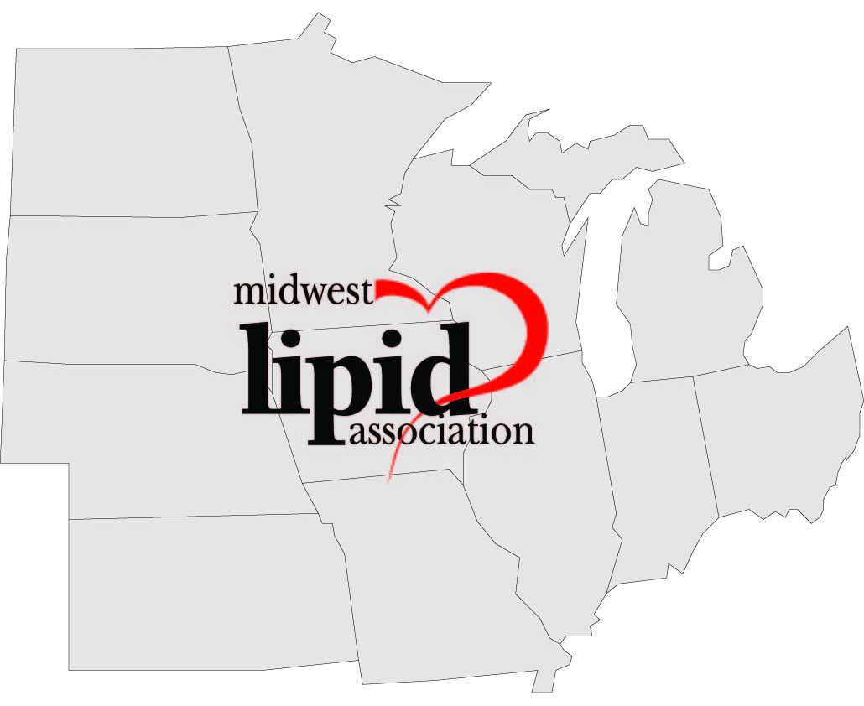


5 Regional Chapters

Slide 8

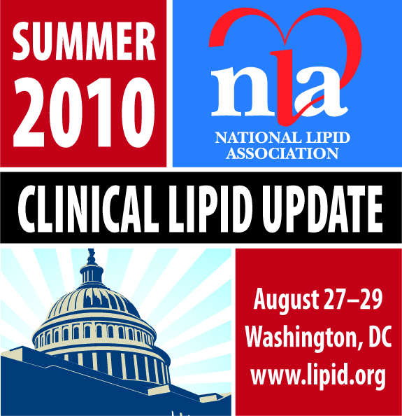
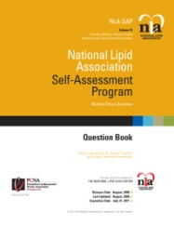
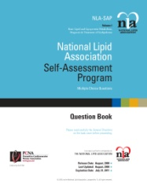
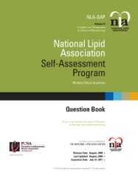


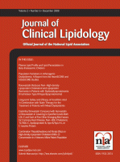
Educational Activities
Annual Scientific Sessions
Regional Clinical Lipid Updates 2x / Year
Self Assessment Programs
Virtual Lipid Clinic Case Activities
Advanced Training Courses
Journal of Clinical Lipidology

Slide 9


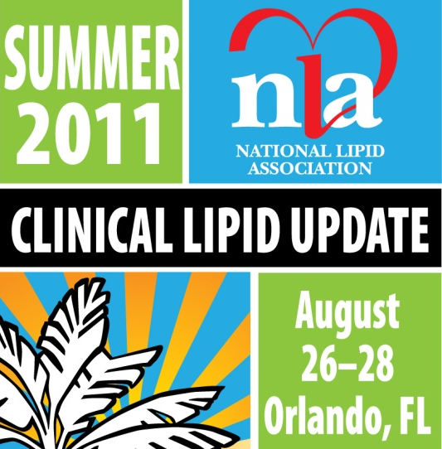
2011 Scientific Meetings
Hosted by the SWLA and PLA
Hosted by the NELA
Hosted by the MWLA and SELA

Slide 10
Professional Development
Core curriculum embraces the evolving field of Lipidology
Professional Pathway Development provides education for all levels – Basic through Certification
CME program provides didactic training, practical application, and clinical tools
Primary goal is to enhance knowledge and competency resulting in certification and improved patient outcomes

Slide 11
Core Curriculum

Slide 12
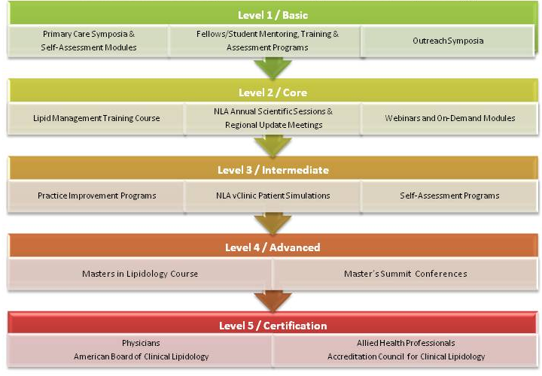
Professional Development Pathway

Slide 13

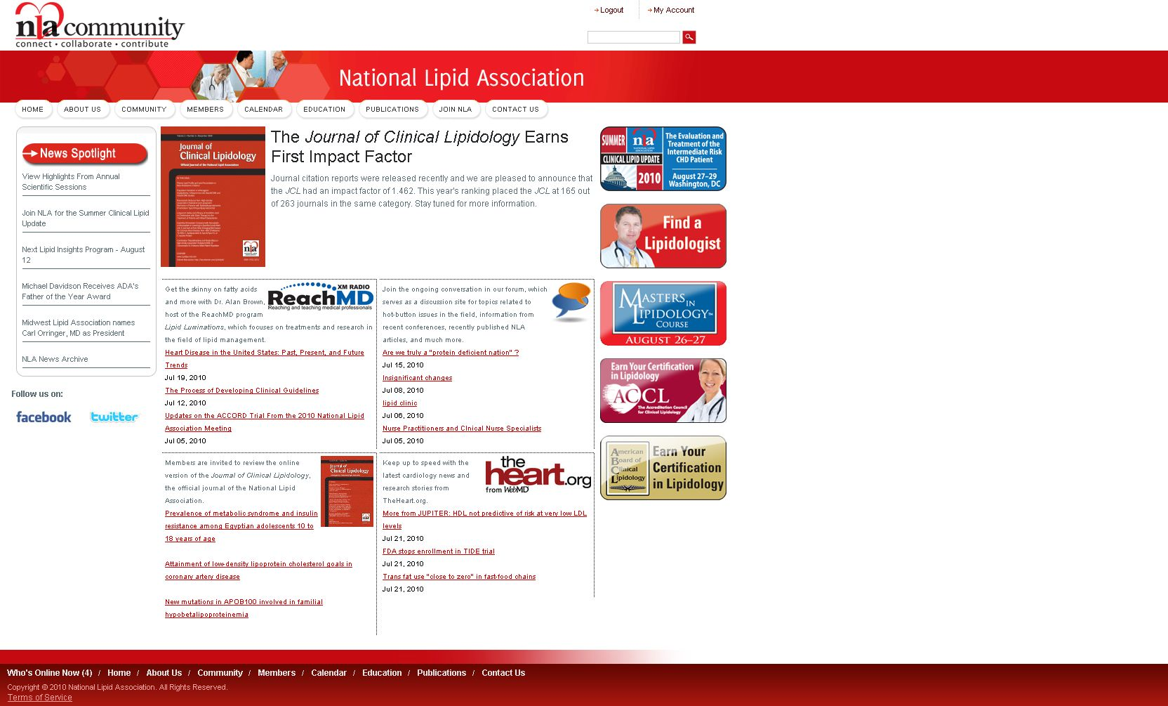
An online community for members to connect, collaborate and contribute:
  Topics
  Groups
  Blogs
  Slides
  Videos
  Podcasts
www.lipid.org
@ www.lipid.org

Slide 14


Certification in Clinical Lipidology
American Board of Clinical Lipidology –
Physician Certification
An independent physician certifying organization offering the highest benchmark of professional competency in clinical lipidology.
www.lipidboard.org
Accreditation Council for Clinical Lipidology –
Allied Health Certification
Offers two unique pathways to certification and competency testing: the Clinical Lipid Specialist and the Basic Competency in Clinical Lipidology programs
www.lipidspecialist.org

