Slide 1
Effects of Combination Lipid Therapy on Cardiovascular Events in Type 2 Diabetes Mellitus: The Action to Control Cardiovascular Risk in Diabetes (ACCORD) Lipid Trial
Henry C. Ginsberg, MD
College of Physicians & Surgeons , Columbia University, New York
For The ACCORD Study Group

Slide 2
Disclosure
Dr. Ginsberg reports receiving
  Consulting fees from Merck, Merck Schering Plough, Bristol-Myers Squibb, AstraZeneca, Abbott, Roche, Isis/Genzyme, GlaxoSmithKline, Novartis, Pfizer, and Regeneron/ SanofiAventis.
  Grant support from Merck, ISIS/Genzyme, Roche, and AstraZeneca.

Slide 3
ACCORD Study Design
Designed to independently test three medical strategies to reduce cardiovascular disease in diabetic patients
  Lipid Trial question: whether combination therapy with a statin plus a fibrate would reduce cardiovascular disease compared to statin monotherapy in people with type 2 diabetes mellitus at high risk for cardiovascular disease.
Randomized, placebo-controlled, double-blind clinical trial conducted in 77 clinical sites in the U.S. and Canada

Slide 4
ACCORD Study Design
Overall ACCORD Glycemia Trial: 10,251 participants
  Lipid Trial: 5,518 in Lipid Trial
    2765 randomized to fenofibrate
    2753 randomized to placebo
Primary Outcome: First occurrence of a major cardiovascular event (nonfatal MI, nonfatal stroke, cardiovascular death)
87% power to detect a 20% reduction in event rate, assuming placebo rate of 2.4%/yr and 5.6 yrs follow-up in participants without events.
Notes:
4

Slide 5
ACCORD Lipid Trial Eligibility
Stable Type 2 Diabetes >3 months
HbA1c 7.5% to 11%
High risk of CVD events = clinical or subclinical disease or 2+ risk factors
Age (limited to <80 years after Vanguard)
  ≥ 40 yrs with history of clinical CVD (secondary prevention)
  ≥ 55 yrs otherwise
Lipids
  60 < LDL-C < 180 mg/dl
  HDL-C < 55 mg/dl for women/Blacks; < 50 mg/dl otherwise
  Triglycerides < 750 mg/dl if on no therapy; < 400 mg/dl otherwise
No contraindication to either fenofibrate or simvastatin

Slide 6
ACCORD Lipid Protocol
All participants on open-labeled simvastatin, 20 to 40 mg/day
  Simvastatin dose complied with lipid guidelines
Patients randomized to double-blind placebo or fenofibrate, 54 to 160mg/day
  Dosing based upon eGFR level
Only blinded ACCORD trial
Observed Follow-up: 4 to 8 years (mean 4.7 years)

Slide 7
Baseline Characteristics
Characteristic | Mean or % | Characteristic | Mean or %
Age (yrs) | 62 | Total Cholesterol (mg/dl) | 175
Women % | 31 | LDL-C (mg/dl) | 101
Race / Ethnicity |  | HDL-C (mg/dl) | 38
White % | 68 | Triglyceride (mg/dl)* | 162
Black % | 15 | Blood pressure (mm Hg) | 134/74
Hispanic % | 7 | Serum creatinine (mg/dl) | 0.9
Secondary prevent % | 37 | Current smoking % | 15
DM duration (yrs)* | 9 | On a statin % | 60
A1c (%) * | 8.3 | On another LLA % | 8
BMI (kg/m²) | 32 | On Insulin % | 33
* Median values
Notes:
7

Slide 9
Adverse Experiences During Follow-up

Slide 10
Lab Measures During Follow-up
Fenofibrate
Placebo
Laboratory Measures (no. (%))
(N=2765)
(N=2753)
P value
ALT ever > 3X ULN
52 (1.9%)
40 (1.5%)
0.21
ALT ever > 5X ULN
16 (0.6%)
6 (0.2%)
0.03
CK ever > 5X ULN
51 (1.9%)
59 (2.2%)
0.43
CK ever > 10X ULN
10 (0.4%)
9 (0.3%)
0.83

Slide 11
Lab Measures During Follow-up
Fenofibrate
Placebo
Laboratory Measures (no. (%))
(N=2765)
(N=2753)
P value
ALT ever > 3X ULN
52 (1.9%)
40 (1.5%)
0.21
ALT ever > 5X ULN
16 (0.6%)
6 (0.2%)
0.03
CK ever > 5X ULN
51 (1.9%)
59 (2.2%)
0.43
CK ever > 10X ULN
10 (0.4%)
9 (0.3%)
0.83
Serum creatinine elevation
235 (27.9%)
157 (18.7%)
<0.001
698 (36.7%)
350 (18.5%)
<0.001
Post-randomization incidence of
microalbuminuria (
>
30 to < 300 mg/g*)
1050 (38.2%)
1137 (41.6%)
0.01
Post-randomization incidence of
macroalbuminuria (
>
300 mg/g*)
289 (10.5%)
337 (12.3%)
0.03

Slide 12
Primary Outcome
Placebo
(N=2753)
N of
Rate
Events
(%/yr)
Primary Outcome:
Major Fatal or Nonfatal
310
2.41
Cardiovascular Event

Slide 13
Primary Outcome
Fenofibrate
Placebo
(N=2765)
(N=2753)
N of
Rate
N of
Rate
Events
(%/yr)
Events
(%/yr)
Primary Outcome:
Major Fatal or Nonfatal
291
2.24
310
2.41
Cardiovascular Event

Slide 14
Primary Outcome
Fenofibrate
Placebo
(N=2765)
(N=2753)
N of
Rate
N of
Rate
Events
(%/yr)
Events
(%/yr)
HR (95% CI)
P Value
Primary Outcome:
Major Fatal or Nonfatal
291
2.24
310
2.41
0.92
(0.79 - 1.08)
0.32
Cardiovascular Event

Slide 15
Prespecified Secondary Outcomes

Slide 16
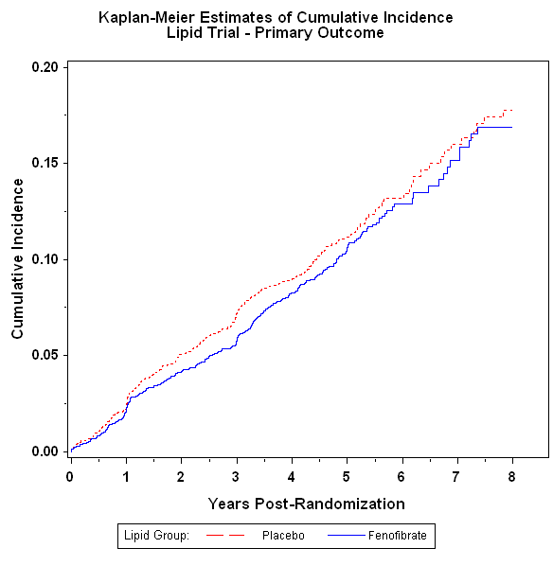
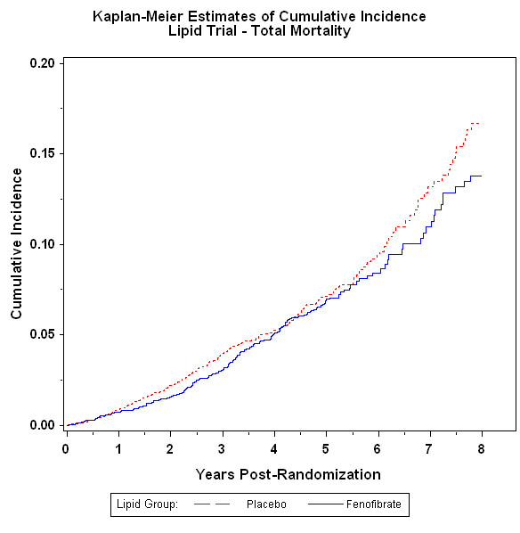

Slide 17
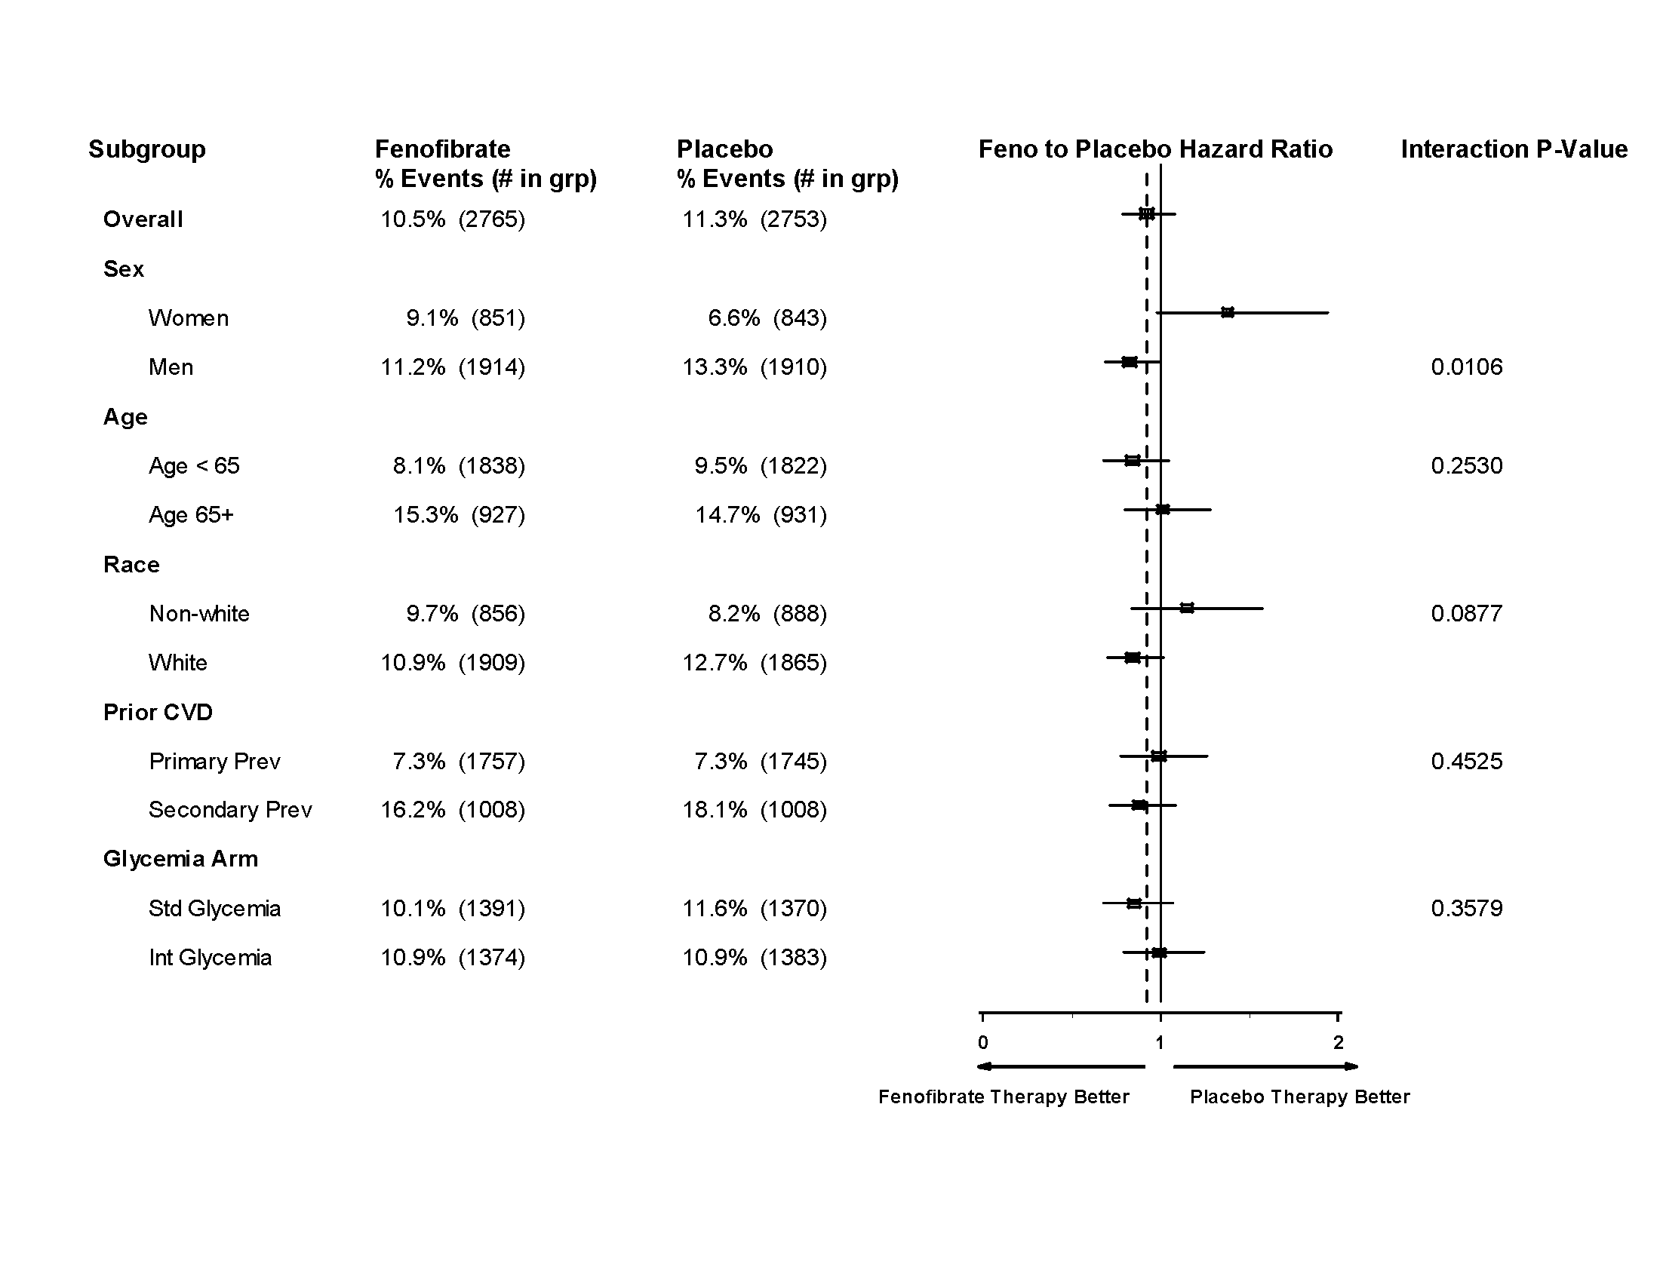
Primary Outcome By Treatment Group and Baseline Subgroups

Slide 18
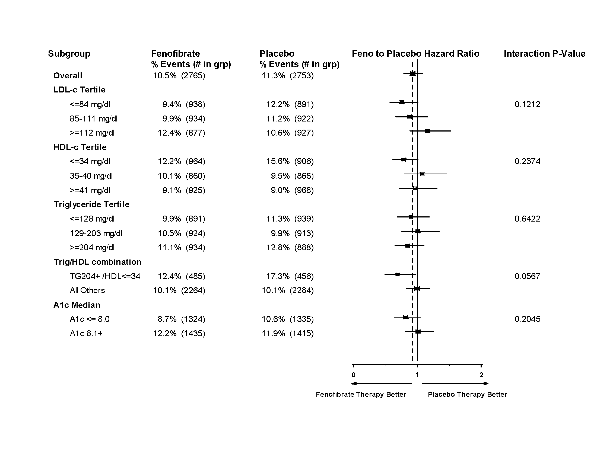
Primary Outcome By Treatment Group and Baseline Subgroups

Slide 19
Comparison of ACCORD subgroup results with those from prior fibrate studies
Trial (Drug) | Primary Endpoint: Entire Cohort (P-value) | Lipid Subgroup Criterion | Primary Endpoint: Subgroup
HHS (Gemfibrozil) | -34% (0.02) | TG > 200 mg/dl LDL-C/HDL-C > 5.0 | -71%
BIP (Bezafibrate) | -7.3% (0.24) | TG > 200 mg/dl | -39.5%
FIELD (Fenofibrate) | -11% (0.16) | TG > 204 mg/dl HDL-C < 42 mg/dl | -27%
ACCORD (Fenofibrate) | -8% (0.32) | TG > 204 mg/dl HDL-C < 34 mg/dl | -31%

Slide 20
Conclusion (1)
ACCORD Lipid does not support use of the combination of fenofibrate and simvastatin compared to simvastatin alone to reduce CVD events in the majority of patients with T2DM who have HDL-C and TG levels that are close to the normal range

Slide 21
Conclusion (2)
Subgroup analyses suggesting heterogeneity in response to combination therapy by gender and by the presence of significant dyslipidemia require further investigation
Notes:
21

