Slide 1
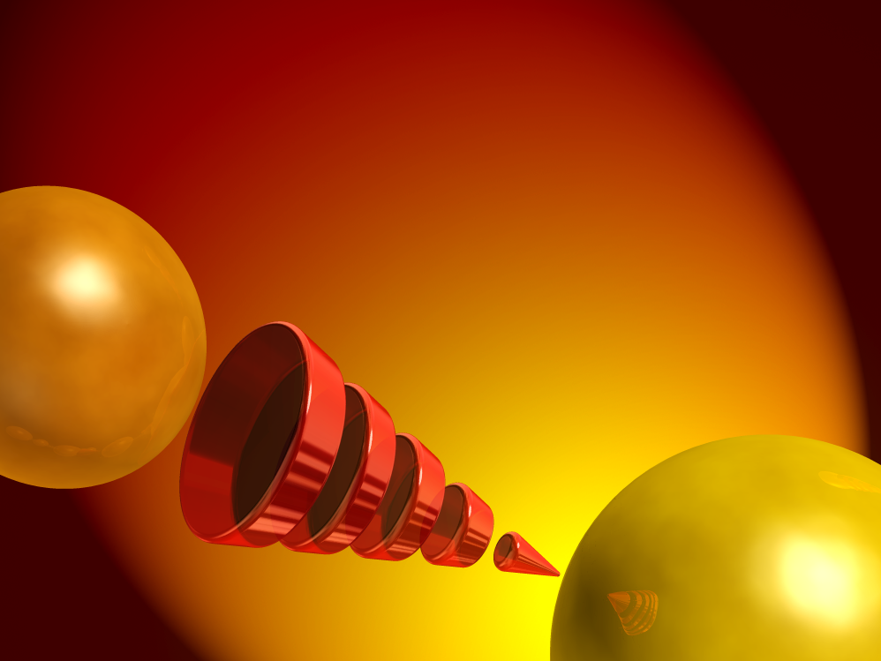
Statin Safety: Key Conclusions and Recommendations
of the NLA

Slide 2
Conclusions of the NLA Safety Task Force for Muscle Safety
Myopathy and rhabdomyolysis are associated with statin therapy, as a class effect
Elevated creatine kinase (CK) levels may indicate statin-induced muscle damage
Muscle weakness or pain without CK elevation may indicate statin-induced muscle damage
Myopathy and rhabdomyolysis risk increases with increased statin dose and serum levels
Myopathy and rhabdomyolysis risk increases with drug-drug interactions that retard statin metabolism
Drugs that can interact to amplify statin related myopathy include gemfibrozil and CYP-3A4 inhibitors
Thompson PD et al. Am J Cardiol. 2006;97:69C-76C

Slide 3
Conclusions of the NLA Safety Task Force on Liver Function
Statin use is associated with elevated serum aminotransferase levels, but it is unclear whether this is a causual link
Statin-associated serum aminotransferase elevation is not predictive of liver damage
Very rare case reports of liver failure have occurred in patients receiving statin therapy
Patients on statin therapy do not require routine liver function testing
Statin therapy is not contraindicated in any hepatic conditions, with the exception of decompensated cirrhosis and acute liver failure
Cohen DE et al. Am J Cardiol. 2006;97:77C-81C

Slide 4
Conclusions of the NLA Safety Task Force on Renal Issues
Marketed doses of statins do not produce clinically meaningful proteinuria
There is no association between statin use and renal tubular damage
There is no evidence that statin use leads to renal glomerular damage
There is no convincing link between statin use and hematouria
Some evidence indicates statins may provide some kidney protection
Kasiske BL et al. Am J Cardiol. 2006;97:82C-85C

Slide 5
Conclusions of the NLA Safety Task Force on Neurology
There is no association between statin use and clinically meaningful peripheral neuropathy
There is no convincing evidence that statins cause impaired memory or cognitive dysfunction
Clinical trial data indicate that lowering lipids with statins does not increase risk of cerebral hemorrhage
Brass LM et al. Am J Cardiol. 2006;97:86C-88C

Slide 6
Recommendations Regarding Patient Monitoring
Monitoring CK levels is recommended only for symptomatic patients
Patients on statin therapy do not require routine monitoring of liver function*, renal function, or cognitive function
* Note: Liver function monitoring is currently recommended by the regulatory authorities and manufacturers

Slide 7
Messages for Patients
Statins can produce muscle pain and weakness, which can very rarely become an important medical problem
Serious liver damage due to statins is extremely rare
Marketed doses of statins do not have any direct adverse effects on the kidney
Statins do not cause peripheral neuropathy and do not impair memory or cognition

