Slide 1
STATINS & Myofibrillar response
Slide resource
R. LaForge
10/2013

Slide 2
Rhabdo Complications
Myoglobinuria
Myoglobinuria, the presence of myoglobin in the urine, occurs when the level in plasma, exceeds 0.5–1.5 mg/dl; once plasma levels reach ≥100 mg/dl, the concentration in the urine becomes sufficient for it to be visibly discolored.
About 200 grams of muscle needs to be destroyed for visible myoglobinuria to occur.^{[12]}
Notes:
The swollen, inflamed muscle may directly compress structures in the same fascial compartment, causing compartment syndrome. The swelling may also further compromise blood supply into the area. Finally, destroyed muscle cells release potassium ions, phosphate ions, the heme-containing protein myoglobin, the enzyme creatine kinase and uric acid (a breakdown product of purines from DNA) into the blood. Activation of the coagulation system may precipitate disseminated intravascular coagulation.^{[3]} High potassium levels may lead to potentially fatal disruptions in heart rhythm. Phosphate binds to calcium from the circulation, leading to low calcium levels in the blood.^{[3]}
Rhabdomyolysis may cause renal failure by several mechanisms. The most important problem is the accumulation of myoglobin in the kidney tubules.^{[2][3][7]} Normally, the blood protein haptoglobin binds circulating myoglobin and other heme-containing substances, but in rhabdomyolysis the quantity of myoglobin exceeds the binding capacity of haptoglobin.^{[7]} Myoglobinuria, the presence of myoglobin in the urine, occurs when the level inplasma exceeds 0.5–1.5 mg/dl; once plasma levels reach 100 mg/dl, the concentration in the urine becomes sufficient for it to be visibly discolored.^{[2]} About 200 grams of muscle needs to be destroyed for visible myoglobinuria to occur.^{[12]} As the kidneys reabsorb more water from the filtrate, myoglobin interacts with Tamm–Horsfall protein in the nephron to form casts (solid aggregates) that obstruct the normal flow of fluid; the condition is worsened further by high levels of uric acid and acidification of the filtrate, which increase cast formation.^{[2]} Iron released from the heme generates reactive oxygen species, damaging the kidney cells. In addition to the myoglobinuria, two other mechanisms contribute to renal impairment: low blood pressure leads toconstriction of the blood vessels and therefore a relative lack of blood flow to the kidney, and finally uric acid may form crystals in the tubules of the kidneys, causing obstruction. Together, these processes lead to acute tubular necrosis, the destruction of the cells of tubules.^{[3][7]} Glomerular filtration rate falls and the kidney is unable to perform its normal excretory functions. This causes disruption of electrolyte regulation, leading to a further rise in potassium levels, and interferes with vitamin D processing, further worsening the low calcium levels.
12. Ropper AH, Brown RH (2005). "45: Electrophysiologic and laboratory aids in the diagnosis of neuromuscular disease". In Ropper AH, Brown RH. Adams and Victor's Principles of Neurology (8th ed.). New York: McGraw-Hill Professional. pp. 1092–1109.doi:10.1036/0071469710. ISBN 0-07-141620-X.

Slide 3
Statins and Musculoskeletal Conditions, Arthropathies, and Injuries
Ishak Mansi et.al. JAMA Intern Med. 2013;():1-9.
Participants Tricare Prime/Plus beneficiaries evaluated from October 1, 2003, to March 1, 2010.
Interventions Statin use during fiscal year 2005. On the basis of medication fills, patients were divided into 2 groups: statin users (received a statin for at least 90 days) and nonusers (never received a statin throughout the study period).
Main Outcomes and Measures Using patients' baseline characteristics, we generated a propensity score that was used to match statin users and nonusers; odds ratios (ORs) were determined for each outcome measure. Secondary analyses determined adjusted ORs for all patients who met study criteria and a subgroup of patients with no comorbidities identified using the Charlson Comorbidity Index. Sensitivity analysis further determined adjusted ORs for a subgroup of patients with no musculoskeletal diseases at baseline and a subgroup of patients who continued statin therapy for 2 years or more. The occurrence of musculoskeletal conditions was determined using prespecified groups of International Classification of Diseases, Ninth Revision, ClinicalModification codes: Msk1, all musculoskeletal diseases; Msk1a, arthropathies and related diseases; Msk1b, injury-related diseases (dislocation, sprain, strain); and Msk2, drug-associated musculoskeletal pain.
Results A total of 46 249 individuals met study criteria (13 626 statin users and 32 623 nonusers). Of these, we propensity score–matched 6967 statin users with 6967 nonusers. Among matched pairs, statin users had a higher OR for Msk1 (OR, 1.19), Msk1b (1.13), and Msk2 (1.09); the OR for Msk1a was 1.07 ( P = .07). Secondary and sensitivity analyses revealed higher adjusted ORs for statin users in all outcome groups.
Conclusions and Relevance Musculoskeletal conditions, arthropathies, injuries, and pain are more common among statin users than among similar nonusers. The full spectrum of statins' musculoskeletal adverse events may not be fully explored, and further studies are warranted, especially in physically active individuals.
Notes:
Design A retrospective cohort study with propensity score matching.
Setting San Antonio Military Multi-Market.
MEDSCAPE DALLAS, TX – The use of statins appears to be associated with an increased risk of musculoskeletal injuries, including an increased risk of dislocations, strains, and sprains, according to a new analysis^{[1]}. Researchers suggest the full range of musculoskeletal adverse events might not be fully known and that further studies are needed, especially in active individuals.
"These findings are concerning because starting statin therapy at a young age for primary prevention of cardiovascular diseases has been widely advocated," report Dr Ishak Mansi(VA North Texas Health Care System, Dallas) and colleagues in a paper published online June 3, 2013 in the Journal of the American Medical Association: Internal Medicine. "Moreover, the numbers needed to be exposed for one additional person to be harmed were 37 to 58 individuals for various outcomes."
The study included 6967 statin users propensity-matched with 6967 nonusers. Of the statin users, the majority was treated with simvastatin (73.5%) and approximately one-third had been prescribed maximum doses of the drugs, including simvastatin 80 mg, atorvastatin 80 mg, or rosuvastatin(Crestor, AstraZeneca) 40 mg. Simvastatin 80 mg is currently restricted on the US market because of concerns about muscle damage.
In the propensity-matched analysis, treatment with a statin was associated with a 19% increased risk of any type of musculoskeletal injury (p<0.001), a 13% increased risk of dislocations, strains, and sprains (p=0.001), and a 9% increased risk of musculoskeletal pain (p=0.02). There was a trend toward a 7% higher risk of osteoarthritis/arthropathies, but the association was not statistically significant in the propensity-matched analysis. There was an increased risk of osteoarthritis/arthropathies in two analyses that first adjusted for and then excluded patients with comorbidities at baseline.
In contrast, researchers observed no association between the number of years an individual took simvastatin and the risk of musculoskeletal injuries.
The group says that musculoskeletal adverse events with statins may represent a lesser known side effect of the drug class and should be studied further, especially in individuals who continue to be physically active. A better understanding of the full risks of statins will also "provide more complete data for cost/benefit and cost-effectiveness analyses of statin use," write Mansi et al.

Slide 4
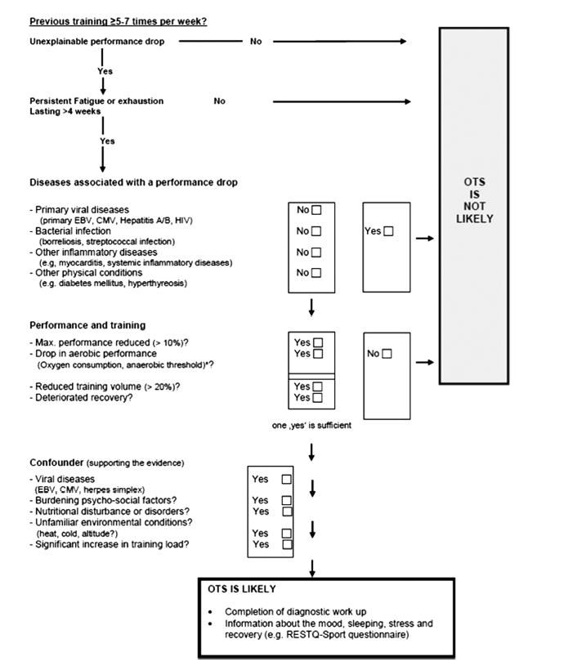
Diagnosis of OTS in athletes
Meeusen et.al, MSSE 2012
Notes:
From: Prevention, Diagnosis, and Treatment of the Overtraining Syndrome: Joint Consensus
Statement of the European College of Sport Science and the American College of
Sports Medicine (MSSE 2012)
Romain Meeusen, Belgium (Chair)
Martine Duclos, France
Carl Foster, United States
Andrew Fry, United States
Michael Gleeson, United Kingdom
David Nieman, United States
John Raglin, United States
Gerard Rietjens, the Netherlands
Ju¨rgen Steinacker, Germany
Axel Urhausen, Luxembourg
Figure: 3—Flowchart. Diagnosis of OTS in athletes. When previous training load was high enough, the occurrence of persistent problems in
performance creates a suspicion for OTS. The flowchart starts with the key symptoms: decrease in performance; duration of symptoms; then other
major diseases that are related to underperformance are ruled out; then performance changes are defined and then possible confounding conditions
and diseases are checked. This flowchart is based on the existing evidence together with the expertise/experience of the authors
Many recent articles have referred to the work of Kreider et al. (77) for the definition of OT and OR.
Overreaching—an accumulation of training and/or nontraining
stress resulting in short-term decrement in performance
capacity with or without related physiological and
psychological signs and symptoms of maladaptation in which
restoration of performance capacity may take from several
days to several weeks.
Overtraining—an accumulation of training and/or nontraining
stress resulting in long-term decrement in performance
capacity with or without related physiological and
psychological signs and symptoms of maladaptation in which
restoration of performance capacity may take several weeks
or months.
As stated by several authors (13,55), these definitions
suggest that the difference between OT and OR is the
amount of time needed for performance restoration and not
the type or duration of training stress or degree of impairment.

Slide 5
Simvastatin impairs exercise training adaptations
Mikus CR, Boyle LJ, Borengasser SJ et.al. JACC April 2013 Duke/Univ. MO
METHODS: We examined the effects of simvastatin on changes in cardiorespiratory fitness and skeletal muscle mitochondrial content in response to aerobic exercise training. Sedentary
overweight or obese adults with at least 2 metabolic syndrome risk factors (defined according to NCEP ATP III criteria) were randomized to 12 weeks of aerobic exercise training or to exercise in combination with simvastatin (40 mg per day). The primary outcomes were cardiorespiratory fitness and skeletal muscle (vastus lateralis) mitochondrial content (citrate synthase enzyme activity).
RESULTS: 37 participants (exercise plus statins; n=18; exercise only; n=19)
completed the study. Cardiorespiratory fitness increased by 10% (P<0.05) in response to exercise training alone, but was blunted by the addition of simvastatin resulting in only a 1.5% increase (P<0.005 for group by time interaction). Similarly, skeletal muscle citrate synthase activity increased by 13% in the exercise only group (P <0.05), but decreased by 4.5% in the simvastatin plus exercise group (P<0.05 for group by time interaction).
CONCLUSION: Simvastatin attenuates increases in cardiorespiratory fitness and skeletal
muscle mitochondrial content when combined with exercise training in overweight or obese
patients at risk of the metabolic syndrome
Notes:
Compare the effects of exercise training to those of simvastatin in combination with exercise on changes in cardiorespiratory fitness and skeletal muscle citrate synthase activity, a marker of skeletal muscle mitochondrial content, in previously sedentary, overweight or obese patients with at least 2 metabolic syndrome risk factors
Forty-one eligible volunteers were randomized to the exercise alone (n=21) or exercise
plus statin (n=20) groups. All participants were statin-naïve. Three participants withdrew from
the exercise group; one due to time constraints, one because of a desire to lose weight, and one
because of a foot injury occurring outside of the intervention, One participant was released from
the exercise plus statin group due to complications unrelated to the intervention. Thirty-seven
participants (13 males and 24 females) completed the study. Cardiorespiratory fitness and blood
variables are available from 18 participants in the exercise only group and 19 participants from
the exercise plus statin group. Skeletal muscle citrate synthase activity data is available in a
subset of participants (12 statin plus exercise subjects and 17 exercise only subjects).
ExRx: The supervised exercise training program began with 30 minutes of treadmill walking or
jogging at 60-75% of heart rate reserve (equivalent to approximately 60-75% of VO2peak) on 3
days during the first week and on 5 days during the second week, where 60% of heart rate
reserve = [(peak heart rate during treadmill test – resting heart rate) X 0.60] + resting heart rate.
During the remaining 12 weeks, participants completed 45 minutes of treadmill walking or
jogging at 60-75% of heart rate reserve 5 days per week. Exercise intensity was monitored via
Polar heart rate monitors as previously described (19). Adherence was calculated as the number
of exercise sessions completed divided by the number of sessions prescribed. Exercise sessions
were performed in a fitness facility on the MU campus under close supervision by study staff.
EFFECTS OF INTERVENTION ON SKELETAL MUSCLE CITRATE SYNTHASE
ACTIVITY
Simvastatin prevented exercise training induced increases in skeletal muscle citrate
synthase activity, a marker of mitochondrial content (P<0.05 for between-group difference in
change from baseline; Figure 2). Skeletal muscle citrate synthase activity increased by 13% in
the exercise only group (P<0.05 for change from baseline) and decreased by 4.5% in the exercise
plus statin group (not significant for change from baseline; Figure 2). Similar patterns were
observed in the protein content of skeletal muscle mitochondrial complexes I, II, III, and IV (data
not shown), providing further evidence that statins minimized or negated responses to exercise
training.
DISCUSSION
In this trial, simvastatin abated improvements in cardiorespiratory fitness and skeletal
muscle citrate synthase activity, a marker of mitochondrial content, following 12 weeks of
aerobic exercise training in overweight and obese volunteers at risk for the metabolic syndrome.
The results have direct clinical ramifications as patients at risk for the metabolic syndrome are
commonly prescribed statins to lower blood lipids and at the same time advised to exercise to
improve fitness, both of which are independently proven to lower cardiovascular disease risk.
During exercise, skeletal muscle energy flux and mitochondrial respiration are increased
to provide ATP for muscle contractions. Exercise also stimulates transcriptional responses that if
repeated over time, promote mitochondrial biogenesis (increase in number or content) andincrease mitochondrial oxidative capacity (improved function). These adaptations, which lead to
greater capacity for skeletal muscle oxygen consumption, are a key component of exercisemediated
improvements in cardiorespiratory fitness. Our findings suggest that simvastatin may
mitigate improvements in fitness in response to exercise training by impairing increases in
skeletal muscle mitochondrial content and function. In support of these data, physiologic doses
of simvastatin disrupt mitochondrial respiration, increase oxidative stress, and activate
mitochondrial apoptotic pathways in isolated skeletal muscle fibers (27). Similar observations
have been reported in studies of muscle fibers taken from patients using statins (28), and high
dose simvastatin (80 mg per day) has been shown to decrease skeletal muscle mitochondrial
content in the absence of exercise (29,30). Statins have also been shown to reduce skeletal
muscle force production (31), running capacity (17,18) and voluntary running volume (31) in
rodents. Collectively, these data indicate that statins may induce mitochondrial oxidative stress
which activates pathways of apoptosis or autophagy, mitigating increases in mitochondrial
content and oxidative capacity in response to exercise training.
It should be mentioned that a placebo was not given to participants. It should be mentioned that a placebo was not given to participants in the exercise only
group. Thus, participants were aware of their group assignment, introducing the possibility of a
‘placebo effect’. However, we do not think a placebo effect was the cause of our outcomes when
our data are considered in light of accumulating evidence that statins can cause undesirable
effects on skeletal muscle mitochondrial function ((13-18,27-30,32). One of the primary
strengths of this trial is the robust agreement between changes in functional (cardiorespiratory
fitness) and biochemical (skeletal muscle citrate synthase) outcomes in response to the
interventions.

Slide 6
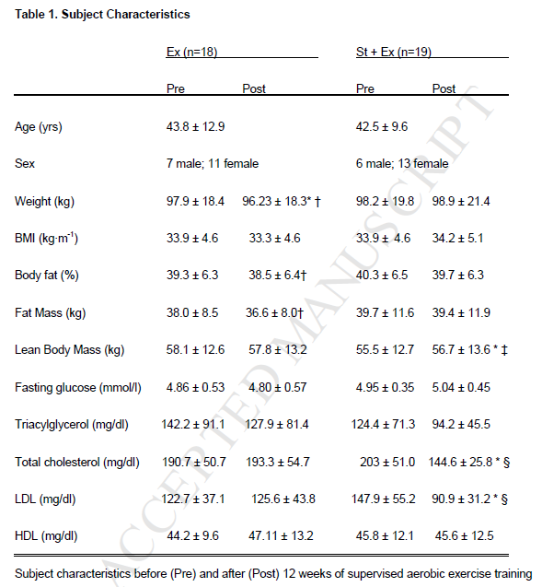
Mikus 2013

Slide 7
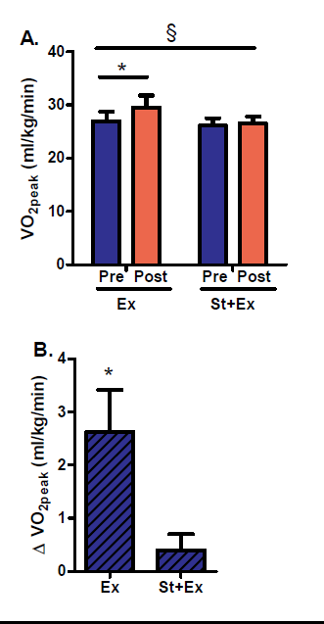
Mikus 2013

Slide 8
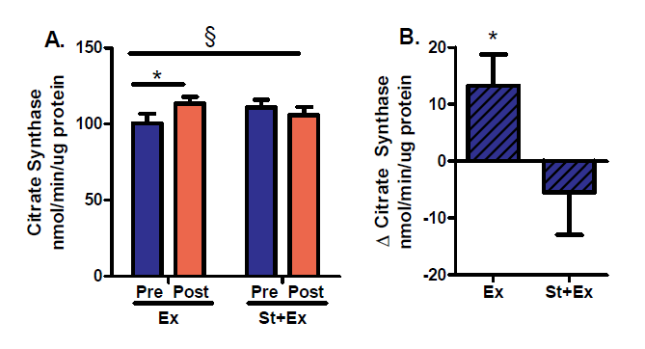
Mikus 2013

Slide 9
In conclusion, simvastatin attenuates increases in cardiorespiratory fitness and skeletal muscle mitochondrial content associated with exercise training in previously sedentary, overweight or obese patients at risk of the metabolic syndrome. Given the strong independent cardio-protective effects of increasing cardiorespiratory fitness or lowering LDL, the benefits
and risks of each should be carefully considered when choosing treatment modalities.
Mikus 2013
Notes:
It should be mentioned that a placebo was not given to participants in the exercise only
group. Thus, participants were aware of their group assignment, introducing the possibility of a
‘placebo effect’.

Slide 10
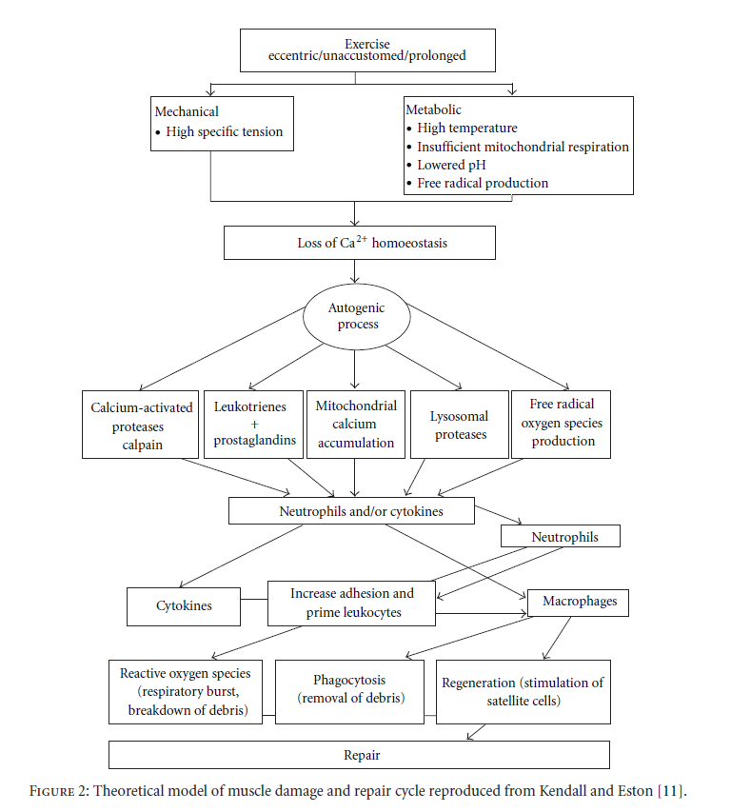
Creatine-Kinase- and Exercise-RelatedMuscle Damage: Implications forMuscle Performance and Recovery
Marianne F. Baird, ScottM. Graham, Julien S. Baker, and Gordon F. Bickerstaff
School of Science, University of the West of Scotland
Journal of Nutrition and Metabolism Volume 2012
Notes:
ON FILE
The appearance of creatine kinase (CK) in blood has been generally considered to be an indirect marker of muscle damage,
particularly for diagnosis of medical conditions such asmyocardial infarction,muscular dystrophy, and cerebral diseases.However,
there is controversy in the literature concerning its validity in reflecting muscle damage as a consequence of level and intensity
of physical exercise. Nonmodifiable factors, for example, ethnicity, age, and gender, can also affect enzyme tissue activity and
subsequent CK serum levels. The extent of effect suggests that acceptable upper limits of normal CK levels may need to be reset
to recognise the impact of these factors. There is a need for standardisation of protocols and stronger guidelines which would
facilitate greater scientific integrity. The purpose of this paper is to examine current evidence and opinion relating to the release of
CK from skeletal muscle in response to physical activity and examine if elevated concentrations are a health concern.

Slide 11
Effect of statins on creatine kinase levels before and after a marathon run.
Parker BA, Thompson PD et.al. Am J Cardiol. 2012 Jan 15;109(2):282-7
We measured the serum levels of myoglobin, total creatine kinase (CK), and the CK myocardial (CK-MB), muscle (CK-MM), and brain (CK-BB) isoenzymes in 37 subjects treated with statins and 43 nonstatin-treated controls running the 2011 Boston Marathon. Venous blood samples were obtained the day before (PRE) and within 1 hour (FINISH) and 24 hours after (POST) the race. The hematocrit and hemoglobin values were used to adjust for changes in the plasma volume. The CK distribution was normalized using log transformation before analysis.
The exercise-related increase in CK 24 hours after exercise, adjusted for changes in plasma volume, was greater in the statin users (PRE to POST 133 ± 15 to 1,104 ± 150 U/L) than in the controls (PRE to POST 125 ± 12 to 813 ± 137 U/L; p = 0.03 for comparison). The increase in CK-MB 24 hours after exercise was also greater in the statin users (PRE to POST 1.1 ± 3.9 to 8.9 ± 7.0 U/L) than in the controls (PRE to POST 0.0 ± 0.0 to 4.2 ± 5.0 U/L; p <0.05 for comparison).
However, the increases in muscle myoglobin did not differ at any point between the 2 groups. Increases in CK at both FINISH and POST race measurements were directly related to age in the statin users (r(2) = 0.13 and r(2) = 0.14, respectively; p <0.05) but not in the controls (r(2) = 0.02 and r(2) = 0.00, respectively; p >0.42), suggesting that susceptibility to exercise-induced muscle injury with statins increases with age. In conclusion, our results show that statins increase exercise-related muscle injury.
Notes:
Henry Low Heart Center, Department of Cardiology, Hartford Hospital, Connecticut, USA. bparker03@harthosp.org
Abstract

Slide 12
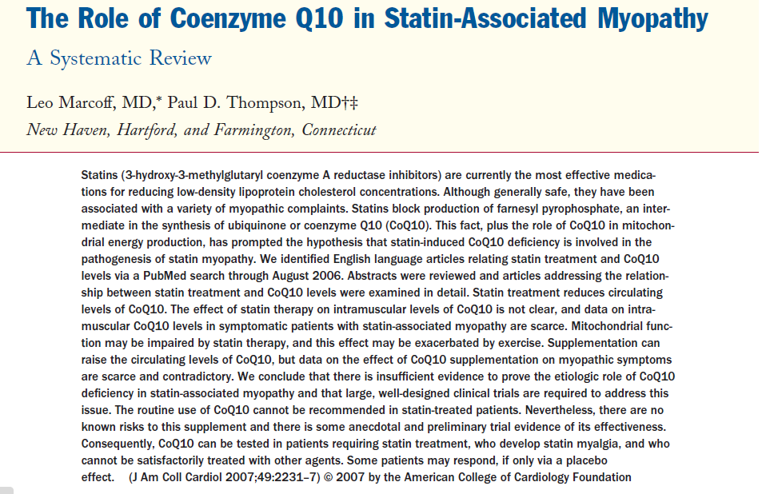

Slide 13
The creatine kinase response to eccentric exercise with atorvastatin 10 mg or 80 mg
Amy K. Kearns AK, Thompson P . Et.al. Atherosclerosis Volume 200, Issue 1 September 2008, Pages 121–125
Methods
79 subjects with LDL cholesterol > 100 mg/dL were randomly assigned to atorvastatin 10 mg (N = 42) or 80 mg (N = 37) for 5 weeks. Subjects performed a downhill walking exercise during the fifth week of treatment. Leg muscle soreness, plasma CK and CK-MB levels were measured daily for 4 days following the exercise. Mean age 42 yrs
Results
CK, CK-MB and muscle soreness increased above pre-exercise levels in all subjects after the exercise. There were no differences in the CK, CK-MB or soreness response between the high and low dose treatment groups at any time point.
Conclusion
The downhill walking model of muscle injury does not distinguish between high and low dose atorvastatin therapy either because this test is insensitive to differences among statin doses or because there is no difference in muscle injury between these two drug doses with this statin. Clinicians should be aware, however, that exercise can increase CK levels with even low dose statin therapy.
Notes:
Downhill exercise
A single bout of eccentric exercise is known to protect the muscle from subsequent exercise-induced injury [3]. Consequently,
subjects were not exercised before starting the statin and were used as their own controls. Five weeks after
randomization, subjects performed a maximal treadmill test using the Bruce protocol to test for exercise-induced cardiac
ischemia and to determine maximal heart rate. Subjects then rested for 30 min before performing the downhill walking
protocol. Subjects walked downhill (−15% grade) on a motor-driven treadmill at a speed that elicited 65% (±5%)
of their predetermined maximum heart rate. Subjects walked for 3 bouts of 15 min with 5 min of rest between each bout.
A fasting blood sample was obtained on the morning of the exercise to determine post-treatment lipids, CK, CKmyocardial
band (CK-MB), and ALT levels. Plasma for CK and CK-MB were obtained 24, 48, 72 and 96 h following
exercise.
3. Laboratory analysis
Blood was obtained via venipuncture from a prominent
forearm vein and collected into a 3 ml sterile or heparinized
vacutainer (BDVacutainer, Franklin Lakes, NJ). Blood lipids,
CK and CK-MB analyses were performed at the Hartford
Hospital Clinical Laboratory. Samples obtained at the University
of Massachusetts were shipped on dry ice to the central
laboratory for analysis.
Subjects and study design
Participants were men who exercised less than once per
week during the preceding 6 months, consumed on average
fewer than two alcoholic beverages per day, and were
free of any chronic medical conditions requiring medication. Mean age 43 yrs
Results
Of the 87 subjects randomized to atorvastatin (10 mg or
80 mg), 79 completed the study protocol. Eight subjects discontinued
the study due to time conflicts, protocol violation,
or unrelated medical issues (4 randomized to 80 mg, 4 randomized
to 10 mg). Thus, 42 subjects were in the atorvastatin
10 mg group and 37 in the atorvastatin 80 mg group. Baseline
age, height, weight and body mass index (BMI) were similar
between the two groups (Table 1).
Soreness
Muscle soreness was not significantly different at baseline
between groups (P > 0.05). Muscle soreness increased significantly
in both groups 24, 48 and 72 h following exercise
(P < 0.05), but these changes were not different between the
treatment groups (Fig. 1C). Therewas no correlation between
baseline CK and subsequent muscle soreness (r = 0.15).
There was also no correlation between maximal CK values
and muscle soreness (r = 0.006).
Discussion
Our results demonstrated increases in resting CK with
atorvastatin treatment, as well as the expected increases in
CK and muscle soreness after downhill walking but no differences
in response in CK, CK-MB, or soreness between
the atorvastatin 10 and 80 mg treatment groups. Indeed, the
CK responses were nearly identical between the two doses
of this drug. In addition, there was little variance in the
CK response among subjects within dosage groups. There
are several possible explanations for the lack of difference
between the doses.
The first possibility is that the eccentric exercise CK
response may be able to differentiate between placebo and
statin, but unable to differentiate between statin doses. This
suggests that exercise-induced muscle injury with statins
occurs at a low statin dose and is not exacerbated by increasing
the dose. Prior research compared the CK response to
exercise between placebo and statin treated subjects [1,5–8],
but we are unaware of prior studies comparing the CK
response to different doses of the same statin or to different
statins. Four [1,5,7,8] of the five reports demonstrate
increases in CK levels with eccentric exercise during statin
treatment compared to placebo.
The second possibility is that there is no difference
in myopathy between 10 and 80 mg of atorvastatin. Most
clinical evidence suggests that myopathy increases with
increasing statin dose, although at least one report maintains
that muscle pain accompanied by an increase in CK with
atorvastatin does not increase with dose [9]. Newman and
colleagues pooled data from 49 clinical trials including 7258
patients treated with 10 mg and 4798 patients treated with
80 mg of atorvastatin [9]. The treatment period ranged from
2 weeks to 52 months. Muscle pain and an increase in CK,
occurred in 2.7 and 2.3% of subjects treated with atorvastatin
10 and 80 mg, respectively. Similarly, the Treat to New
Targets or TNT study [10] treated 10,001 patients with atorvastatin
10 or 80 for a median of 4.9 years. Only 4.8 and 4.7%
of subjects in the 10 and 80 mg groups, respectively, reported
myalgia.
A third possibility is that the higher baseline CK
values in the 10 mg atorvastatin group (131.6±8.8 U/L,
mean±S.E.M. vs. 118.2±11.4 U/L) obscured the myopathic
effect of the higher statin dose after exercise.
Pretreatment CK elevations were associated with subsequent
statin myalgia in the Prediction of Muscular Risk in Observational
conditions or PRIMO study [11] so it is possible that
the higher CK values in the 10 mg group were a marker of
increased susceptibility to statin muscle injury and that this
susceptibility obscured a greater myopathic effect of atorvastatin
80 mg. Baseline CK values in all subjects were normal,
however, and we are unaware of evidence supporting the
hypothesis that baseline CK values within the normal range
are a predictor of statin myopathy.
An additional possibility is that the present sample did
not contain individuals susceptible to muscle injury during
exercise or to the myopathic effects of statins. Our
prior results suggest that some individuals appear particularly
susceptible to CK increases during exercise while
on statin treatment [1,12]. Individuals not on statin treatment
who are homozygous for the myosin light chain kinase
(MLCK) 49T allele or heterozygous for MLCK C37885A
demonstrate greater increases in CK after eccentric exercise
than individuals lacking these genotypes.13 Similarly,
there appears to be a genetic predisposition to non-exercise
induced CK increases during statin treatment.14 Vladutiu
and colleagues performed mutation testing on 110 patients
with drug induced, primarily statin, myopathies and noted
that 10% of these patients had at least one abnormal allele
for a gene affecting muscle metabolism [15]. Abnormal
alleles for muscle phosphorylase, the enzyme involved in
McArdle’s disease, and for carnitine palmitoyltransferase
II were 20 and 13 times more prevalent than expected.
Such observations suggest that demonstrating differences
in the CK response to different statin doses may require
the inclusion of individuals who are genetically susceptible
to muscle injury with exercise or in combination with
a statin.
It is not possible to determine which of these explanations
accounts for the present results. Nevertheless, it does
appear that eccentric exercise using the present protocol cannot
differentiate the muscle injury with different doses of
atorvastatin. Additional studies are required to determine if
this applies to other drugs and to drug combinations.
CK-MB values were normal, but detectable, in 19 subjects
in the 10 mg and 10 subjects in the 80 mg group at all
six study visits. Among these 29 subjects, CK-MB increased
slightly, but not significantly from screening to pre-exercise
in both the 10 and 80 mg groups (5 and 12%, respectively).
CK-MB did increased significantly at 24 and 48 h after exercise
in the 10 mg group and at 24 h in the 80 mg group. These
increases were proportional to the increase in total CK and
do not indicate myocardial injury since they did not exceed
the CK-MB/CK relative index normal value in any subject.
The primary limitations to the present study are that the
subjects were healthy volunteers and had no history of statin
intolerance. Different results may occur using a similar protocol
with myopathic patients. A second limitation is that pain
was measured only after exercise and we did not examine
differences in myalgia during drug treatment. A third limitation
is that there was no placebo group in this study to
compare the results with our previous results with lovastatin
[1]. It is unfortunate that the pretreatment CK levels were
slightly, but significantly, higher in the low treatment group.
If baseline ck is a marker of predisposition to statin toxicity
or muscle injury, then a higher CK level in the low dose
group may have obscured an effect of high dose atorvastatin
therapy. Finally, we do not know if exercise increase in CK
levels is associated with the risk of myopathy with statins.
Nevertheless, the present results demonstrate that there are
no differences in theCKresponse to eccentric exercise in subjects
treated with 10 mgvs. 80 mgof atorvastatin. Such results
suggest that eccentric exercise using this model may not be
used to differentiate the myopathic potential between different
doses of other statins, between different statins and even
between different lipid-lowering medications although these
conclusions require further study. Similarly, clinicians should
consider exercise as cause when statin patients have increased
CK levels and not necessarily altering the medication dose

Slide 14
Lovastatin increases exercise-induced skeletal muscle injury.
Thompson PD, Guyton JR et.al. Metabolism. 1997 Oct;46(10):1206-10
Fifty-nine healthy men aged 18 to 65 years with low-density lipoprotein cholesterol (LDL-C) levels greater than 3.36 mmol/L (130 mg/dL) despite diet therapy were studied. Subjects were randomly assigned to receive lovastatin (40 mg/d) or placebo for 5 weeks. Subjects completed 45 minutes of downhill treadmill walking (-15% grade) at 65% of their predetermined maximum heart rate after 4 weeks of treatment.
During the subsequent week, they completed four 10-repetition sets of one-arm biceps curl exercise using 50% of their maximum capacity. CK levels were measured before exercise and daily for 4 and 5 days after the treadmill and biceps exercises, respectively. Age, body weight, and blood lipid and lipoprotein levels were similar in lovastatin and placebo groups. Resting CK levels were 33% higher in the lovastatin group before treatment (P < .05), but were not significantly altered by lovastatin.
CK levels were 62% and 77% higher (P < .05) in the lovastatin group 24 and 48 hours after treadmill exercise after adjusting for initial CK differences. There were no significant CK differences between lovastatin and placebo groups after biceps curl exercise. We conclude that HMG-CoA reductase inhibitors exacerbate exercise-induced skeletal muscle injury.
Notes:
This study tested the hypothesis that exercise in combination with a 3-hydroxy-3-methylglutaryl coenzyme A (HMG-CoA) reductase inhibitor produces greater creatine kinase (CK) elevations, an index of skeletal muscle injury, than exercise alone, using a double-blind, placebo-controlled design.

Slide 15
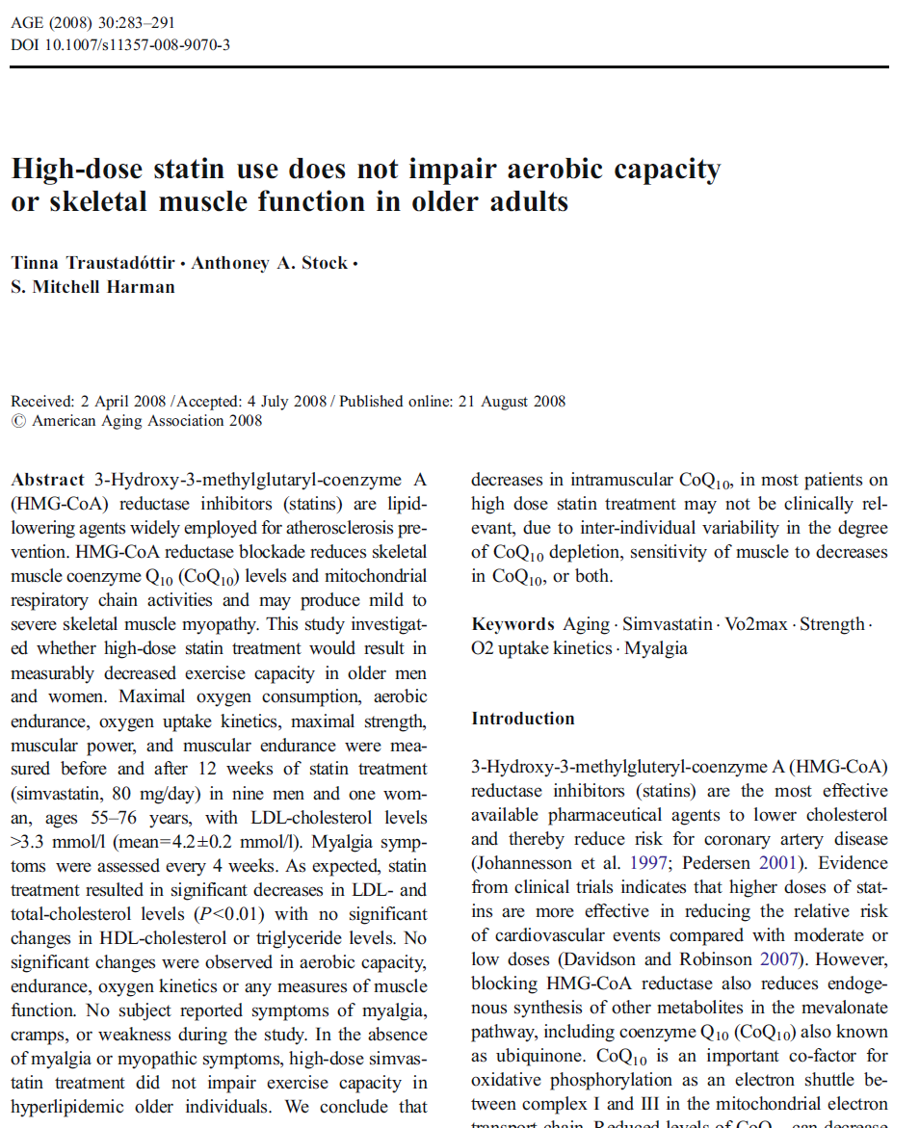

Slide 16
Are Physically Active Individuals Taking Statins at Increased Risk for Myopathy?
Thomas L. Lenz, PharmD, MA, PAPHS
American Journal of Lifestyle Medicine
Published: 10/01/2009 in MEDSCAPE (Cardiology)
Abstract and Introduction
Abstract
Statin drugs are generally well tolerated in most patients. A limited number of studies have been published that look at the relationship of skeletal muscle injury in patients who take statin medications and exercise compared with taking statin medications without exercise. To date, the sample size of these studies is small, but there appears to be evidence to show that statin medications may exacerbate exercise-induced skeletal muscle injury. In addition, a study of professional athletes with familial hyper-cholesterolemia showed that 16 of 22 athletes could not tolerate statin medications. Patients with dyslipidemia who experience muscle pain and discomfort may be less likely to be compliant with their medication and/or physical activity regimens. Educating patients to recognize the signs and symptoms of medication-induced myopathy versus exercise-induced muscle soreness is an important counseling topic for health care providers.

Slide 17
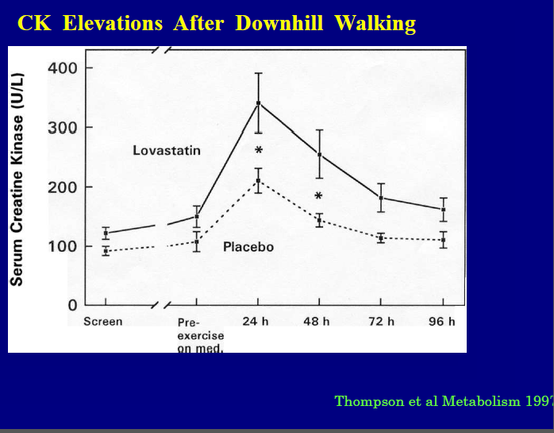

Slide 18
Statin-Associated Myopathy with Normal Creatine Kinase Levels
Paul S. Phillips et.al. Annals of Int. Med. Oct. 2002 Scripps Mercy Clinical Research Center, SD
Objective: To report biopsy-confirmed myopathy and normal kinase levels associated with statin use.
Design: Case reports from preliminary analysis of an ongoing clinical trial.
Setting: Clinical research center in a community hospital.
Patients: Four patients with muscle symptoms that developed during statin therapy and reversed during placebo use.
Measurements: 1] patients' ability to identify blinded statin therapy and 2) standard measures of functional capacity and muscle strength.
Results: All four patients repeatedly distinguished blinded statin therapy from placebo. Strength testing confirmed weakness during statin therapy that reversed during placebo use. Muscle biopsies showed evidence of mitochondrial dysfunction, including abnormally increased lipid stores, fibers that did not stain for cytochrome oxidase activity, and ragged red fibers. These findings reversed in the three patients who had repeated biopsy when they were not receiving statins. Creatine kinase levels were normal in all four patients despite the presence of significant myopathy.
Conclusion: Some patients who develop muscle symptoms while receiving statin therapy have demonstrable weakness and histopathologic findings of myopathy despite normal serum creatine kinase levels.
Notes:
Background: Muscle symptoms in patients who are treated with statins and have normal creatine kinase levels are not well understood

Slide 19
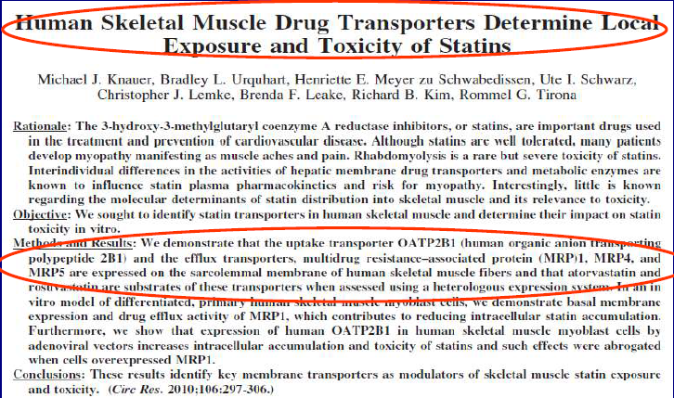

Slide 20
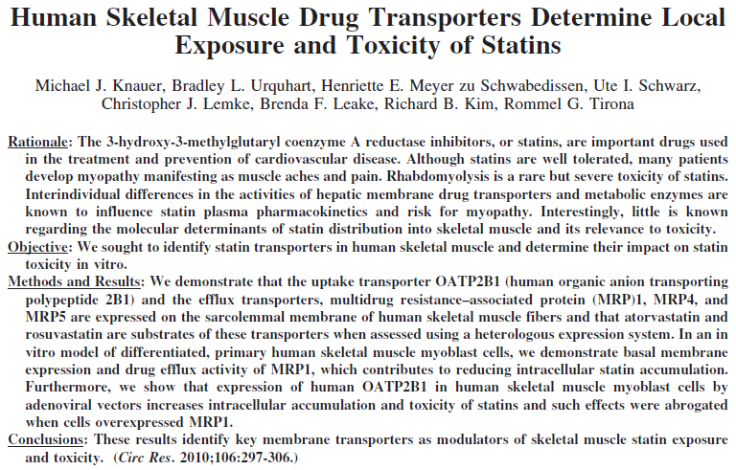
Knauer 2010
Notes:
In addition to decreased cholesterol synthesis, HMG-CoA reductase inhibition by statins causes a commensurate
reduction in the levels of downstream metabolic products including isoprenoids, dolichol, and ubiquinone
(coenzyme Q10).10–13 Among these are the isoprenoid secondary metabolic intermediates geranylgeranyl pyrophosphate
and farnesylpyrophosphate that are involved in protein isoprenylation and activation of small GTPases such as Rho
and Rab. The important role for diminished isoprenylation in the mechanism of statin myotoxicity is related to induction of
the muscle atrophy-linked protein atrogin-1.12
Methods
An expanded Methods section is available in the Online Data
Supplement at http://circres.ahajournals.org.
Gene Expression Analysis
Tissue and cell culture expression of transporters was determined by quantitative polymerase chain reaction, and Western blotting and
immunofluorescence microscopy were performed as described in the Online Data Supplement.
Identification of Statin Transporters
Heterologous expression of transporters in human cervical cancer cells (HeLa) by recombinant vaccinia virus method and statin
transport activity assays were performed as described previously39 with modifications detailed in the Online Data Supplement.
Statin Accumulation and Toxicity in Skeletal
Muscle Cells
Overexpression of transporters in cultured primary differentiated human skeletal muscle myoblast (HSMM) (Lonza, Walkersville,
Md) cells by adenoviral gene delivery, statin cellular accumulation assays, as well as toxicity assays (ATP content, mitochondrial
methylthiazolyldiphenyl-tetrazolium bromide reduction, caspase 3/7
activation) are described in detail in the Online Data Supplement.

Slide 21
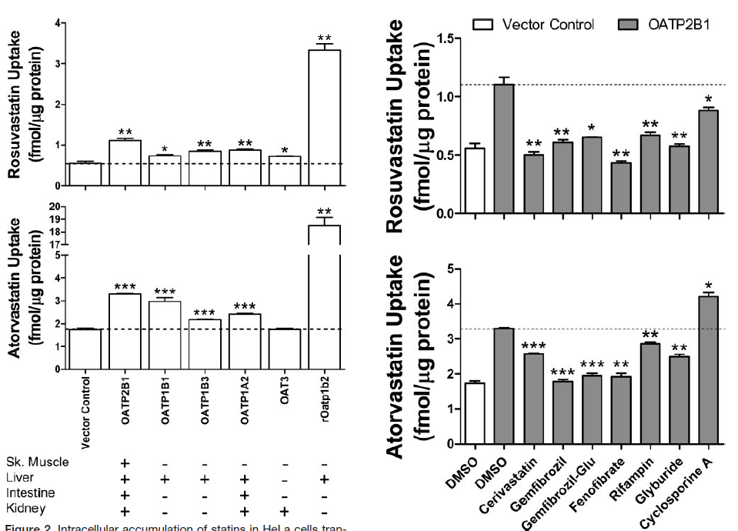
Knauer 2010

Slide 22
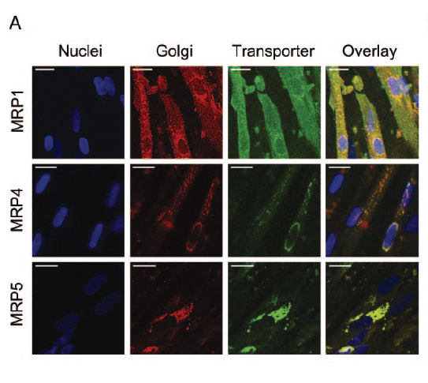
Knauer 2010
Notes:
Immunofluorescence localization of MRP1, MRP4, and MRP5 (green), Golgi (red), and nuclei (blue) in differentiated
HSMM cells using confocal microscopy. Scale bar20 m. B, Intracellular accumulation of [3H]rosuvastatin and [3H]atorvastatin
after 30 minutes in HSMM cells cotreated with or without 100 mol/L cerivastatin or the nonspecific MRP inhibitors dipyridamole,
MK-571, quercetin, and verapamil at 100 mol/L. Results are presented as percentages of DMSO controlSEM (n3 to 4).
**P0.01, ***P0.001 compared with DMSO control
Discussion
Drug transporters have recently been implicated in statininduced
myopathy. However, those that have been previously
considered have been the transporters located in the liver and
small intestine, which are largely responsible for controlling
The known statin efflux transporters, namely P-gp, MRP2
and BCRP are not expressed in human skeletal muscle
(Figure 1A). However, isoforms of the MRP transporter
family such as MRP1, MRP4, and MRP5 are highly expressed
in skeletal muscle, although previous to this report,
their capacity for statin efflux was unknown. Here, we
demonstrate that the 3 human skeletal muscle MRPs (MRP1,
MRP4, and MRP5) transport rosuvastatin and/or atorvastatin.
These transporters are expressed on the sarcolemmal membrane
of muscle fibers, indicating a protective role against
intracellular statin accumulation.
The dynamic interplay between uptake and efflux transporter
activities likely controls muscle fiber statin concentrations,
which determines susceptibility to toxicity. We have
shown that the toxicity of rosuvastatin and atorvastatin in
primary human skeletal muscle cells is dependent on the
achieved intracellular drug concentrations. This is highlighted
by the findings that reduction of cellular statin accumulation
by MRP1 overexpression in cultured skeletal muscle cells
heterologously expressing OATP2B1 (Figure 6B) afforded
cytoprotection against statin exposure (Figure 7C and 7D).
In our evaluation of the literature, the
plasma-to-skeletal muscle concentration ratio of statins in
humans is not known, but this value will undoubtedly be
dependent on the relative expression and intrinsic activities of
the attendant uptake (OATP2B1) and efflux (MRP1, MRP4,
MRP5) transporters. The present results would also suggest
that drug–statin interactions occurring not only at the level of
the hepatocyte cell membrane but also in skeletal muscle
fibers could contribute to myopathy.
In conclusion, statin transporters are present in human
skeletal muscle that control intracellular drug exposure. We
propose a role for OATP2B1 in sensitizing skeletal muscle
cells to statin toxicity and that the novel statin efflux
transporters MRP1, MRP4, and MRP5 protect muscle from
toxicity. The dynamic functional interplay between these
uptake and efflux transporters in vivo likely determines risk
for statin-induced myopathy.

Slide 23
The known statin efflux transporters, namely P-gp, MRP2 and BCRP are not expressed in human skeletal muscle (Figure 1A). However, isoforms of the MRP transporter family such as MRP1, MRP4, and MRP5 are highly expressed in skeletal muscle, although previous to this report, their capacity for statin efflux was unknown. Here, we demonstrate that the 3 human skeletal muscle MRPs (MRP1, MRP4, and MRP5) transport rosuvastatin and/or atorvastatin.
These transporters are expressed on the sarcolemmal membrane of muscle fibers, indicating a protective role against intracellular statin accumulation.
Knauer 2010
Notes:
In conclusion, statin transporters are present in human
skeletal muscle that control intracellular drug exposure. We
propose a role for OATP2B1 in sensitizing skeletal muscle
cells to statin toxicity and that the novel statin efflux
transporters MRP1, MRP4, and MRP5 protect muscle from
toxicity. The dynamic functional interplay between these
uptake and efflux transporters in vivo likely determines risk
for statin-induced myopathy.

Slide 24
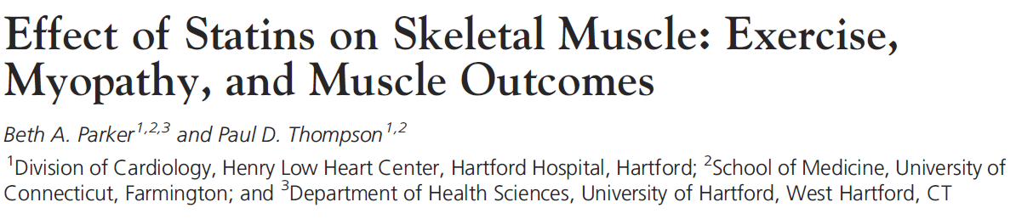
Ex. Sport Sci. Rev. 2012;40:188
We have confirmed that eccentric exercise during statin therapy does increase CK levels more than exercise on placebo (e.g., 2011 Boston Marathon)
We recently have completed data collection of an NHBLI-funded (STOMP [The Effect of STatins On Skeletal Muscle Function and Performance]) study assessing CK, exercise capacity, and muscle
strength before and after atorvastatin 80 mg or placebo treatment
for 6 months in 420 healthy statin-naive subjects
Notes:
18. Parker BA, Augeri AL, Capizzi JA, et al. Effect of statins on creatine kinase levels before and after a marathon run. Am. J. Cardiol. 2012; 109(2):
282Y7.
We measured total CK in 37 statin-using athletes (29 men and eight women) and 43 controls (30 men
and 13 women) running the race. Subjects were on a variety of statin medications and doses. Venous blood samples were
obtained the day before and within 1 h and 24-h after the race. The exercise-related increase in CK 24 h after exercise,
adjusted for changes in plasma volume, was greater in statin users than controls (Fig. 3). Notably, there was no relationship
between statin potency and the changes in CK immediately and 24 h after exercise, although increases in CK at
both finish and 24 h after the race measurements were directly related to age in the statin users.

Slide 25
Statins and CoQ10
Serum CoQ10 levels decrease during statin therapy, but CoQ10 is transported in LDL particles, and its decrease is commensurate with decreases in blood cholesterol. This suggests that the decrease in serum CoQ10 is caused by a reduction in transport particles.
CoQ10 levels do not decrease during ezetimibe and cholestyramine therapy, however, despite reductions in LDL levels, so it is possible that the effect of statins on CoQ10 is independent of their reductions in transport particles.
Muscle biopsy studies have failed to detect consistent reductions in muscle CoQ10 levels, although one study in statin-naive subjects found microscopic evidence of statin myopathy and reductions of 30% in intramuscular CoQ10 levels in subjects treated with simvastatin 80 mg for 8 wk
Parker & Thompson 2012
Notes:
15. Marcoff L, Thompson PD. The role of coenzyme Q10 in statin-associated myopathy: a systematic review. J. Am. Coll. Cardiol. 2007; 49(23):2231Y7.
18. Parker BA, Augeri AL, Capizzi JA, et al. Effect of statins on creatine kinase levels before and after a marathon run. Am. J. Cardiol. 2012; 109(2):
282Y7.
The most popular but largely untested theory for statin myopathy at rest and during exercise is depletion of intramuscular CoQ10 producing mitochondrial dysfunction, subsequent abnormal muscle energy metabolism, and, ultimately, symptoms. We have recently summarized the data linking CoQ10 to statin myopathy (15).
To our knowledge, only two small studies have administered CoQ10 to patients with statin myalgia but neither tested muscle
injury after exercise, and these reports produced contrasting results. One study randomly assigned patients with previous
statin myalgia and currently on statin treatment to low-dose CoQ10(100mgIdj1, n = 18) or vitamin E (400 IUIdj1, n = 14)
for 30 d. Pain severity decreased by 40% and pain interference with daily activities decreased by 38% in the group treated
with CoQ10, but neither pain severity nor pain interference with daily activities changed with vitamin E. Another study randomized
44 patients with statin myalgia to CoQ10 200 mgIdj1 or placebo during upward dose titration of simvastatin from
10 to 40 mgIdj1 but found no difference in myalgia score, adherence to simvastatin treatment, or the number of patients
tolerating the highest simvastatin dose.
SLCO1B1 encodes the organic aniontransporting polypeptide OATP1B1, thereby regulating the hepatic uptake of statins

Slide 26
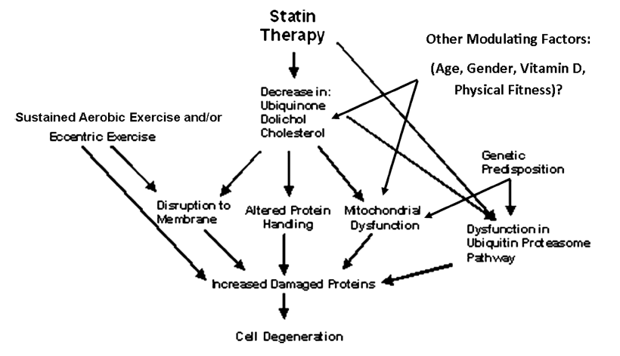
Statins and Exercise and Myofibril Response
Parker & Thompson 2012
Notes:
Sustained muscular contraction during periods of glycogen depletion and reduced adenosine-5¶-triphosphate availability
result in membrane permeability and fiber damage, permitting muscle enzyme efflux that is proportional to the duration and
intensity of the exercise. There are several mechanisms by which statins could amplify this process (Fig. 4).
The most popular but largely untested theory for statin myopathy at rest and during exercise is depletion of intramuscular
CoQ10 producing mitochondrial dysfunction, subsequent abnormal muscle energy metabolism, and, ultimately,
symptoms. We have recently summarized the data linking CoQ10 to statin myopathy (15). Serum CoQ10 levels decrease
during statin therapy, but CoQ10 is transported in lower density
lipoprotein particles, and its decrease is commensurate with
decreases in blood cholesterol. This suggests that the decrease
in serum CoQ10 is caused by a reduction in transport particles.
CoQ10 levels do not decrease during ezetimibe and cholestyramine
therapy, however, despite reductions in LDL levels,
so it is possible that the effect of statins on CoQ10 is independent
of their reductions in transport particles. Muscle biopsy
studies have failed to detect consistent reductions in muscle
CoQ10 levels, although one study in statin-naive subjects found microscopic evidence of statin myopathy and reductions
of 30% in intramuscular CoQ10 levels in subjects treated
with simvastatin 80 mg for 8 wk. Another report noted muscle
CoQ10 levels 2 to 4 SD below normal in 50% of patients
with statin myopathy.

Slide 27
Effect of statins on skeletal muscle function. STOMP
Parker BA, Capizzi JA Thompson PD et.al. Circ. 2013 1;127:96-103
METHODS AND RESULTS:
The Effect of Statins on Skeletal Muscle Function and Performance (STOMP) study assessed symptoms and measured creatine kinase, exercise capacity, and muscle strength before and after atorvastatin 80 mg or placebo was administered for 6 months to 420 healthy, statin-naive subjects. No individual creatine kinase value exceeded 10 times normal, but average creatine kinase increased 20.8±141.1 U/L (P<0.0001) with atorvastatin. There were no significant changes in several measures of muscle strength or exercise capacity with atorvastatin, but more atorvastatin than placebo subjects developed myalgia (19 versus 10; P=0.05). Myalgic subjects on atorvastatin or placebo had decreased muscle strength in 5 of 14 and 4 of 14 variables, respectively (P=0.69).
CONCLUSIONS:
These results indicate that high-dose atorvastatin for 6 months does not decrease average muscle strength or exercise performance in healthy, previously untreated subjects. Nevertheless, this blinded, controlled trial confirms the undocumented impression that statins increase muscle complaints. Atorvastatin also increased average creatine kinase, suggesting that statins produce mild muscle injury even among asymptomatic subjects. This increase in creatine kinase should prompt studies examining the effects of more prolonged, high-dose statin treatment on muscular performance.
✓ We observed that high-dose atorvastatin doubled the incidence of reproducible muscle complaints, from 4.6% to 9.4% of subjects.
Notes:
NHLBI Funded.
Division of Cardiology, Henry Low Heart Center, Hartford Hospital, Hartford, CT, USA.
Abstract
BACKGROUND:
Many clinicians believe that statins cause muscle pain, but this has not been observed in clinical trials, and the effect of statins on muscle performance has not been carefully studied.
Study Measurements
Body anthropometrics, hand-grip isometric strength of the dominant hand, elbow and knee extension/flexion isometric and isokinetic strength, knee endurance fatigue index8 of the dominant limb, maximal oxygen uptake, resting and peak respiratory gas exchange ratio and ventilatory threshold, and habitual self-reported and directly measured physical activity were measured at baseline and after 6 months of drug treatment as described.6 Compliance with study medications was assessed by pill counts of unused medication at 3 months and again at 6 months
Myalgia/Muscle Symptoms
Muscle complaints were assessed at the baseline, at the 3- and 6-month visits, and by phone twice monthly with the Short-Form Brief Pain Inventory as described.6 Subjects met the study definition for “myalgia” if all of the following occurred: (1) They reported new or increased muscle pain, cramps, or aching not associated with exercise; (2) symptoms persisted for at least 2 weeks; (3) symptoms resolved within 2 weeks of stopping the study drug; and (4) symptoms reoccurred within 4 weeks of restarting the study medication. Subjects who tested positive for myalgia with these criteria subsequently performed repeat serological, muscle, and aerobic testing immediately after reoccurrence of muscle symptoms.
Changes in Serological Markers
Atorvastatin produced a 20.8±141.1 U/L (P<0.0001) increase in CK, although no subject demonstrated a CK value >10 times the ULN
Muscle Complaints
Twenty-three atorvastatin and 14 placebo subjects reported new, unexplained muscle pain. Nineteen atorvastatin and 10 placebo subjects ultimately met the study definition for myalgia (χ2=3.74; P=0.05). Myalgic subjects on atorvastatin reported predominantly leg symptoms: hip flexor, quadriceps, hamstring, and/or calf aches (n=10); quadriceps or calf cramps (n=5); and/or quadriceps, hamstring, and/or calf fatigue (n=6). Myalgic subjects on placebo reported more diverse symptoms such as whole-body fatigue (n=3), worsening of pain in previous injuries (n=3), groin pain (n=3), and foot cramping (n=1), but they were otherwise similar (Table 1). Time to symptom onset was shorter in atorvastatin myalgic subjects than in myalgic subjects on placebo (35±31 versus 61±33 days; P=0.045). Myalgic versus nonmyalgic subjects on atorvastatin or placebo did not exhibit differences in CK, ALT, lipid (Table 2), or vitamin D changes with treatment (P>0.19).
The reported incidence of myalgia during statin therapy has varied from 1% to 25%.3,10,11
Determining the true incidence of mild muscle complaints from prior studies is difficult because these complaints are typically not solicited and because most large trials typically define myopathy as either myositis or rhabdomyolysis and require CK levels to be >10 times the ULN. We used a standardized study protocol and definition and observed that high-dose atorvastatin doubled the incidence of reproducible muscle complaints, from 4.6% to 9.4% of subjects.

Slide 28
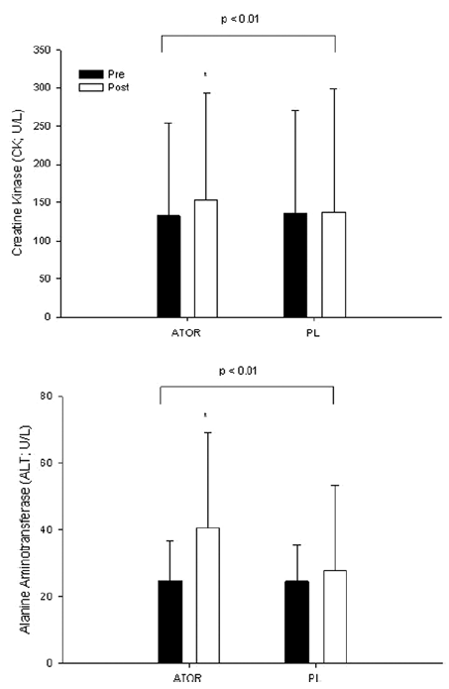
Parker et.al. 2013
Notes:
Group mean±SD of creatine kinase (CK; top) and alanine aminotransferase (ALT; bottom) before (Pre) and after (Post) 6 months of atorvastatin (ATOR) or placebo (PL) treatment. Brackets indicate the P value for group-by-time interaction. *Significant difference between groups within a time point at P<0.05.

Slide 29
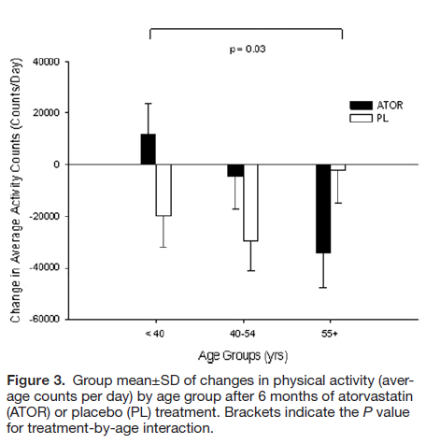
Activity (step counts) and Atorvastatin 80 vs Placebo
Parker et.al. 2013

Slide 30
The effects of statins on skeletal muscle strength and exercise performance.
Krishnan GM Thompson PD Curr Opin Lipidol.2010 Aug;21(4):324-8
PURPOSE OF REVIEW:
HMG-CoA reductase inhibitors or statins are associated with a variety of muscle side-effects but little is known about the effect of statins on skeletal muscle strength and exercise performance. We performed a literature search to examine these issues.
RECENT FINDINGS:
We identified six studies examining the effect of statins on muscle strength and nine studies examining their effect on exercise tolerance. In general, studies examining both issues were small and used crude measures of strength and exercise performance.
SUMMARY:
There is insufficient data to determine if statins affect muscle strength and exercise performance. There is suggestive evidence that these drugs may reduce muscle strength in older patients and alter energy metabolism during aerobic exercise, both possibilities require further study.
Notes:
Source
Department of Internal Medicine, University of Connecticut, Farmington, Connecticut, USA.
Abstract

Slide 31
High-dose statins and skeletal muscle metabolism in humans: A randomized, controlled trial
Pavia H et.al. (Clin Pharmacol Ther 2005;78:60-8.)
This study was designed to assess the effect of high-dose statin treatment on cholesterol and ubiquinone metabolism and mitochondrial function in human skeletal muscle. Methods: 48 patients with hypercholesterolemia (33 men and 15 women) were randomly assigned to receive 80 mg/d of simvastatin (n  16), 40 mg/d of atorvastatin (n  16), or placebo (n  16) for 8 weeks. Plasma samples and muscle biopsy specimens were obtained at baseline and at the end of the follow-up.
Results: The ratio of plasma lathosterol to cholesterol, a marker of endogenous cholesterol synthesis, decreased significantly by 66% in both statin groups. Muscle campesterol concentrations increased from 21.1  7.1 nmol/g to 41.2  27.0 nmol/g in the simvastatin group and from 22.6  8.6 nmol/g to 40.0  18.7 nmol/g in the atorvastatin group (P  .005, repeated-measurements ANOVA). The muscle ubiquinone concentration was reduced significantly from 39.7  13.6 nmol/g to 26.4  7.9 nmol/g (P  .031, repeated-measurements ANOVA) in the simvastatin group, but no reduction was observed in the atorvastatin or placebo group. Respi- ratory chain enzyme activities were assessed in 6 patients taking simvastatin with markedly reduced muscle ubiquinone and in matched subjects selected from the atorvastatin (n  6) and placebo (n  6) groups. Respira- tory chain enzyme and citrate synthase activities were reduced in the patients taking simvastatin. Conclusions: High-dose statin treatment leads to changes in the skeletal muscle sterol metabolism. Furthermore, aggressive statin treatment may affect mitochondrial volume. (Clin Pharmacol Ther 2005;78:60-8.)

Slide 32
Statins, Exercise, and Exercise Training
Paul D. Thompson, MD, FACC Beth Parker, PhD
The mechanisms mediating statin myopathy are unclear, but possibilities include:
decreased sarcolemmal or endoplasmic reticulum cholesterol,
reduced production of prenylated proteins including the mitochondrial electron transport protein coenzyme Q10,
reduced fat catabolism,
increased myocellular concentrations of cholesterol and plant sterols,
failure to repair damaged skeletal muscle,
vitamin D deficiency,
inflammation.
Increasingly, interest has focused on altered cellular energy utilization
and mitochondrial dysfunction, with the dysfunction activating pathways leading to muscle atrophy
Thompson 2013
Notes:
Statins, Exercise, and Exercise Training Paul D. Thompson, MD, FACC Beth Parker, PhD
PII: S0735-1097(13)01402-2 DOI: 10.1016/j.jacc.2013.03.030
Reference: JAC 18759
To appear in: Journal of the American College of Cardiology
Received Date: 25 February 2013
Accepted Date: 1 March 2013
1. Ghatak A, Faheem O, Thompson PD. The genetics of statin-induced myopathy. Atherosclerosis. 2010;210:337-343. - hepatic organic anion transporter protein SLCO1B1.
Statins are life-saving medications and so effective that some have suggested they
be added to the drinking water to “fluorinate” the vascular bed against atherosclerotic
disease. But statins, in both research models and clinically, can have deleterious effects
on skeletal muscle. The most serious side effects are myositis and rhabdomyolysis
manifested by marked elevations in creatine kinase (CK) and associated in several
studies, with variants in the hepatic organic anion transporter protein SLCO1B1. These
variations result in reduced statin hepatic uptake and expose more of the periphery and
skeletal muscle to the drug. Rhabdomyolysis is extremely rare in the absence of
concomitant medications such as gemfibrozil, cyclosporine, human immunodeficiency
virus protease inhibitors, azole antifungals, and macrolide antibiotics that increase statin
blood and muscle levels.2 Statins have also been associated with a rare inflammatory
myositis that does not resolve with drug cessation, often requires immunosuppressive
therapy and has antibodies against hydoxy-methyl-glutaryl Co A reductase.3 Much more
common, however, are milder muscle complaints including myalgia, muscle cramps, and
weakness.
The incidence of these milder muscle complaints was 10.5% in the French
PRIMO study of 7924 hyperlipidemic patients treated with high dose statins for at lease 3
months.4 We observed a similar incidence (11.3%) of muscle complaints among 203
statin-naïve subjects treated for 6 months with atorvastatin 80 mg daily.5 Only 9.4% of
our subjects met the study definition of statin myalgia, which required new muscle
symptoms that persisted for at least 2 weeks, resolved within 2 weeks of drug cessation,
and reappeared within 4 weeks of restarting the atorvastatin.5 Interestingly, 6.0% of the
placebo control group (n=217) developed similar muscle symptoms and 4.6% of these
placebo-treated individuals met the study criteria for drug related myalgia. These results
suggest that the true incidence of statin myalgia with high dose statins during 6 months of
treatment is only approximately 4.8%, or the rate in the atorvastatin minus the placebo
treated subjects. Notably, this is only half the rate reported in the PRIMO study, which
was not placebo controlled and did not use a standardized challenge-dechallenge
definition of myalgia.4
The mechanisms mediating statin myopathy are unclear, but possibilities include
decreased sarcolemmal or endoplasmic reticulum cholesterol, reduced production of
prenylated proteins including the mitochondrial electron transport protein coenzyme Q10,
reduced fat catabolism, increased myocellular concentrations of cholesterol and plant
sterols, failure to repair damaged skeletal muscle, vitamin D deficiency, and
inflammation.2 Increasingly, interest has focused on altered cellular energy utilization
and mitochondrial dysfunction, with the dysfunction activating pathways leading to
muscle atrophy.6-8
This issue of JACC presents results from an exercise training study that further
implicate altered mitochondrial function in statin-associated muscle dysfunction. Metkus
and colleagues randomized previously sedentary, statin-naive adults with at least 2 risk
factors for the metabolic syndrome to 12 weeks of supervised, aerobic exercise training
alone (n=19) or in combination with 40 mg of simvastatin (n=18).9 Maximal oxygen
uptake, expressed as either an absolute value or relative to body weight, increased 10%
with training in the exercise only group, but only 1.5% in the exercise and simvastatin

Slide 33
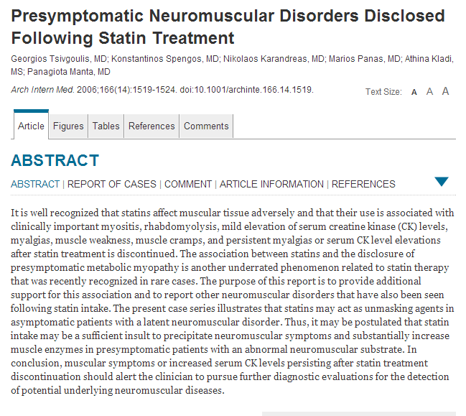

Slide 34
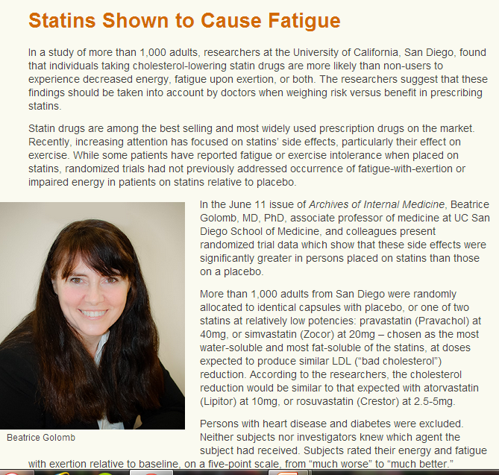
Notes:
…Persons with heart disease and diabetes were excluded. Neither subjects nor investigators knew which agent the subject had received. Subjects rated their energy and fatigue with exertion relative to baseline, on a five-point scale, from “much worse” to “much better.”
Those placed on statins were significantly more likely than those on placebo to report worsening in energy, fatigue-with-exertion, or both. Both statins contributed to the finding, though the effect appeared to be stronger in those on simvastatin. (Simvastatin led to significantly greater cholesterol reduction.)
“Side effects of statins generally rise with increasing dose, and these doses were modest by current standards,” said Golomb. “Yet occurrence of this problem was not rare – even at these doses, and particularly in women.”
The magnitude of the effect observed can be seen in the research findings if, for example, 4 of 10 treated women on simvastatin cited worsened energy or exertional fatigue; 2 in 10 cited worsening in both, or rated either one as “much worse”; or if 1 in 10 study participants rated energy and exertional fatigue as “much worse.”
“Energy is central to quality of life. It also predicts interest in activity,” said Golomb. “Exertional fatigue not only predicts actual participation in exercise, but both lower energy and greater exertional fatigue may signal triggering of mechanisms by which statins may adversely affect cell health.”
For these reasons, the researchers state that decreases in energy, and increases in exertional fatigue on statins represent important findings which should be taken into account in risk-benefit determinations for statins. According to Golomb, this is particularly true for groups for whom evidence does not support mortality benefit on statins – such as most patients without heart disease, and women and those over 70 or 75, even if heart disease is present.
Additional contributors to the paper include Marcella A. Evans, Department of Anatomy and Neurobiology, UC Irvine; Joel E. Dimsdale, MD, UC San Diego Department of Psychiatry; and Halbert L. White, UC San Diego Department of Economics.
This study was funded by the National Heart, Lung and Blood Institute, part of the National Institutes of Health, # RO1 HL63055; and supported by the UCSD General Clinical Research Center, NIH # MO1 RR00827.

Slide 35
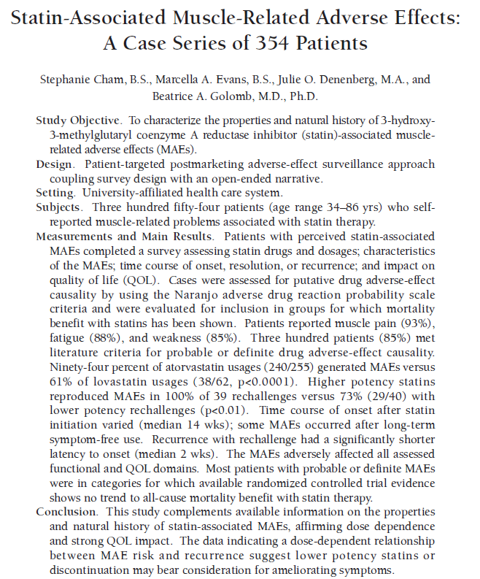
Pharmacotherapy 2010;30(6):541–553
Notes:
Conclusion
Findings from this study extend existing literature on MAEs. Information based on patient self-report suggests that MAEs can arise with all
statins, are dose dependent, can develop (although
less commonly) even well after statin initiation,
have significant functional and QOL implications,
and do not universally show full recovery. Many
individuals exhibiting MAEs were in groups for
whom there is no expected mortality benefit from
statins. Physicians should be aware of statinassociated
MAEs and their functional and QOL
implications to enable more informed riskbenefit
decisions, and to allow effective treatment
modification when MAEs occur.

Slide 36
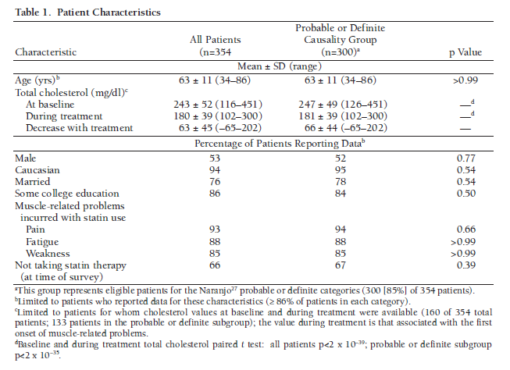
Cham/Golomb 2010

Slide 37
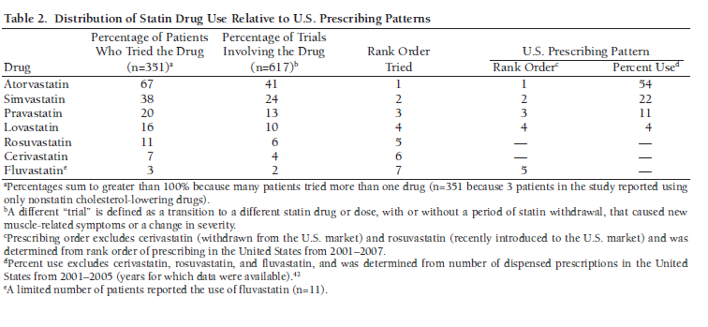
Cham/Golomb 2010

Slide 38
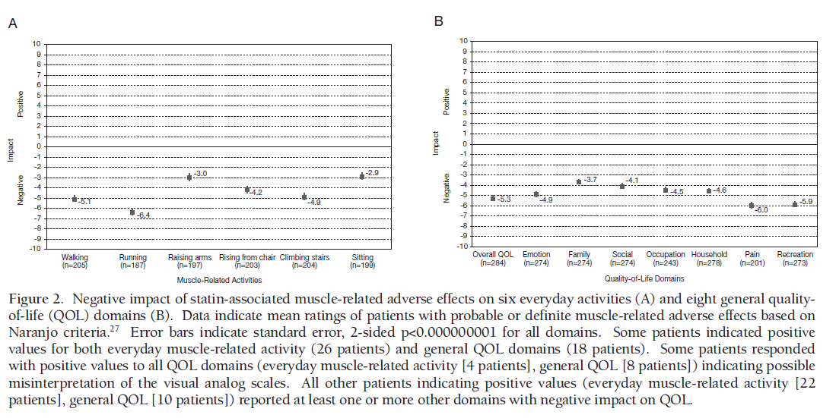
Cham/Golomb 2010
Notes:
Pharmacotherapy 2010;30(6):541–553
FIGURE – VAS. Negative impact of statin-associated muscle-related adverse effects on six everyday activities (A) and eight general qualityof-
life (QOL) domains (B). Data indicate mean ratings of patients with probable or definite muscle-related adverse effects based on
Naranjo criteria.27 Error bars indicate standard error, 2-sided p<0.000000001 for all domains. Some patients indicated positive
values for both everyday muscle-related activity (26 patients) and general QOL domains (18 patients). Some patients responded
with positive values to all QOL domains (everyday muscle-related activity [4 patients], general QOL [8 patients]) indicating possible
misinterpretation of the visual analog scales. All other patients indicating positive values (everyday muscle-related activity [22
patients], general QOL [10 patients]) reported at least one or more other domains with negative impact on QOL
A fourth key finding is that statin-associated MAEs significantly affected many domains of
QOL. Walking and running were particularly affected, which is relevant to mortality because of
the established benefits of exercise to health and QOL extending to cardiovascular disease,51, 52
peripheral arterial disease,53, 54 cognitive function,55 mood,56 bone density,57 all elements of metabolic
syndrome,58 diabetes mellitus,59 as well as cancer60, 61 and all-cause mortality52, 62 in observational
studies. General QOL domains were also significantly negatively impacted; among queried
domains, pain was the most affected followed by recreational function. These data are buttressed
by existing literature; it has been postulated that statins may interfere with muscle response to
physical exertion,63 and in a clinical observational setting, a great number of patients who indicated
MAEs noted that symptoms prevented even moderate exertion.24 Moreover, a previous study
has shown a majority of professional athletes with familial hyperlipidemia could not tolerate
statins because of MAEs.
Discussion
To our knowledge, this study is the first to use
patient-targeted postmarketing surveillance as an
approach to characterize muscle-related problems
associated with statins and to expand our understanding
of statin-associated MAEs. Musclerelated
adverse effects were reported with all
prescribed statins, with most cases meeting
existing literature criteria for probable or definite
adverse-effect causality. Symptoms entailed pain,
weakness, and/or fatigue, and commonly all
three. “Trials” yielding MAEs correlated strongly
with the potency of the statin in that trial. In
addition, a powerful relationship was seen
between the relative potency of the cholesterollowering
agent and the recurrence of musclerelated
symptoms with rechallenge. The time
course for symptom onset was variable; however,
time to onset for recurrence of MAEs with
rechallenge was significantly shorter than time to
onset for initial statin-associated MAEs. Findings
agree with others’ observations that recovery
from statin-associated MAEs is not universally
complete.21, 22, 46 Visual analog scales as well as
patient narratives indicated that symptoms had a
significant and sometimes life-altering negative…
Naranjo algorithm
The Naranjo algorithm, Naranjo Scale, or Naranjo Nomogram is a questionnaire designed by Naranjo et al. for determining the likelihood of whether an ADR (adverse drug reaction) is actually due to the drug rather than the result of other factors. Probability is assigned via a score termed definite, probable, possible or doubtful. Values obtained from this algorithm are sometimes used in peer reviews to verify the validity of author's conclusions regarding adverse drug reactions. It is also called the Naranjo Scale or Naranjo Score.
[edit]Questionnaire
1. Are there previous conclusive reports on this reaction?
Yes (+1) No (0) Do not know or not done (0)
2. Did the adverse events appear after the suspected drug was given?
Yes (+2) No (-1) Do not know or not done (0)
3. Did the adverse reaction improve when the drug was discontinued or a specific antagonist was given?
Yes (+1) No (0) Do not know or not done (0)
4. Did the adverse reaction appear when the drug was readministered?
Yes (+2) No (-1) Do not know or not done (0)
5. Are there alternative causes that could have caused the reaction?
Yes (-1) No (+2) Do not know or not done (0)
6. Did the reaction reappear when a placebo was given?
Yes (-1) No (+1) Do not know or not done (0)
7. Was the drug detected in any body fluid in toxic concentrations?
Yes (+1) No (0) Do not know or not done (0)
8. Was the reaction more severe when the dose was increased, or less severe when the dose was decreased?
Yes (+1) No (0) Do not know or not done (0)
9. Did the patient have a similar reaction to the same or similar drugs in any previous exposure?
Yes (+1) No (0) Do not know or not done (0)
10. Was the adverse event confirmed by any objective evidence?
Yes (+1) No (0) Do not know or not done (0)
Scoring
> 9 = definite ADR
5-8 = probable ADR
1-4 = possible ADR
0 = doubtful ADR
References
Naranjo CA, Busto U, Sellers EM et al. (1981). "A method for estimating the probability of adverse drug reactions". Clin. Pharmacol. Ther. 30 (2): 239–45

Slide 39
VAS
Functional and Quality-of-Life Impact The subjective impact of MAEs on six areas of everyday muscle-related activity and eight domains relevant to QOL was appraised on a visual analog scale ranging from −10 (“maximally worse”) to +10 (“maximally better”) and was analyzed with nonparametric sign tests.
Visual analog scales were selected because of their favorable psychometric properties for subjective outcomes (Clark 2003; Rosier 2002). They circumvent concerns regarding QOL instruments, which sum scores on specific questions and thereby may weight QOL considerations differently from patients’ weightings (Gill 1994). Although patients were selected for reporting MAEs, benefits as well as harm to QOL domains were elicited.
Cham/Golomb 2010
Notes:
32. Clark P, Lavielle P, Martinez H. Learning from pain scales: patient perspective. J Rheumatol 2003;30:1584–8.
33. Rosier EM, Iadarola MJ, Coghill RC. Reproducibility of pain measurement and pain perception. Pain 2002;98:205–16
34. Gill TM, Feinstein AR. A critical appraisal of the quality of quality-of-life measurements. JAMA 1994;272:619–26.

Slide 40
Naranjo algorithm
Adverse Drug Reactions
1. Are there previous conclusive reports on this reaction?
Yes (+1) No (0) Do not know or not done (0)
2. Did the adverse events appear after the suspected drug was given?
Yes (+2) No (-1) Do not know or not done (0)
3. Did the adverse reaction improve when the drug was discontinued or a specific antagonist was given?
Yes (+1) No (0) Do not know or not done (0)
4. Did the adverse reaction appear when the drug was readministered?
Yes (+2) No (-1) Do not know or not done (0)
5. Are there alternative causes that could have caused the reaction?
Yes (-1) No (+2) Do not know or not done (0)
6. Did the reaction reappear when a placebo was given?
Yes (-1) No (+1) Do not know or not done (0)
7. Was the drug detected in any body fluid in toxic concentrations?
Yes (+1) No (0) Do not know or not done (0)
8. Was the reaction more severe when the dose was increased, or less severe when the dose was decreased?
Yes (+1) No (0) Do not know or not done (0)
9. Did the patient have a similar reaction to the same or similar drugs in any previous exposure?
Yes (+1) No (0) Do not know or not done (0)
10. Was the adverse event confirmed by any objective evidence?
Yes (+1) No (0) Do not know or not done (0)
Scoring
> 9 = definite ADR
5-8 = probable ADR
1-4 = possible ADR
0 = doubtful ADR
Notes:
Naranjo CA, Busto U, Sellers EM et al. (1981). "A method for estimating the probability of adverse drug reactions". Clin. Pharmacol. Ther. 30 (2): 239–45.
The Naranjo algorithm, Naranjo Scale, or Naranjo Nomogram is a questionnaire designed by Naranjo et al. for determining the likelihood of whether an ADR (adverse drug reaction) is actually due to the drug rather than the result of other factors. Probability is assigned via a score termed definite, probable, possible or doubtful. Values obtained from this algorithm are sometimes used in peer reviews to verify the validity of author's conclusions regarding adverse drug reactions. It is also called the Naranjo Scale or Naranjo Score.

Slide 41
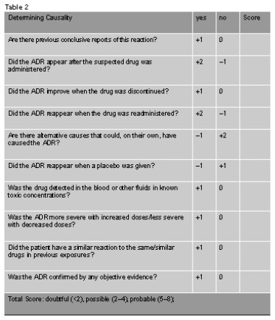
Naranjo algorithm
Notes:
Naranjo CA, Busto U, Sellers EM et al. (1981). "A method for estimating the probability of adverse drug reactions". Clin. Pharmacol. Ther. 30 (2): 239–45

Slide 42
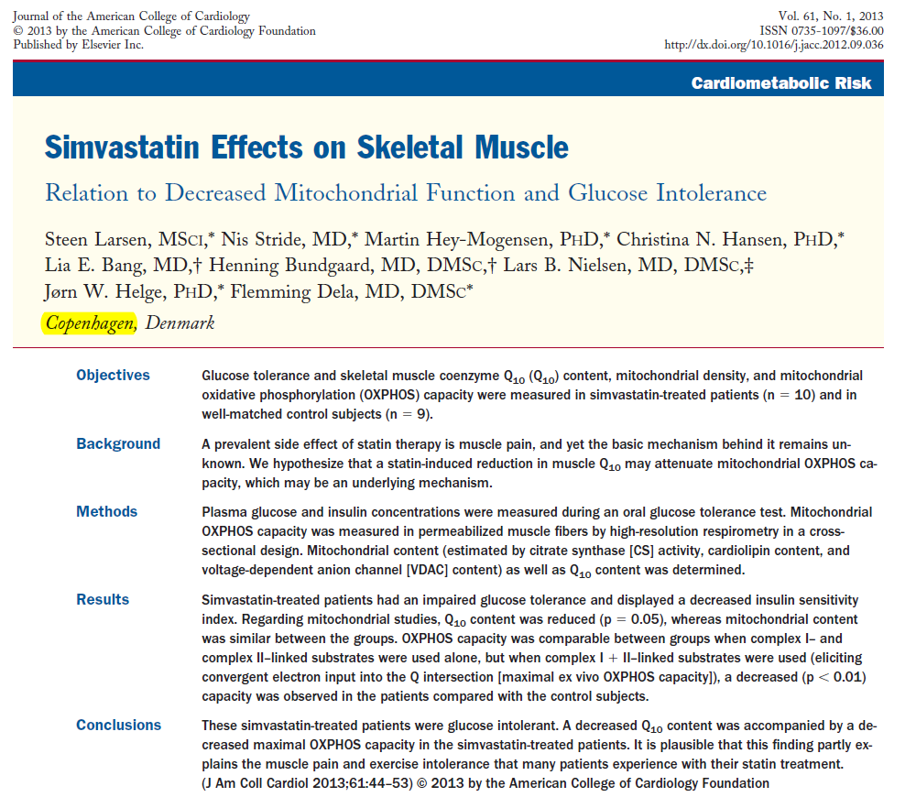

Slide 43
Simvastatin Effects on Skeletal Muscle Relation to Decreased Mitochondrial Function and Glucose Intolerance
Steen Larsen et.al. JACC 2013;61(1):44-53
Methods Plasma glucose and insulin concentrations were measured during an oral glucose tolerance test. Mitochondrial OXPHOS capacity was measured in permeabilized muscle fibers by high-resolution respirometry in a cross-sectional design. Mitochondrial content (estimated by citrate synthase [CS] activity, cardiolipin content, and voltage-dependent anion channel [VDAC] content) as well as Q10 content was determined. Average time on Simva: 5 years
Results Simvastatin-treated patients had an impaired glucose tolerance and displayed a decreased insulin sensitivity index. Regarding mitochondrial studies, Q10 content was reduced (p = 0.05), whereas mitochondrial content was similar between the groups. OXPHOS capacity was comparable between groups when complex I– and complex II–linked substrates were used alone, but when complex I + II–linked substrates were used (eliciting convergent electron input into the Q intersection [maximal ex vivo OXPHOS capacity]), a decreased (p < 0.01) capacity was observed in the patients compared with the control subjects.
Conclusions These simvastatin-treated patients were glucose intolerant. A decreased Q10 content was accompanied by a decreased maximal OXPHOS capacity in the simvastatin-treated patients. It is plausible that this finding partly explains the muscle pain and exercise intolerance that many patients experience with their statin treatment.
Notes:
mitochondrial oxidative phosphorylation (OXPHOS) capacity
Participants
Twenty male subjects were recruited to participate in the study: 10 patients with hypercholesterolemia, in medical treatment with simvastatin (10 to 40 mg/day: 10 mg/day, n = 1; 20 mg/day, n = 4; and 40 mg/day, n = 5) for at least 12 months (average: 5 years) (recruited via the Unit for Inherited Cardiac Diseases, Department of Cardiology, Rigshospitalet), and 10 healthy control subjects. The groups were matched for age, weight, body mass index, fat percentage (total and abdominal), and maximal oxygen uptake (Vo_{2MAX}) (Table 1). The patients with hypercholesterolemia took 1 dose of medication per day in the evening and did not take any other medication, and control subjects did not take any medication. Medication was not withdrawn prior to the test days. Subjects with a family history of type 2 diabetes were excluded from the study. Muscle pain was evaluated with the visual analog scale. After the subjects were recruited and the blood and skeletal muscle were analyzed, 1 of the control subjects turned out to have impaired glucose tolerance; therefore, data from this subject were omitted, leaving 9 in the control group.
In summary, we found that patients treated with simvastatin have impaired glucose tolerance compared with healthy control subjects. Furthermore, we found that skeletal muscle from patients treated long term with simvastatin displayed a decreased maximal OXPHOS capacity that may well be explained by a concomitant decrease in Q₁₀ protein content without any changes in mitochondrial content. The result is a compromised energetic state within the skeletal muscle, possibly explaining side effects such as myalgia and exercise intolerance. Finally, we have reported that simvastatin-treated patients have an increased mitochondrial substrate sensitivity when complex I substrate was used, which is a true intrinsic mitochondrial event, and we hypothesize that this could be a compensatory mechanism for increased ROS production.

Slide 44
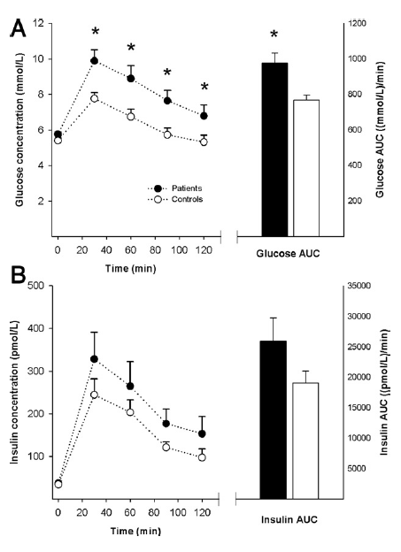
Plasma Glucose and Insulin Concentrations
During the 120-min OGTT
Larsen 2013
Notes:
Plasma glucose (A) and insulin (B) concentrations in patients with hypercholesterolemia
(soild circles and soild bars) and in control subjects (open circles
and open bars) are shown. Data are mean SE. *p 0.05 for patients
versus control subjects. AUC area under the curve; OGTT oral glucose
tolerance test

Slide 45
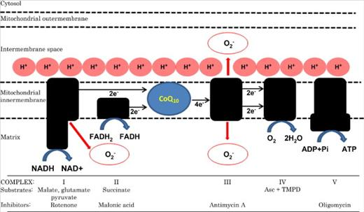
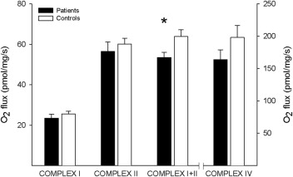
Larsen 2013
Notes:
Fig 1 (top) Simplified View of the Electron Transport Chain Illustrating the Electron Carrier Function of Q₁₀
Reactive oxygen species–producing complexes are emphasized. Below each complex is listed the substrates and inhibitors that were used. ADP = adenosine diphosphate; Asc = ascorbate; ATP = adenosine triphosphate; Pi = phosphate; Q₁₀ = coenzyme Q₁₀; TMPD = N,N,N′,N′-tetramethyl-p-phenylenediamine.
Mitochondrial OXPHOS Capacity for Complexes I, II, I + II, and IV
Oxidative phosphorylation (OXPHOS) capacity (measured as O₂ flux rates per mg tissue) in skeletal muscle from patients with hypercholesterolemia (solid bars) and control subjects (open bars) is shown. The following substrates were used: complex I: malate, glutamate, pyruvate, ADP; complex II: malate, glutamate, pyruvate, ADP, rotenone (inhibiting complex I), succinate; complex I + II: malate, glutamate, pyruvate, ADP, succinate; and complex IV: ADP, cytochrome c, antimycin A, TMPD + Asc. The y-axis to the right refers to the O₂ flux rates for complex IV. Data are mean ± SE. *p < 0.05 for patients versus control subjects. Abbreviations as in (Figure 1).
Fig 2 (bottom right)

Slide 46
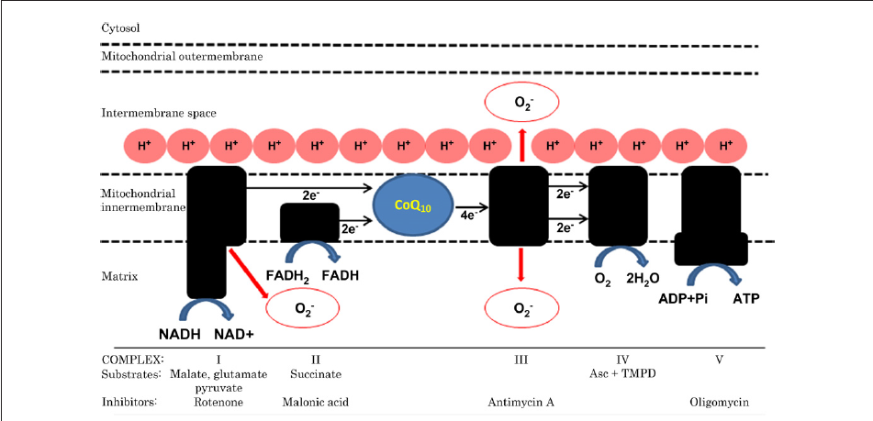
Simplified View of the Electron Transport Chain Illustrating the Electron Carrier Function of Q10
Larsen 2013
Notes:
MITOCHONDRIAL RESPIRATION. Mitochondrial respiratory capacity was measured in permeabilized skeletal muscle
fibers. The details of the procedure have been described previously (30). Briefly, all respiratory measurements were
carried out in duplicate after hyperoxygenation to avoid any potential oxygen limitation to respiration. Five different
substrate and inhibitor protocols were employed simultaneously
(Oxygraph-2k, Oroboros Instruments, Innsbruck,
Austria)

Slide 47
The decreased Q10 protein content in patients in long-term treatment with simvastatin offers a mechanistic explanation for the limitation in maximal OXPHOS capacity (Figs. 1 and 3).
This hypothesis requires further testing, but is to some extent supported by the correlation between Q10 content and maximal OXPHOS capacity, even though this correlation was not strong and has to be confirmed in other studies.
Mitochondrial oxidative phosphorylation (OXPHOS) capacity
Steen Larsen 2013

Slide 48
In summary, we found that patients treated with simvastatin have impaired glucose tolerance compared with healthy control subjects. Furthermore, we found that skeletal muscle from patients treated long term with simvastatin displayed a decreased maximal OXPHOS capacity that may well be explained by a concomitant decrease in Q10 protein content without any changes in mitochondrial content.
The result is a compromised energetic state within the skeletal muscle, possibly explaining side effects such as myalgia and exercise intolerance. Finally, we have reported that simvastatin-treated patients have an increased mitochondrial substrate sensitivity when complex I substrate was used, which is a true intrinsic mitochondrial event, and we hypothesize that this could be a compensatory mechanism for increased ROS production.
Steen Larsen 2013

Slide 49
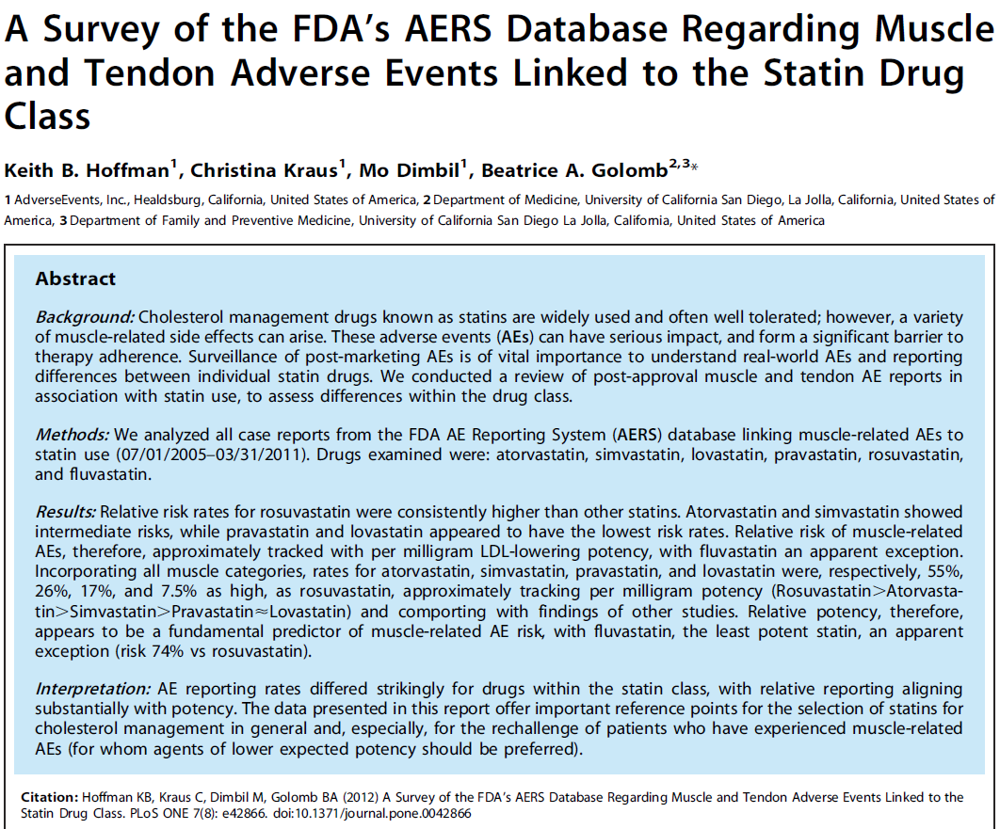
PLOS One: August 2012 | Volume 7 | Issue 8 | e42866

Slide 50
Statin Intolerance Assessment Service
Evaluation of intolerance characteristics/manifestations
Determine risk/benefit of statin
Check for risk factors: statin pharmacodynamics, other meds, ETOH, >65 yrs, eccentric exercise, hypothyroidism, vitamin D deficiency, SLCO1B1 variant, muscle ubiquinone, hypomagnesmia ,muscle disease, high distribution of fast-twitch (type II) muscle fibers, family history of intolerance
Labs: CPK, serum 25-OH D (Vit. D), thyroid hormones, plasma magnesium.
Recommendations/Rx
Notes:
Normal plasma Mg is 1.7-2.3 mg/dl (0.69-0.94 mmol/l).
1. SEARCH and STRENTH studies demonstrated high prevalence of SLCO1B1 variant.
Solute carrier organic anion transporter family member 1B1 is a protein that in humans is encoded by the SLCO1B1 gene
2. Vitamin D Deficiency is Associated With Myalgias in Hyperlipidemic Subjects Taking Statins (AHA 2008 abstract)
P. Barton Duell; William E Connor Oregon Health & Science Univ, Portland, OR.
Statin-associated myalgias were reported by 38.8% of patients. These patients had a 32% lower mean vitamin D level (20.5 vs 30.1 ng/mL, P = .0003) and were more likely to be female (68% vs 49%, P = .095). Vitamin D levels were similar in men and women (24.3 vs 28.8 ng/mL, P = .09). Deficiency was prevalent in the group (62.6% <30 ng/mL; 31.9% <20 ng/mL). Patients with myalgias were more likely to have vitamin D levels <30 ng/mL (81.3% vs 52.5%, P < .01) and <20 ng/mL (62.5% vs 18.6%, P < .01).
3. Ahmed W et.al. Transl Res. 2009 Jan;153(1):11-6. Epub 2008 Dec 6. (Cincinnati). Low serum 25 (OH) vitamin D levels (<32 ng/mL) are associated with reversible myositis-myalgia in statin-treated patients.
Our specific aims were to determine whether low serum 25 (OH) vitamin D (D2 + D3) (<32 ng/mL) was associated with myalgia in statin-treated patients and whether the myalgia could be reversed by vitamin D supplementation while continuing statins. After excluding subjects who took corticosteroids or supplemental vitamin D, serum 25 (OH) D was measured in 621 statin-treated patients, which consisted of 128 patients with myalgia at entry and 493 asymptomatic patients. The 128 myalgic patients had lower mean +/- standard deviation (SD) serum vitamin D than the 493 asymptomatic patients (28.6 +/- 13.2 vs 34.2 +/- 13.8 ng/mL, P < 0.0001), but they did not differ (p > 0.05) by age, body mass index (BMI), type 2 diabetes, or creatine kinase levels. By analysis of variance, which was adjusted for race, sex, and age, the least square mean (+/- standard error [SE]) serum vitamin D was lower in the 128 patients with myalgia than in the 493 asymptomatic patients (28.7 +/- 1.2 vs 34.3 +/- 0.6 ng/mL, P < 0.0001). Serum 25 (OH) D was low in 82 of 128 (64%) patients with myalgia versus 214 of 493 (43%) asymptomatic patients (chi(2) = 17.4, P < 0.0001). Of the 82 vitamin-D-deficient, myalgic patients, while continuing statins, 38 were given vitamin D (50,000 units/week for 12 weeks), with a resultant increase in serum vitamin D from 20.4 +/- 7.3 to 48.2 +/- 17.9 ng/mL (P < 0.0001) and resolution of myalgia in 35 (92%). We speculate that symptomatic myalgia in statin-treated patients with concurrent vitamin D deficiency may reflect a reversible interaction between vitamin D deficiency and statins on skeletal muscle.

Slide 51
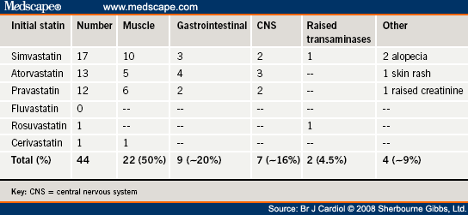
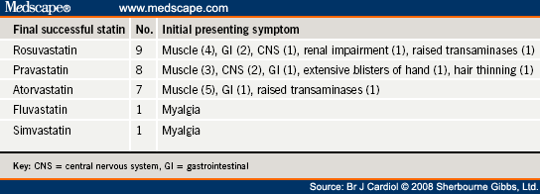
Nair R. Br J Cardiol. 2008;15(3):158-160
Notes:
Rajesh K Nair et.al.
Summary
The incidence of statin intolerance due to non-severe side effects is estimated to be 5-10%. As an increasing number of patients become eligible for lipid-lowering treatment, this is becoming a more prevalent issue. Very limited, if any, data exist so far in the management of this subgroup of patients. Clinic letters from 1,100 patients who attended the Lipid Clinic at Hull Royal Infirmary from January 2000 until December 2004 were searched for 'statin intolerance'. Forty patients (19 male, 21 female, median age 62 years) were identified with intolerance to at least one statin drug but with an absolute indication to be on treatment. Out of the 40 patients, 26 (65%, 11 male, 15 female) were eventually able to tolerate a statin for at least six months without their initial side effect, the most commonly successful statins being rosuvastatin (n=9) and pravastatin (n=8). Overall, this required a median of two switches (range one to four) in statin treatment. Fourteen (35%) were unable to continue treatment after a median of 1.5 switches (range one to three), either because of continued intolerance or a decision not to proceed with more alternatives. In conclusion, nearly two thirds of patients with initial problems with a particular statin are able to take an alternative statin without side effects. This supports the trial of different statins in intolerant patients.
Bottom slide: Of those remaining, 26 out of the 40 patients (65%; 11 male, 15 female) were eventually able to tolerate an alternate statin without the initial side effect and remained symptom and complication free in the six-month follow-up ( table 2 ). This required a median of two switches (range one to four) in statin treatment. Fourteen (35%; eight male, six female) were unable to continue statin treatment after a median of 1.5 switches (range one to three), either because of continued intolerance to other agents or a decision not to proceed with trying more alternatives.
Discussion
This is the first study to document the degree of success in switching from a poorly tolerated statin to another of the same class. We found that nearly two thirds of patients (65%) referred to a specialist clinic because of this problem eventually managed to take an alternative statin without side effects. This figure may have been still higher if more patients were willing to persevere with statin switching.
The incidence of statin intolerance in the real-world situation is thought to be between 5% and 10%,^{[2,3]} which is higher than that found in most clinical trials. Although the prevalence in our study is 4% of referrals, it is unlikely to be a true prevalence since it involves a selected population attending a specialist lipid clinic. The most common side effects reported are myalgia (prevalence up to 9%),^{[4]} non-specific gastrointestinal symptoms, headache, sleep disturbance and minor elevation in transaminases.^{[5]} Thus, the side effect profile of patients in this study is similar to that found previously. There were a higher proportion of patients with initial side effects due to simvastatin and atorvastatin, but this is likely to be a consequence of local prescribing patterns rather than an increase in problems with these particular drugs.
The reasons as to why some statins should be tolerated when others are not remain speculative. Certainly, currently prescribed statins can differ in the rate of their metabolism, with atorvastatin and rosuvastatin having particularly long half-lives. Though all statins undergo significant liver metabolism their individual pathways vary. Whereas simvastatin and atorvastatin are mainly metabolised by the cytochrome P450 isoform CYP3A4, fluvastatin utilises the CYP2C9 isoform. Rosuvastatin is not extensively metabolised except for some interaction with the CYP2C9 enzyme and is largely excreted unchanged faecally. Pravastatin is unique since it is metabolised by hepatic pathways independent of the cytochromes and has significant renal excretion. Some statins, such as pravastatin and rosuvastatin, are structurally much more hydrophilic than others so may differ in crossing cell membranes and the blood-brain barrier.^{[5]} It is of interest that the two statins that were most frequently tolerated in this study were those which are water soluble, although the number of patients involved were too small to be able to establish these as the drugs of choice in statin-intolerant patients.
In conclusion, this retrospective study supports the trial of alternative statins in patients presenting with initial intolerance due to non-severe adverse effects. Future studies may be able to identify the statin(s) of choice for this growing group of patients.

Slide 52
Prevalence of statin intolerance (circa 2008)
– 10% overall prevalence (Nair 2008)
~8.2 million people > 40 years of age use statins in the U.S.
22% of statin users report muscle pain in at least 1 anatomical region vs. 16% in non-statin users
~25% of MS pain appear to be associated with statin use (~450,000 people) (Buettner 2008)
Notes:
1. Rajesh K Nair; Rangaprasad L Karadi; Eric S Kilpatrick. Posted: Br J Cardiol. 2008;15(3):158-160.
The incidence of statin intolerance due to non-severe side effects is estimated to be 5-10%. As an increasing number of patients become eligible for lipid-lowering treatment, this is becoming a more prevalent issue. Very limited, if any, data exist so far in the management of this subgroup of patients. Clinic letters from 1,100 patients who attended the Lipid Clinic at Hull Royal Infirmary from January 2000 until December 2004 were searched for 'statin intolerance'. Forty patients (19 male, 21 female, median age 62 years) were identified with intolerance to at least one statin drug but with an absolute indication to be on treatment. Out of the 40 patients, 26 (65%, 11 male, 15 female) were eventually able to tolerate a statin for at least six months without their initial side effect, the most commonly successful statins being rosuvastatin (n=9) and pravastatin (n=8). Overall, this required a median of two switches (range one to four) in statin treatment. Fourteen (35%) were unable to continue treatment after a median of 1.5 switches (range one to three), either because of continued intolerance or a decision not to proceed with more alternatives. In conclusion, nearly two thirds of patients with initial problems with a particular statin are able to take an alternative statin without side effects. This supports the trial of different statins in intolerant patients.
This is the first study to document the degree of success in switching from a poorly tolerated statin to another of the same class. We found that nearly two thirds of patients (65%) referred to a specialist clinic because of this problem eventually managed to take an alternative statin without side effects. This figure may have been still higher if more patients were willing to persevere with statin switching.
The incidence of statin intolerance in the real-world situation is thought to be between 5% and 10%,^{[2,3]} which is higher than that found in most clinical trials. Although the prevalence in our study is 4% of referrals, it is unlikely to be a true prevalence since it involves a selected population attending a specialist lipid clinic. The most common side effects reported are myalgia (prevalence up to 9%),^{[4]} non-specific gastrointestinal symptoms, headache, sleep disturbance and minor elevation in transaminases.^{[5]} Thus, the side effect profile of patients in this study is similar to that found previously. There were a higher proportion of patients with initial side effects due to simvastatin and atorvastatin, but this is likely to be a consequence of local prescribing patterns rather than an increase in problems with these particular drugs.
The reasons as to why some statins should be tolerated when others are not remain speculative. Certainly, currently prescribed statins can differ in the rate of their metabolism, with atorvastatin and rosuvastatin having particularly long half-lives. Though all statins undergo significant liver metabolism their individual pathways vary. Whereas simvastatin and atorvastatin are mainly metabolised by the cytochrome P450 isoform CYP3A4, fluvastatin utilises the CYP2C9 isoform. Rosuvastatin is not extensively metabolised except for some interaction with the CYP2C9 enzyme and is largely excreted unchanged faecally. Pravastatin is unique since it is metabolised by hepatic pathways independent of the cytochromes and has significant renal excretion. Some statins, such as pravastatin and rosuvastatin, are structurally much more hydrophilic than others so may differ in crossing cell membranes and the blood-brain barrier.^{[5]} It is of interest that the two statins that were most frequently tolerated in this study were those which are water soluble, although the number of patients involved were too small to be able to establish these as the drugs of choice in statin-intolerant patients.
In conclusion, this retrospective study supports the trial of alternative statins in patients presenting with initial intolerance due to non-severe adverse effects. Future studies may be able to identify the statin(s) of choice for this growing group of patients.
2. Prevalence of Musculoskeletal Pain and Statin Use Catherine BuettnerJ Gen Intern Med 2008;23(8):1182–6
METHODS: Cross-sectional analysis using data from the National Health and Nutrition Examination Survey (NHANES) 1999–2002. Participants were 3,580 adults
≥40 years without arthritis who were interviewed at home and examined in a mobile examination center. Participants were asked about sociodemographic characteristics,
health conditions, medication use, and musculoskeletal pain. Height, weight, blood pressure, ankle brachial index, and cholesterol were measured.
MEASUREMENTS AND MAIN RESULTS: Prevalence and adjusted odds ratios (OR) of any musculoskeletal pain and musculoskeletal pain in 4 different anatomical
regions (neck/upper back, upper extremities, lower back, and lower extremities) by statin use during the last 30 days. Among statin users (n=402), 22.0% (95%
CI 18.0–26.7%) reported musculoskeletal pain in at least 1 anatomical region during the last 30 days, compared with 16.7% (95%CI 15.1–18.4%) of those who did not use
a statin. Compared to persons who did not use statins, those who used statins had multivariable-adjusted odds ratios (95%CI; p value) of 1.50 (1.07–2.11; p=.01) for any
musculoskeletal pain, 1.59 (1.04–2.44, p=.03) for lower back pain, and1.50 (1.02–2.22, p=.03) for lower extremity
Pain. CONCLUSION: Musculoskeletal pain is common in adults ≥40 years without arthritis. In this nationally
representative sample, statin users were significantly more likely to report musculoskeletal pain.
COMMENT: Using the NHANES-supplied sample weights, we estimate that 8.2 million individuals ≥ 40 years of age
use statins in the United States. Of these, 22% (representing 1.8 million people) report musculoskeletal pain in at least 1 anatomical region and 11% (representing 0.9 million people) report lower extremity pain in the last month. Based on the observed differences in the prevalence of pain according to
statin use (22% among statin users compared to 16.7% among non-statin users), we estimate that nearly 25% of cases of
musculoskeletal pain at any region among statin users (corresponding to 450,000 individuals) appear to be associated
with statin use. Likewise, we estimate that statins could account for approximately 45% of cases of lower extremity
pain among statin users.
3. Statin Adverse Effects: A Review of the Literature and Evidence for a Mitochondrial Mechanism Beatrice A. Golomb; Marcella A. Evans. Am J Cardiovasc Drugs. 2008;8(6):373-418.
Abstract
HMG-CoA reductase inhibitors (statins) are a widely used class of drug, and like all medications, have potential for adverse effects (AEs). Here we review the statin AE literature, first focusing on muscle AEs as the most reported problem both in the literature and by patients. Evidence regarding the statin muscle AE mechanism, dose effect, drug interactions, and genetic predisposition is examined. We hypothesize, and provide evidence, that the demonstrated mitochondrial mechanisms for muscle AEs have implications to other nonmuscle AEs in patients treated with statins. In meta-analyses of randomized controlled trials (RCTs), muscle AEs are more frequent with statins than with placebo. A number of manifestations of muscle AEs have been reported, with rhabdomyolysis the most feared. AEs are dose dependent, and risk is amplified by drug interactions that functionally increase statin potency, often through inhibition of the cytochrome P450 3A4 system. An array of additional risk factors for statin AEs are those that amplify (or reflect) mitochondrial or metabolic vulnerability, such as metabolic syndrome factors, thyroid disease, and genetic mutations linked to mitochondrial dysfunction. Converging evidence supports a mitochondrial foundation for muscle AEs associated with statins, and both theoretical and empirical considerations suggest that mitochondrial dysfunction may also underlie many nonmuscle statin AEs. Evidence from RCTs and studies of other designs indicates existence of additional statin-associated AEs, such as cognitive loss, neuropathy, pancreatic and hepatic dysfunction, and sexual dysfunction. Physician awareness of statin AEs is reportedly low even for the AEs most widely reported by patients. Awareness and vigilance for AEs should be maintained to enable informed treatment decisions, treatment modification if appropriate, improved quality of patient care, and reduced patient morbidity.
4. Bruckert E. Mild to Moderate Muscular Symptoms with High-Dosage Statin Therapy in Hyperlipidemic Patients —The PRIMO Study. Cardiovascular Drugs & Therapy 2005;19:403. (Paris)
Objectives: To characterize the risk factors, rate of occurrence, onset, nature and impact of mild to moderate muscular symptoms with high-dosage HMG-CoA reductase inhibitor (statin) therapy in general practice. Methods: The Prédiction du Risque Musculaire en Observationnel (Prediction of Muscular Risk in Observational conditions, PRIMO) survey was an observational study of muscular symptoms in an unselected population of 7924 hyperlipidemic patients receiving high-dosage statin therapy in a usual care, outpatient setting in France. Information on patient demographics, treatment history and muscular symptoms was obtained by question-naires.
Results: Multivariate analysis revealed the strongest predictors for muscular symptoms to be a personal history of muscle pain during lipid-lowering therapy (odds ratio, OR, 10.12, 95% CI 8.23–12.45; P < 0.0001), unexplained cramps (OR 4.14; 95% CI 3.46–4.95; P < 0.0001) and a history of creatine kinase (CK) elevation (OR 2.04; 95% CI 1.55–2.68; P < 0.0001). Overall, muscular symptoms were reported by 832 patients (10.5%), with a median time of onset of 1 month following initiation of statin therapy. Muscular pain prevented even moderate exertion during everyday activities in 315 patients (38%), while 31 (4%) were confined to bed or unable to work. Fluvastatin XL was associated with the lowest rate of muscular symptoms (5.1%) among individual statins.
PRIMO demonstrated that mild to moderate muscular symptoms with high-dosage statin therapy may be more common and exert a greater impact on everyday lives than previously thought. Knowledge of the risk factors for muscular symptoms will allow identification and improved management of high-risk patients. The risk of muscular symptoms with fluvastatin XL treatment may be lower than with high dosages of other statins.

Slide 53
Muscle Manifestations of Statin-related Myalgia
n=832/7924
Widespread Pain | % of Patients
Yes | 60
No | 28
Site of Pain
Thighs/calves | 26
Calves | 17
Thighs | 10
All over | 24
Trunk | 8
Arm | 8
Brucket E Cardiovasc Drug Ther 2005;19:403
Notes:
4. Bruckert E. Mild to Moderate Muscular Symptoms with High-Dosage Statin Therapy in Hyperlipidemic Patients —The PRIMO Study. Cardiovascular Drugs & Therapy 2005;19:403. (Paris)
Objectives: To characterize the risk factors, rate of occurrence, onset, nature and impact of mild to moderate muscular symptoms with high-dosage HMG-CoA reductase inhibitor (statin) therapy in general practice. Methods: The Prédiction du Risque Musculaire en Observationnel (Prediction of Muscular Risk in Observational conditions, PRIMO) survey was an observational study of muscular symptoms in an unselected population of 7924 hyperlipidemic patients receiving high-dosage statin therapy in a usual care, outpatient setting in France. Information on patient demographics, treatment history and muscular symptoms was obtained by question-naires.
Results: Multivariate analysis revealed the strongest predictors for muscular symptoms to be a personal history of muscle pain during lipid-lowering therapy (odds ratio, OR, 10.12, 95% CI 8.23–12.45; P < 0.0001), unexplained cramps (OR 4.14; 95% CI 3.46–4.95; P < 0.0001) and a history of creatine kinase (CK) elevation (OR 2.04; 95% CI 1.55–2.68; P < 0.0001). Overall, muscular symptoms were reported by 832 patients (10.5%), with a median time of onset of 1 month following initiation of statin therapy. Muscular pain prevented even moderate exertion during everyday activities in 315 patients (38%), while 31 (4%) were confined to bed or unable to work. Fluvastatin XL was associated with the lowest rate of muscular symptoms (5.1%) among individual statins.
PRIMO demonstrated that mild to moderate muscular symptoms with high-dosage statin therapy may be more common and exert a greater impact on everyday lives than previously thought. Knowledge of the risk factors for muscular symptoms will allow identification and improved management of high-risk patients. The risk of muscular symptoms with fluvastatin XL treatment may be lower than with high dosages of other statins.

Slide 54
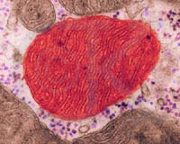
High-dose statins and skeletal muscle metabolism in humans: a randomized, controlled trial.
Paiva H et. al. Clin Pharmacol Ther. 2005 Jul;78(1):60-8. Finland.
Effects of high-dose statin treatment on cholesterol and ubiquinone metabolism and mitochondrial function in human skeletal muscle.
N=48 patients with hypercholesterolemia (33 men and 15 women) were randomly assigned to receive 80 mg/d of simvastatin (n = 16), 40 mg/d of atorvastatin (n = 16), or placebo (n = 16) for 8 weeks. Plasma samples and muscle biopsy specimens were obtained at baseline and at the end of the follow-up.
RESULTS: The ratio of plasma lathosterol to cholesterol, a marker of endogenous cholesterol synthesis, decreased significantly by 66% in both statin groups. Muscle campesterol concentrations increased from 21.1 to 41.2 nmol/g in the simvastatin group and from 22.6 to 40.0 nmol/g in the atorvastatin group (P = .005).
 The muscle ubiquinone concentration was reduced significantly from 39.7 to 26.4 nmol/g (P = .031) in the simvastatin group, but no reduction was observed in the atorvastatin or placebo group.

Slide 55
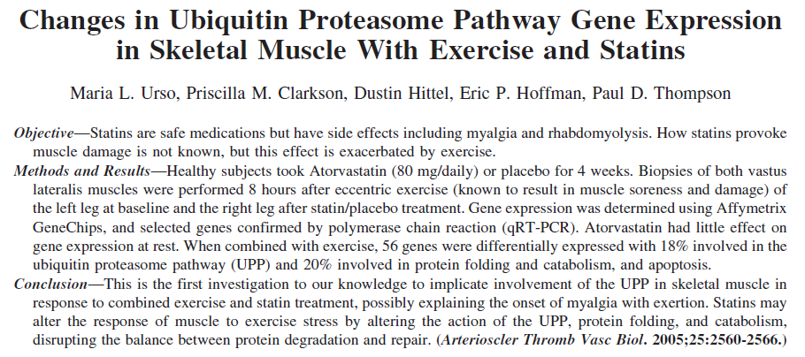
Notes:
Eccentric Exercise
To perform the 300 1-leg, eccentric (muscle-lengthening) contractions, 14 subjects lowered themselves into a mechanical chair using
only the exercised leg. Once seated, the subject was assisted to the standing position by the mechanical chair. Each eccentric action took
four seconds, and the entire exercise lasted 30 minutes.
Blood Samples and Muscle Biopsy Procedure
Blood samples were taken from an antecubital vein after a 10-hour fast before and after statin or placebo treatment and analyzed for
serum cholesterol, LDL cholesterol, high-density lipoprotein (HDL) cholesterol, triglycerides, and CK levels. Muscle biopsies were
performed using a Bergstrom 5-mm biopsy needle with applied suction. Skin was first anesthetized with lidocaine, and a small
incision was made in the skin and fascia. The biopsy needle was inserted and 100 mg of tissue removed, rapidly frozen in liquid
nitrogen (LN2), and stored at 80°. The time point of 8 hours after exercise…
This study examined gene expression changes in response to exercise and statin treatment in eight volunteers. There are 4
primary findings from the microarray experiment. First, there was little difference in global gene expression between the
nonexercised legs in placebo subjects. Second, eccentric exercise alone increased the expression of many genes,
especially those involved in cell cycle, growth and transcription.
These results are similar to a previous study in our laboratory that used a similar eccentric exercise model in the
leg.14 Third, statin treatment without exercise produced little alteration in gene expression. And fourth, statin treatment
plus exercise produced substantial changes in gene expression compared with statin treatment alone or exercise alone;
this analysis showed that statin plus exercise considerably affected the UPP (Figure 1b). This finding is significant
because the UPP is tightly regulated and responsible for the recognition and degradation of the majority of proteins in
skeletal muscle. Because the UPP has not been identified as being altered by statin treatment, we chose to further explore
this important muscle protein regulatory pathway using
qRT-PCR.
In response to eccentric exercise alone, 34% of the gene
alterations were related to cell cycle/growth and transcription,
whereas only 8% were related to the UPP (Figure 1a).
Eccentric exercise has previously been shown to induce the
upregulation of genes involved in regeneration and repair and
result in an overall gene expression profile indicative of
protein accumulation. Thus, there is a distinct transcriptional
profile in skeletal muscle in response to eccentric exercise,
which is characterized by the expression of genes involved in
the progression of the cell cycle. In contrast, in response to
disuse, denervation, and muscle damage, previous studies
have found that mRNAs for the expression of UPP components
are increased 2- to 3-fold, reflecting an increased rate of
protein breakdown.20
In conclusion, our study suggests that FBXO3 and other
members of the UPP are transcriptionally activated in response
to statins plus exercise, but are not induced by statins
or exercise alone. Further studies are needed to determine the
specificity of upregulation of the alternatively spliced isoform
of FBXO3 for statins plus exercise. However, our data
suggest that this isoform of FBXO3 is a strong candidate gene
for mediating statin plus exercise alterations of muscle
ubiquitin ligase machinery. Moreover, the role of FBXO3,
and its relationship to the better-studied FBX32 (Atrogin-1)
protein requires detailed study.

Slide 56
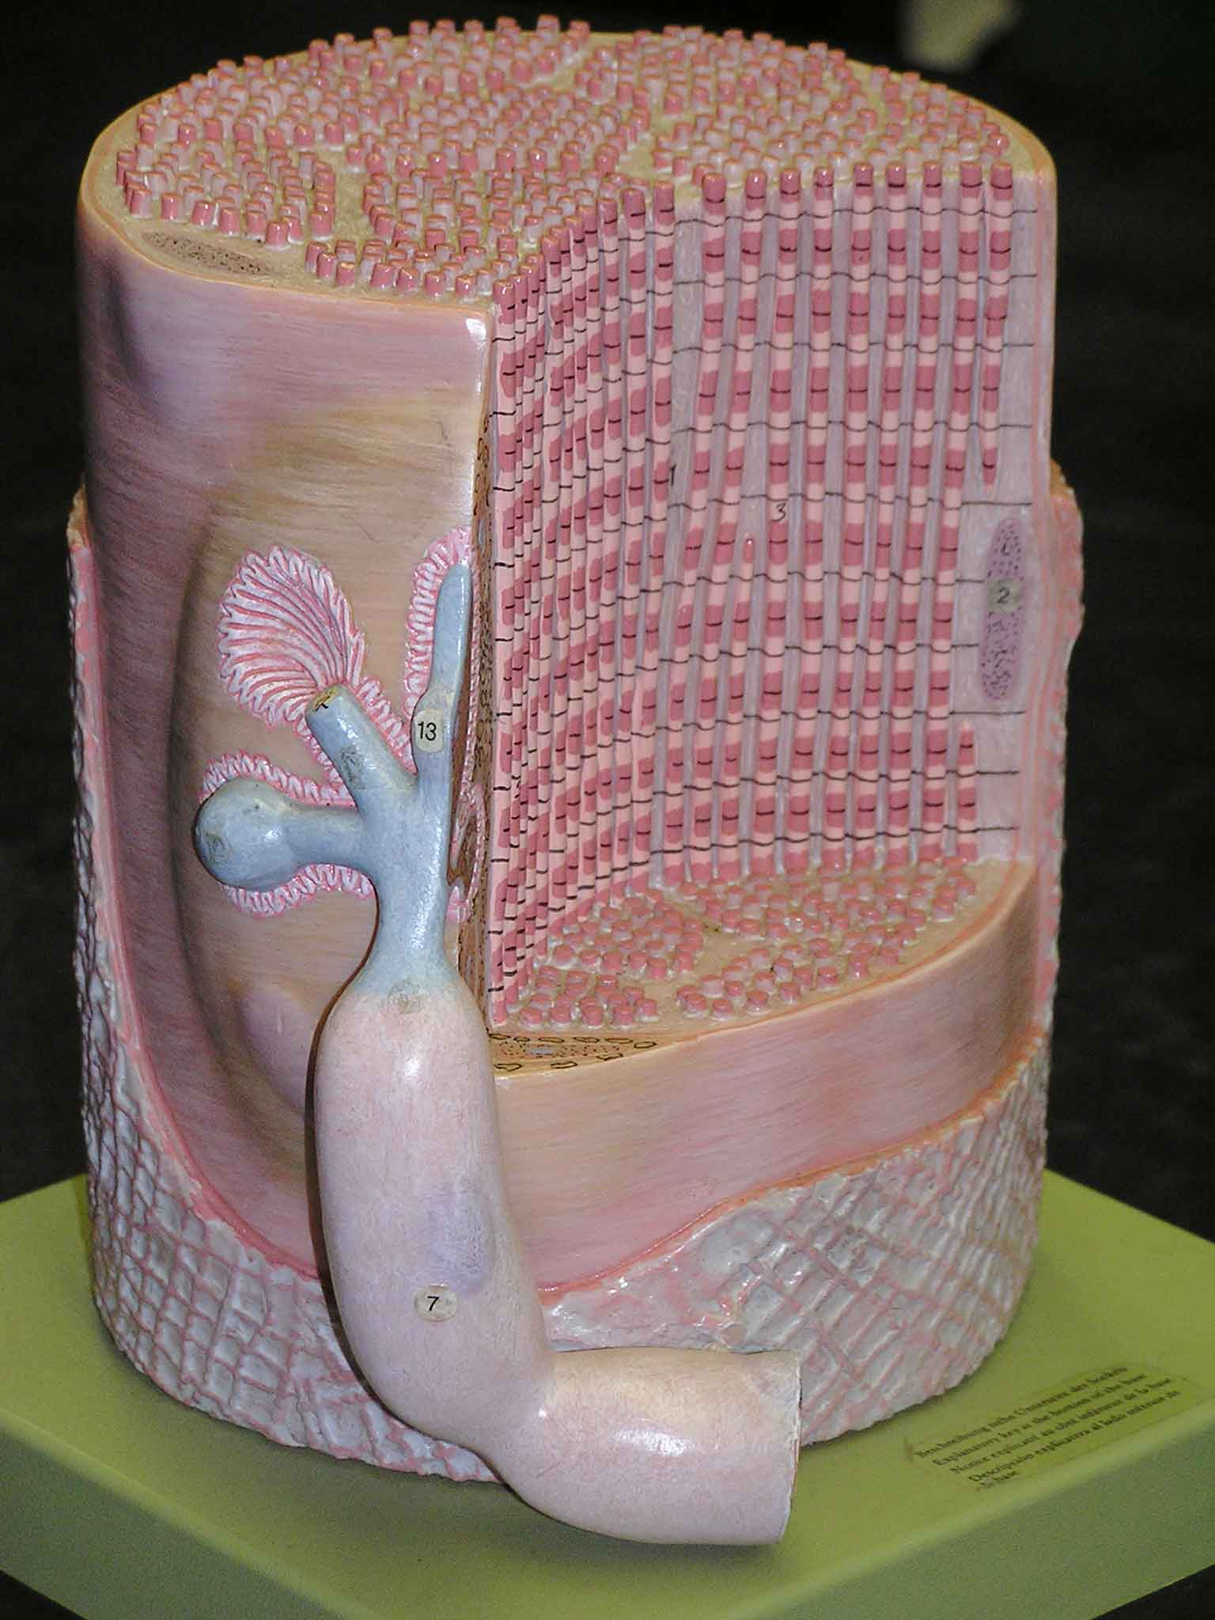
“We hypothesize that instability of the sarcolemmal membrane may be an effect of statin treatment, and when the integrity of the membrane is challenged is response to a bout of eccentric exercise, proteolytic cascades are activated in muscle.
This would explain the increase in the number of genes in protein catabolism (UPP) as well as lend support to the increase in the UPP genes.”
Urso ML, Thompson PD, Clarkson P. et. al. ATVB 2005;25:2560 Umass

Slide 57
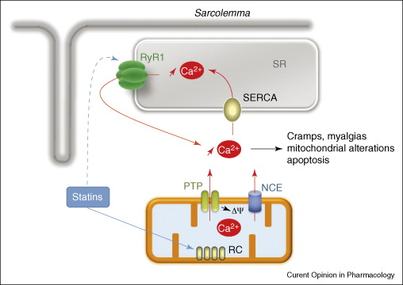
Sirvent 2008
Notes:
From: New insights into mechanisms of statin-associated myotoxicity. Pascal Sirvent ^{et.al.} Current Opinion in Pharmacology, Volume 8, Issue 3, June 2008, Pages 333–338
A possible direct physiopathological effect of statins. Although statin myotoxycity may occur through the reduction of cholesterol synthesis, a direct effect of statins has been reported in vitro and in vivo in muscle fibers from both animal and human models. This diagram summarizes some of the most recent data suggesting a physiopathological mechanism. Statins diffuse into muscle fibers and inhibit complex I of the mitochondrial respiratory chain (RC). This depolarizes the inner membrane (Δψ) triggering a calcium release through the permeability transient pore (PTP) and sodium calcium exchanger (NCE). This results in a first elevation of cytoplasmic calcium that will be partially uptaken by the sarcoendoplasmic reticulum calcium pump (SERCA) to the sarcoplasmic reticulum (SR). When overloaded, SR may spontaneously release calcium through the ryanodine receptor (RyR1) to generate a calcium wave. A direct effect of statins on RyR1 may not be excluded (dotted line). Impaired mitochondrial function and consequently calcium signaling may account for muscle symptoms.

Slide 58
Statin therapy depresses fat metabolism in older individuals.
Limprasertkul A, Fisher NM, Awad AB, Pendergast DRJ Am Coll Nutr. 2012 Feb;31(1):32-8.
METHODS: A total of 14 elderly patients (71 ± 6 years) on statin therapy were compared with 14 matched elderly controls (75 ± 7 years). Subjects were tested for respiratory exchange ratio (RER) during both maximal and submaximal sustained (70% Vo(2max)) exercise to voluntary exhaustion. Blood samples were drawn for lipoprotein analysis and substrate availability.
RESULTS: RER was significantly higher in subjects taking statins during both the max and submax tests, indicating reduced fat oxidation. Blood lipoprotein levels after a fast were not different between the statin and control groups. Levels of glucose, lactate, or triglyceride were not different between groups; however, free fatty acid levels were elevated by exercise in the statin group. Fat oxidation was significantly reduced in older subjects taking statin drugs that were not associated with diet, exercise, and fitness, which were matched between groups, nor availability of fat from the blood, which was higher in the statin group.
CONCLUSION: Although statin therapy normalizes blood lipoproteins, it reduced fat metabolism in older individuals, which cannot be a result of lower availability from blood.
Notes:
Source
Department of Exercise and Nutrition Sciences, University at Buffalo, New York 14214, USA.
Abstract
OBJECTIVE:
Statins (3-hydroxy-3-methylglutaryl coenzyme A [HMG CoA] reductase inhibitors) reduce blood lipoproteins and reduce the risk of cardiovascular events. However, they may reduce fat metabolism. This study tested the hypothesis that total body fat oxidation is reduced by statinsin older subjects and the reduction is not due to substrate availability.

Slide 59
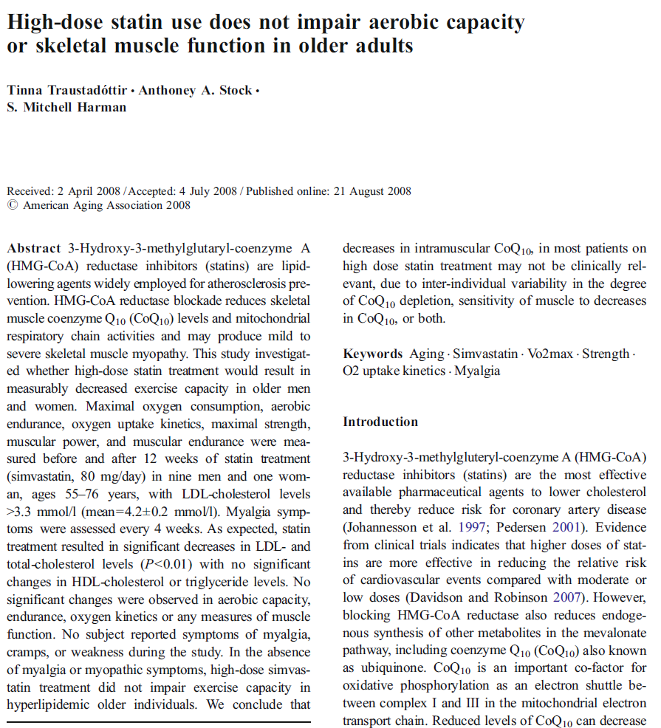
AGE (2008) 30:283–291
Notes:
Kronos Longevity Research Institute, 2390 E. Camelback Rd, Suite 440,
Phoenix, AZ 85016, USA
e-mail: tinna.traustadottir@kronosinstitute.org
Study population We recruited 12 healthy men and women, ages 55–
76 years for this pilot study. Criteria for inclusion included LDL-cholesterol levels above 3.3 mmol/l
(130 mg/dl), not overly obese as determined by body mass index (BMI)<32 kg/m2, no contraindications to
exercise testing, and not currently on any cholesterollowering medications.
Of 12 subjects enrolled, two were excluded from participation, one due to a borderline-positive stress test
at screening and the other due to a BMI>32. Thus, ten subjects completed the study, nine men and one
woman.
Before and after 12 weeks of testing
Maximal oxygen consumption (VO2 max) Maximal aerobic capacity was measured using a graded
exercise test (GXT). The GXT was performed on an electronically-braked stationary cycle ergometer
(Ergoline 900) with an integrated metabolic measurement cart (SensorMedics Vmax Series 229, Yorba
Linda, Calif.) that measured oxygen uptake via opencircuit indirect calorimetry throughout the test. A
continuous 12-lead EKG (Marquette CardioSoft, Milwaukee, Wis.) was recorded, and blood pressure was
measured every 3 min throughout exercise and recovery (SunTech Tango, Raleigh, N.C.). The initial
workload during the GXT was 15 or 20 W (chosen based on the individual’s predicted maximal workload
so that the test would be completed in 7–12 min), followed by an incremental increase in workload (same
watts as the initial workload) every minute thereafter until the subject was at a point of volitional fatigue.
Maximal oxygen uptake was considered to be achieved if two of the following three criteria were met: (1) a plateau in VO2 with an increase in workload, (2) a respiratory
exchange ratio (RER) ≥1.10 or (3) heart rate within ten beats of the age-predicted maximal heart rate
(Kohrt et al. 1991). Standard contraindications to exercise testing and termination criteria as outlined by the ACSM were followed (American College of Sports Medicine 1991).
Maximal muscle strength (1-RM)
Maximal strength via a standard one-repetition maximum (1-RM) test was determined for upper and lower
body using a Keiser pneumatic bi-axial chest press and seated leg press fitted…
Muscle power output
After re-assessing 1-RM, power output for each subject was determined using the Keiser pneumatic bi-axial
chest press and seated leg press previously described. Power was determined at 30%, 40%, 50%, 60%, and
70% 1-RM for the chest press and 40%, 50%, 60%, 70% and 80% 1-RM for the leg press
High-intensity muscular endurance
Each subject performed as many repetitions as possible, through a full range of motion, at a workload set to
80% of 1-RM for the leg press and 70% of 1-RM for chest press. Failure to complete the full range of
motion for two consecutive repetitions ended the test. The number of repetitions completed was used as a
marker of muscular endurance.

Slide 60
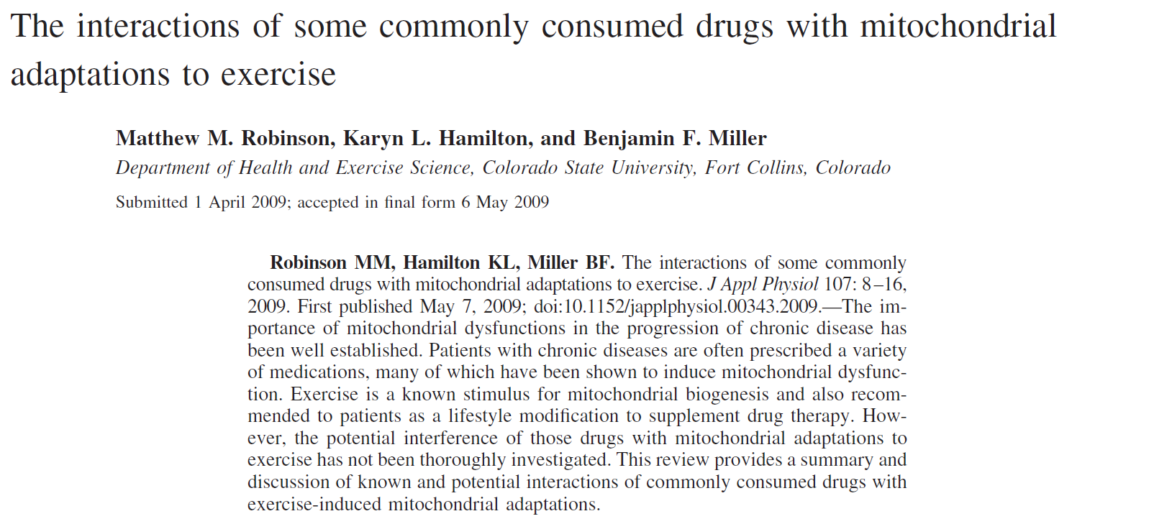
J Appl Physiol 107: 8–16, 2009.
Statins have the potential to adversely affect aerobic exercise tolerance, possibly through impaired mitochondrial function, decreased mitochondrial content, and apoptotic pathways.
Notes:
The alterations to mitochondrial content and function discussed above likely play a role in contributing to skeletal myopathies that can occur during statin therapy. The known
side effects of muscle pain and weakness can impair mobility or exercise capacity and may hinder functional capacity of patients. Indeed, leg strength was reduced in four older patients while on statin therapy, but improved within 2 wk of stopping treatment (47). On return to treatment, each patient reported
muscle pain and weakness again. The effect of four different statin treatments on muscle pain and weakness has also been
evaluated in professional athletes with familial hypercholesterolaemia (Sinzinger H, O’Grady J. Professional athletes suffering from familial
hypercholesterolaemia rarely tolerate statin treatment because of muscular problems. Br J Clin Pharmacol 57: 525–528, 2004.).
Out of 22 athletes, 16 were not able to tolerate statin treatment of any form due to adverse muscle symptoms. These were relieved in 1–3 wk following removal of treatment
and indicate statins can induce muscle myopathy in athletes.
In summary, statins have the potential to adversely affect aerobic exercise tolerance, possibly through impaired mitochondrial
function, decreased mitochondrial content, and apoptotic pathways. Although clinically serious myopathies are rare
side effects of statin therapy, minor impairments to mitochondrial function that do not elicit severe symptoms could hinder
mitochondrial adaptations to aerobic exercise. Thus mitochondrial adaptations, which are a primary response to aerobic
exercise, could be limited in patients who are consuming statins.

Slide 61
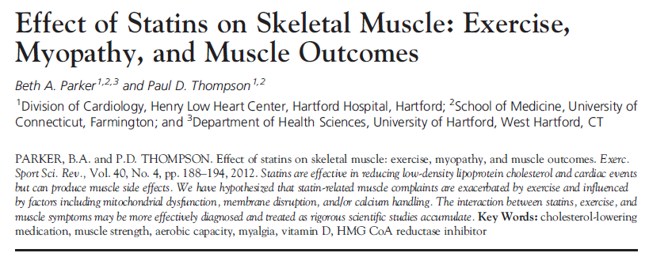

Slide 62
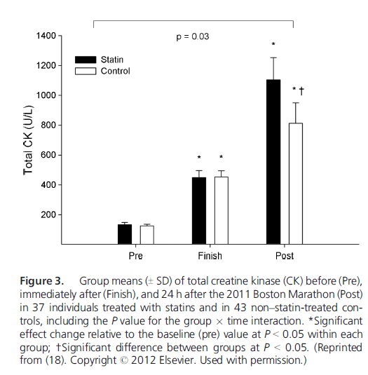
Parker/Thompson 2012

Slide 63
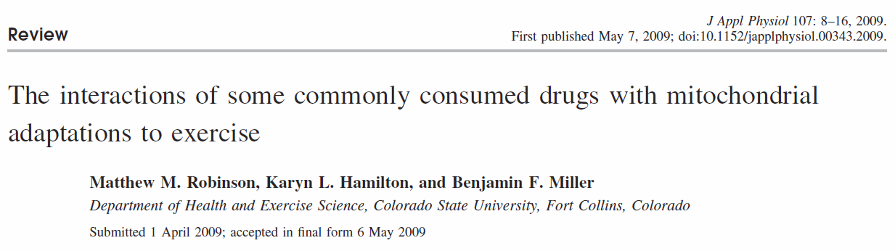
Drugs such as -blockers and statins that are commonly prescribed for their treatment have the potential to limit the beneficial effects of exercise on mitochondria. Similarly, NSAIDs used to ameliorate postexercise pain or decrease cardiovascular disease risk may also impact skeletal muscle recovery from exercise.
Notes:
References:
1. Ades PA, Gunther PG, Meyer WL, Gibson TC, Maddalena J, Orfeo
T. Cardiac and skeletal muscle adaptations to training in systemic hypertension
and effect of beta blockade (metoprolol or propranolol). Am J
Cardiol 66: 591–596, 1990.
2. Appelkvist EL, Aberg F, Guan Z, Parmryd I, Dallner G. Regulation of
coenzyme Q biosynthesis. Molecular Aspects of Medicine 15, Suppl:
s37–s46, 1994.
3. Baker JG. The selectivity of beta-adrenoceptor antagonists at the human
beta1, beta2 and beta3 adrenoceptors. Br J Pharmacol 144: 317–322,
2005.
4. Balaban RS, Nemoto S, Finkel T. Mitochondria, oxidants, and aging.
Cell 120: 483–495, 2005.
5. Blanco-Colio LM, Villa A, Ortego M, Hernandez-Presa MA, Pascual
A, Plaza JJ, Egido J. 3-Hydroxy-3-methyl-glutaryl coenzyme A reductase
inhibitors, atorvastatin and simvastatin, induce apoptosis of vascular
smooth muscle cells by downregulation of Bcl-2 expression and Rho A
prenylation. Atherosclerosis 161: 17–26, 2002.
6. Bogacka I, Xie H, Bray GA, Smith SR. Pioglitazone induces mitochondrial
biogenesis in human subcutaneous adipose tissue in vivo. Diabetes
54: 1392–1399, 2005.
7. Breyer RM, Bagdassarian CK, Myers SA, Breyer MD. Prostanoid
receptors: subtypes and signaling. Annu Rev Pharmacol Toxicol 41:
661–690, 2001.
8. Bruckert E, Hayem G, Dejager S, Yau C, Begaud B. Mild to moderate
muscular symptoms with high-dosage statin therapy in hyperlipidemic
patients–the PRIMO study. Cardiovasc Drugs Ther 19: 403–414, 2005.
9. Chandrasekharan NV, Dai H, Roos KL, Evanson NK, Tomsik J, Elton
TS, Simmons DL. COX-3, a cyclooxygenase-1 variant inhibited by
acetaminophen and other analgesic/antipyretic drugs: cloning, structure,
and expression. Proc Natl Acad Sci USA 99: 13926–13931, 2002.
10. Chicco AJ, Sparagna GC. Role of cardiolipin alterations in mitochondrial
dysfunction and disease. Am J Physiol Cell Physiol 292: C33–C44,
2007.
11. Chobanian AV, Bakris GL, Black HR, Cushman WC, Green LA, Izzo
JL Jr, Jones DW, Materson BJ, Oparil S, Wright JT Jr, Roccella EJ.
The Seventh Report of the Joint National Committee on Prevention,
Detection, Evaluation, and Treatment of High Blood Pressure: the JNC 7
report. JAMA 289: 2560–2572, 2003.
12. Cover C, Mansouri A, Knight TR, Bajt ML, Lemasters JJ, Pessayre
D, Jaeschke H. Peroxynitrite-induced mitochondrial and endonucleasemediated
nuclear DNA damage in acetaminophen hepatotoxicity. J Pharmacol
Exp Ther 315: 879–887, 2005.
13. Davidson M, McKenney J, Stein E, Schrott H, Bakker-Arkema R,
Fayyad R, Black D. Comparison of one-year efficacy and safety of
atorvastatin versus lovastatin in primary hypercholesterolemia. Atorvastatin
Study Group I. Am J Cardiol 79: 1475–1481, 1997.
14. Dawkins PD, Gould BJ, Smith MJ. Inhibitory effect of salicylate on the
incorporation of L-(U-14C)leucine into the protein of rat tissue preparations
in vitro. Biochem J 99: 703–707, 1966.
15. Demyanets S, Kaun C, Pfaffenberger S, Hohensinner PJ, Rega G,
Pammer J, Maurer G, Huber K, Wojta J. Hydroxymethylglutarylcoenzyme
A reductase inhibitors induce apoptosis in human cardiac
myocytes in vitro. Biochem Pharmacol 71: 1324–1330, 2006.
16. Dikshit P, Chatterjee M, Goswami A, Mishra A, Jana NR. Aspirin
induces apoptosis through the inhibition of proteasome function. J Biol
Chem 281: 29228–29235, 2006.
17. Dykens JA, Will Y. Drug-induced Mitochondrial Dysfunction. Hoboken,
NJ: Wiley, 2008, p. xvii, 612, 616.
18. Elmberger PG, Kalen A, Lund E, Reihner E, Eriksson M, Berglund L,
Angelin B, Dallner G. Effects of pravastatin and cholestyramine on
products of the mevalonate pathway in familial hypercholesterolemia. J
Lipid Res 32: 935–940, 1991.
19. Hanai J, Cao P, Tanksale P, Imamura S, Koshimizu E, Zhao J, Kishi
S, Yamashita M, Phillips PS, Sukhatme VP, Lecker SH. The musclespecific
ubiquitin ligase atrogin-1/MAFbx mediates statin-induced muscle
toxicity. J Clin Invest 117: 3940–3951, 2007.
20. Haskell WL, Lee IM, Pate RR, Powell KE, Blair SN, Franklin BA,
Macera CA, Heath GW, Thompson PD, Bauman A. Physical activity
and public health: updated recommendation for adults from the American
College of Sports Medicine and the American Heart Association. Circulation
116: 1081–1093, 2007.

Slide 64
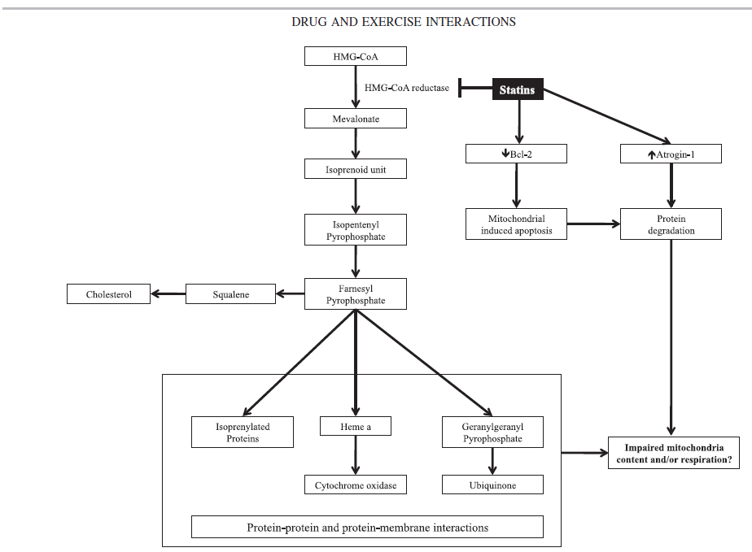
Robinson 2009
Notes:
Statin-induced skeletal myopathies may originate with mitochondrial dysfunction. The decreased flux through the cholesterol biosynthesis pathway with
statin therapy can impair production of necessary components of the electron transport chain, including isoprenylated proteins (for membrane attachment), heme
A (necessary for complex-IV), and ubiquinone (electron shuttle). Statins may also negatively affect mitochondria by increasing apoptosis [via B-cell
CLL/lymphoma 2 (Bcl-2)] and protein degradation (via atrogin-1). A combination of diminished functional respiratory chain components and proapoptotic
environment can lead to statin-induced mitochondrial dysfunction. HMG-CoA, 3-hydroxy-3-methylglutaryl coenzyme A.

Slide 65
While statin treatments are considered free of serious side effects (death, severe functionally impairment), epidemiological data have shown 10% of patients on statins (40–80 mg/day) report at least mild muscular symptoms after 1 mo of beginning therapy (8). Additionally, 38% of those with symptoms reported pain with moderate exertion during activities of daily living (8).
Biopsy samples from four patients with statin-associated myopathy revealed histological evidence for mitochondrial dysfunction, including ragged red fibers, negative staining for cytochrome-c oxidase, and increased lipid accumulation.
Robinson 2009
Notes:
21. Hiona A, Leeuwenburgh C. The role of mitochondrial DNA mutations in
aging and sarcopenia: implications for the mitochondrial vicious cycle
theory of aging. Exp Gerontol 43: 24–33, 2008.
22. Holloszy JO. Biochemical adaptations in muscle. Effects of exercise on
mitochondrial oxygen uptake and respiratory enzyme activity in skeletal
muscle. J Biol Chem 242: 2278–2282, 1967.
23. Hood DA. Invited Review: contractile activity-induced mitochondrial
biogenesis in skeletal muscle. J Appl Physiol 90: 1137–1157, 2001.
24. Horsley V, Pavlath GK. Prostaglandin F2(alpha) stimulates growth of
skeletal muscle cells via an NFATC2-dependent pathway. J Cell Biol 161:
111–118, 2003.
25. Ji LL, Lennon DL, Kochan RG, Nagle FJ, Lardy HA. Enzymatic
adaptation to physical training under beta-blockade in the rat. Evidence of
a beta 2-adrenergic mechanism in skeletal muscle. J Clin Invest 78:
771–778, 1986.
26. Joseph AM, Pilegaard H, Litvintsev A, Leick L, Hood DA. Control of
gene expression and mitochondrial biogenesis in the muscular adaptation
to endurance exercise. Essays Biochem 42: 13–29, 2006.
27. Kearney PM, Whelton M, Reynolds K, Muntner P, Whelton PK, He
J. Global burden of hypertension: analysis of worldwide data. Lancet 365:
217–223, 2005.
28. Kim JY, Hickner RC, Cortright RL, Dohm GL, Houmard JA. Lipid
oxidation is reduced in obese human skeletal muscle. Am J Physiol
Endocrinol Metab 279: E1039–E1044, 2000.
29. Kim JA, Wei Y, Sowers JR. Role of mitochondrial dysfunction in insulin
resistance. Circ Res 102: 401–414, 2008.
30. Krause MM, Brand MD, Krauss S, Meisel C, Vergin H, Burmester
GR, Buttgereit F. Nonsteroidal antiinflammatory drugs and a selective
cyclooxygenase 2 inhibitor uncouple mitochondria in intact cells. Arthritis
Rheum 48: 1438–1444, 2003.
31. Laaksonen R, Jokelainen K, Laakso J, Sahi T, Harkonen M, Tikkanen
MJ, Himberg JJ. The effect of simvastatin treatment on natural
antioxidants in low-density lipoproteins and high-energy phosphates and
ubiquinone in skeletal muscle. Am J Cardiol 77: 851–854, 1996.
32. Laaksonen R, Jokelainen K, Sahi T, Tikkanen MJ, Himberg JJ.
Decreases in serum ubiquinone concentrations do not result in reduced
levels in muscle tissue during short-term simvastatin treatment in humans.
Clin Pharmacol Ther 57: 62–66, 1995.
33. Lamperti C, Naini AB, Lucchini V, Prelle A, Bresolin N, Moggio M,
Sciacco M, Kaufmann P, DiMauro S. Muscle coenzyme Q10 level in
statin-related myopathy. Arch Neurol 62: 1709–1712, 2005.
34. Leick L, Wojtaszewski JF, Johansen ST, Kiilerich K, Comes G,
Hellsten Y, Hidalgo J, Pilegaard H. PGC-1 is not mandatory for
exercise- and training-induced adaptive gene responses in mouse skeletal
muscle. Am J Physiol Endocrinol Metab 294: E463–E474, 2008.
35. Lin J, Handschin C, Spiegelman BM. Metabolic control through the
PGC-1 family of transcription coactivators. Cell Metab 1: 361–370, 2005.
36. Lin J, Wu PH, Tarr PT, Lindenberg KS, St-Pierre J, Zhang CY,
Mootha VK, Jager S, Vianna CR, Reznick RM, Cui L, Manieri M,
Donovan MX, Wu Z, Cooper MP, Fan MC, Rohas LM, Zavacki AM,
Cinti S, Shulman GI, Lowell BB, Krainc D, Spiegelman BM. Defects
in adaptive energy metabolism with CNS-linked hyperactivity in PGC-1
alpha null mice. Cell 119: 121–135, 2004.
37. Lopez-Lluch G, Hunt N, Jones B, Zhu M, Jamieson H, Hilmer S,
Cascajo MV, Allard J, Ingram DK, Navas P, de Cabo R. Calorie
restriction induces mitochondrial biogenesis and bioenergetic efficiency.
Proc Natl Acad Sci USA 103: 1768–1773, 2006.
38. Mann D, Reynolds K, Smith D, Muntner P. Trends in statin use and
low-density lipoprotein cholesterol levels among US adults: impact of the
2001 National Cholesterol Education Program guidelines. Ann Pharmacother
42: 1208–1215, 2008.
39. Menshikova EV, Ritov VB, Fairfull L, Ferrell RE, Kelley DE, Goodpaster
BH. Effects of exercise on mitochondrial content and function in
aging human skeletal muscle. J Gerontol A Biol Sci Med Sci 61: 534–540,
2006.
40. Mingatto FE, Santos AC, Uyemura SA, Jordani MC, Curti C. In vitro
interaction of nonsteroidal anti-inflammatory drugs on oxidative phosphorylation
of rat kidney mitochondria: respiration and ATP synthesis.
Arch Biochem Biophys 334: 303–308, 1996.
41. Miura S, Kai Y, Kamei Y, Ezaki O. Isoform-specific increases in murine
skeletal muscle peroxisome proliferator-activated receptor- coactivator-
1 (PGC-1) mRNA in response to 2-adrenergic receptor activation
and exercise. Endocrinology 149: 4527–4533, 2008.
42. Miura S, Kawanaka K, Kai Y, Tamura M, Goto M, Shiuchi T,
Minokoshi Y, Ezaki O. An increase in murine skeletal muscle peroxisome
proliferator-activated receptor-gamma coactivator-1alpha (PGC-
1alpha) mRNA in response to exercise is mediated by beta-adrenergic
receptor activation. Endocrinology 148: 3441–3448, 2007.
43. Nulton-Persson AC, Szweda LI, Sadek HA. Inhibition of cardiac mitochondrial
respiration by salicylic acid and acetylsalicylate. J Cardiovasc
Pharmacol 44: 591–595, 2004.
44. Olson RE, Rudney H. Biosynthesis of ubiquinone. Vitam Horm 40:
1–43, 1983.
45. Paiva H, Thelen KM, Van Coster R, Smet J, De Paepe B, Mattila KM,
Laakso J, Lehtimaki T, von Bergmann K, Lutjohann D, Laaksonen R.
High-dose statins and skeletal muscle metabolism in humans: a randomized,
controlled trial. Clin Pharmacol Ther 78: 60–68, 2005.
46. Petersen KF, Dufour S, Befroy D, Garcia R, Shulman GI. Impaired
mitochondrial activity in the insulin-resistant offspring of patients with
type 2 diabetes. N Engl J Med 350: 664–671, 2004.
47. Phillips PS, Haas RH, Bannykh S, Hathaway S, Gray NL, Kimura BJ,
Vladutiu GD, England JD. Statin-associated myopathy with normal
creatine kinase levels. Ann Intern Med 137: 581–585, 2002.
48. Pilegaard H, Saltin B, Neufer PD. Exercise induces transient transcriptional
activation of the PGC-1alpha gene in human skeletal muscle.
J Physiol 546: 851–858, 2003.
49. Redlak MJ, Power JJ, Miller TA. Role of mitochondria in aspirininduced
apoptosis in human gastric epithelial cells. Am J Physiol Gastrointest
Liver Physiol 289: G731–G738, 2005.
50. Reiter MJ. Cardiovascular drug class specificity: beta-blockers. Prog
Cardiovasc Dis 47: 11–33, 2004.
51. Ritz P, Berrut G. Mitochondrial function, energy expenditure, aging and
insulin resistance. Diabetes Metab 31, Spec. No 2: 5S67–65S73, 2005.
52. Rundek T, Naini A, Sacco R, Coates K, DiMauro S. Atorvastatin
decreases the coenzyme Q10 level in the blood of patients at risk for
cardiovascular disease and stroke. Arch Neurol 61: 889–892, 2004.
53. Scarpulla RC. Transcriptional paradigms in mammalian mitochondrial
biogenesis and function. Physiol Rev 88: 611–638, 2008.
54. Schick BA, Laaksonen R, Frohlich JJ, Paiva H, Lehtimaki T,
Humphries KH, Cote HC. Decreased skeletal muscle mitochondrial
DNA in patients treated with high-dose simvastatin. Clin Pharmacol Ther
81: 650–653, 2007.
55. Short KR, Bigelow ML, Kahl J, Singh R, Coenen-Schimke J, Raghavakaimal
S, Nair KS. Decline in skeletal muscle mitochondrial function
with aging in humans. Proc Natl Acad Sci USA 102: 5618–5623, 2005.
56. Sinzinger H, O’Grady J. Professional athletes suffering from familial
hypercholesterolaemia rarely tolerate statin treatment because of muscular
problems. Br J Clin Pharmacol 57: 525–528, 2004.
57. Svedenhag J, Henriksson J, Juhlin-Dannfelt A. Beta-adrenergic blockade
and training in human subjects: effects on muscle metabolic capacity.
Am J Physiol Endocrinol Metab 247: E305–E311, 1984.
58. Thompson PD, Clarkson P, Karas RH. Statin-associated myopathy.
JAMA 289: 1681–1690, 2003.
59. Trappe TA, Fluckey JD, White F, Lambert CP, Evans WJ. Skeletal
muscle PGF(2)(alpha) and PGE(2) in response to eccentric resistance
exercise: influence of ibuprofen acetaminophen. J Clin Endocrinol Metab
86: 5067–5070, 2001.
60. Trappe TA, White F, Lambert CP, Cesar D, Hellerstein M, Evans WJ.
Effect of ibuprofen and acetaminophen on postexercise muscle protein
synthesis. Am J Physiol Endocrinol Metab 282: E551–E556, 2002.
61. Trifunovic A, Wredenberg A, Falkenberg M, Spelbrink JN, Rovio
AT, Bruder CE, Bohlooly YM, Gidlof S, Oldfors A, Wibom R, Tornell
J, Jacobs HT, Larsson NG. Premature ageing in mice expressing defective
mitochondrial DNA polymerase. Nature 429: 417–423, 2004.
62. Vasan RS, Beiser A, Seshadri S, Larson MG, Kannel WB, D’Agostino
RB, Levy D. Residual lifetime risk for developing hypertension in
middle-aged women and men: The Framingham Heart Study. JAMA 287:
1003–1010, 2002.
63. Wallace DC. A mitochondrial paradigm of metabolic and degenerative
diseases, aging, and cancer: a dawn for evolutionary medicine. Annu Rev
Genet 39: 359–407, 2005.
64. Warner TD, Giuliano F, Vojnovic I, Bukasa A, Mitchell JA, Vane JR.
Nonsteroid drug selectivities for cyclo-oxygenase-1 rather than cyclooxygenase-
2 are associated with human gastrointestinal toxicity: a full in
vitro analysis. Proc Natl Acad Sci USA 96: 7563–7568, 1999.
65. Weinheimer EM, Jemiolo B, Carroll CC, Harber MP, Haus JM, Burd
NA, LeMoine JK, Trappe SW, Trappe TA. Resistance exercise and

Slide 66
Inhibition of HMG-CoA reductase can decrease the formation of isopentenyl diphosphate units needed for ubiquinone formation. In addition to sharing a common pathway, ubiquinone is transported by low-density lipoprotein cholesterol.
A combination of impaired synthesis and a decrease in low-density lipoprotein cholesterol most likely contribute to the decreased concentration of circulating ubiquinone observed following statin treatment (13, 18, 31, 52).
Robinson 2009
Notes:
cyclooxygenase (COX) expression in human skeletal muscle: implications
for COX-inhibiting drugs and protein synthesis. Am J Physiol Regul Integr
Comp Physiol 292: R2241–R2248, 2007.
66. Wilcox CM, Cryer B, Triadafilopoulos G. Patterns of use and public
perception of over-the-counter pain relievers: focus on nonsteroidal antiinflammatory
drugs. J Rheumatol 32: 2218–2224, 2005.
67. Wilkinson SB, Phillips SM, Atherton PJ, Patel R, Yarasheski KE,
Tarnopolsky MA, Rennie MJ. Differential effects of resistance and
endurance exercise in the fed state on signaling molecule phosphorylation
and protein synthesis in human muscle. J Physiol 586: 3701–
3717, 2008.
68. Williams D, Feely J. Pharmacokinetic-pharmacodynamic drug interactions
with HMG-CoA reductase inhibitors. Clin Pharmacokinet 41: 343–
370, 2002.
69. Wolfel EE, Hiatt WR, Brammell HL, Carry MR, Ringel SP, Travis V,
Horwitz LD. Effects of selective and nonselective beta-adrenergic blockade
on mechanisms of exercise conditioning. Circulation 74: 664–674,
1986.
70. Wu Z, Puigserver P, Andersson U, Zhang C, Adelmant G, Mootha V,
Troy A, Cinti S, Lowell B, Scarpulla RC, Spiegelman BM. Mechanisms
controlling mitochondrial biogenesis and respiration through the thermogenic
coactivator PGC-1. Cell 98: 115–124, 1999. cyclooxygenase (COX) expression in human skeletal muscle: implications
for COX-inhibiting drugs and protein synthesis. Am J Physiol Regul Integr
Comp Physiol 292: R2241–R2248, 2007.
66. Wilcox CM, Cryer B, Triadafilopoulos G. Patterns of use and public
perception of over-the-counter pain relievers: focus on nonsteroidal antiinflammatory
drugs. J Rheumatol 32: 2218–2224, 2005.
67. Wilkinson SB, Phillips SM, Atherton PJ, Patel R, Yarasheski KE,
Tarnopolsky MA, Rennie MJ. Differential effects of resistance and
endurance exercise in the fed state on signaling molecule phosphorylation
and protein synthesis in human muscle. J Physiol 586: 3701–
3717, 2008.
68. Williams D, Feely J. Pharmacokinetic-pharmacodynamic drug interactions
with HMG-CoA reductase inhibitors. Clin Pharmacokinet 41: 343–
370, 2002.
69. Wolfel EE, Hiatt WR, Brammell HL, Carry MR, Ringel SP, Travis V,
Horwitz LD. Effects of selective and nonselective beta-adrenergic blockade
on mechanisms of exercise conditioning. Circulation 74: 664–674,
1986.
70. Wu Z, Puigserver P, Andersson U, Zhang C, Adelmant G, Mootha V,
Troy A, Cinti S, Lowell B, Scarpulla RC, Spiegelman BM. Mechanisms
controlling mitochondrial biogenesis and respiration through the thermogenic
coactivator PGC-1. Cell 98: 115–124, 1999.

Slide 67
Intramuscular ubiquinone concentrations are less well characterized and may not respond to statin treatment in a similar fashion to circulating levels. Indeed, statin treatment in humans has shown inconsistent effects, with reports of decreases (45), increases (32), and no change (31) on skeletal muscle concentrations of ubiquinone. The difference in effects on ubiquinone concentration may be related to differences in treatment doses and pharmacokinetics of the drugs.
Robinson 2009
Notes:
For example, the liver metabolizes 90–95% of an oral simvastatin dose, which leaves 5–10% to enter general circulation as a bioactive metabolite,
whereas cerivastatin has 60% active bioavailability (68). The variable and limited peripheral exposure to active metabolites of statins may contribute to the varied response of skeletal muscle to statins.

Slide 68
The variability in peripheral exposure to bioactive statin metabolites may contribute to varied responses of skeletal muscle concentrations of ubiquinone and mitochondria respiratory activity.
For example, Lamperti et al. (33) evaluated skeletal muscle concentrations of ubiquinone and cytochrome- c oxidase in hypercholesterolemic patients receiving low doses of statins (5–20 mg/day of a variety of statins) and did not show differences compared with control subjects in either variable.
In contrast, higher doses of simvastatin (80 mg/day) for 8 wk decreased intramuscular ubiquinone and decreased respiratory activity (24 to 74%) of complexes II-IV and citrate synthase, with no changes shown in groups receiving atorvastatin (40 mg/day) or placebo (45).
Robinson 2009

Slide 69
In a follow-up report, the simvastatin treatment resulted in a decrease in the ratio of mtDNA to nDNA, providing further support that changes in mitochondrial respiratory capacity were due to decreased mitochondrial content (54).
Recent data from embryonic zebra fish showed lovastatin treatment decreased mitochondrial function (determined via MitoTracker and fluorescence-activated cell sorting) in a dose-dependent manner (19).
Robinson 2009
Notes:
The effect was abolished with concomitant trans-Fig. 2. Statin-induced skeletal myopathies may originate with mitochondrial dysfunction. The decreased flux through the cholesterol biosynthesis pathway with statin therapy can impair production of necessary components of the electron transport chain, including isoprenylated proteins (for membrane attachment), heme A (necessary for complex-IV), and ubiquinone (electron shuttle). Statins may also negatively affect mitochondria by increasing apoptosis [via B-cell CLL/lymphoma 2 (Bcl-2)] and protein degradation (via atrogin-1). A combination of diminished functional respiratory chain components and proapoptotic environment can lead to statin-induced mitochondrial dysfunction. HMG-CoA, 3-hydroxy-3-methylglutaryl coenzyme A.

Slide 70
Statins may also promote muscle fiber atrophy, specifically through atrogin-1, a muscle-specific ubiquitin ligase. Recent evidence from human muscle samples showed atrogin-1 mRNA is increased with statin therapy (19). Atrogin-1 null myotubes and zebra fish embryos appear to be resistant to statin-induced damage, suggesting atrogin-1 plays an important role in statin myopathies (19).
Thus mitochondrial-induced apoptosis or skeletal muscle atrophy may contribute to statin induced skeletal muscle myopathies.
Robinson 2009

Slide 71
The alterations to mitochondrial content and function discussed above likely play a role in contributing to skeletal myopathies that can occur during statin therapy. The known side effects of muscle pain and weakness can impair mobility or exercise capacity and may hinder functional capacity of patients.
Indeed, leg strength was reduced in four older patients while on statin therapy, but improved within 2 wk of stopping treatment (47). On return to treatment, each patient reported muscle pain and weakness again. The effect of four different statin treatments on muscle pain and weakness has also been evaluated in professional athletes with familial hypercholesterolaemia (56).
Out of 22 athletes, 16 were not able to tolerate statin treatment of any form due to adverse muscle symptoms. These were relieved in 1–3 wk following removal of treatment and indicate statins can induce muscle myopathy in athletes. (Sinzinger 2004)
Notes:
Sinzinger H, O’Grady J. Professional athletes suffering from familial
hypercholesterolaemia rarely tolerate statin treatment because of muscular
problems. Br J Clin Pharmacol 57: 525–528, 2004.

Slide 72
Out of 22 athletes, 16 were not able to tolerate statin treatment of any form due to adverse muscle symptoms. These were relieved in 1–3 wk following removal of treatment and indicate statins can induce muscle myopathy in athletes.
Sinzinger 2004
Notes:
Sinzinger H, O’Grady J. Professional athletes suffering from familial hypercholesterolaemia rarely tolerate statin treatment because of muscular
problems. Br J Clin Pharmacol 57: 525–528, 2004.
The alterations to mitochondrial content and function discussed above likely play a role in contributing to skeletal
myopathies that can occur during statin therapy. The known side effects of muscle pain and weakness can impair mobility
or exercise capacity and may hinder functional capacity of patients. Indeed, leg strength was reduced in four older patients
while on statin therapy, but improved within 2 wk of stopping treatment (47). On return to treatment, each patient reported
muscle pain and weakness again. The effect of four different statin treatments on muscle pain and weakness has also been
evaluated in professional athletes with familial hypercholesterolaemia
(56). Out of 22 athletes, 16 were not able to tolerate
statin treatment of any form due to adverse muscle symptoms.
These were relieved in 1–3 wk following removal of treatment
and indicate statins can induce muscle myopathy in athletes.

Slide 73
In summary, statins have the potential to adversely affect
aerobic exercise tolerance, possibly through impaired mitochondrial function, decreased mitochondrial content, and apoptotic pathways.
Although clinically serious myopathies are rare side effects of statin therapy, minor impairments to mitochondrial function that do not elicit severe symptoms could hinder mitochondrial adaptations to aerobic exercise. Thus mitochondrial adaptations, which are a primary response to aerobic exercise, could be limited in patients who are consuming statins.
Robinson 2009

Slide 74
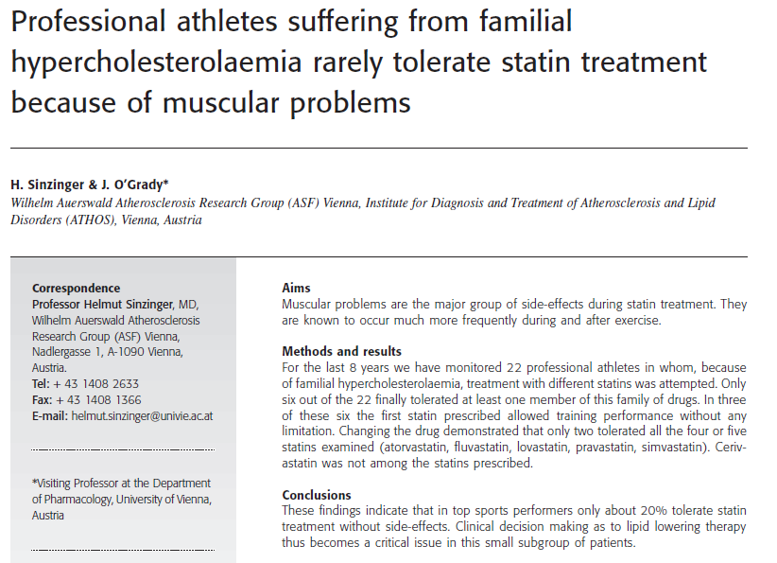
✓ Our findings demonstrate that the great majority of professional athletes with severe FH do not tolerate any of the statins available.
Notes:
Methods
Patients were considered as professional athletes when they had attended an Austrian championship at any age
class during the last 2 years or were playing in the top two leagues of their respective discipline (for characteristics
of athletes see Table 1). They all were suffering from FH as diagnosed at the receptor level. No other
drugs including vitamins were taken for at least 4 weeks. Testing for anabolic steroids was done in all
athletes to exclude any possible influence. According to a recommendation of the Austrian Cholesterol Consensus
[9] the starting dose of the respective statin was always the lowest available dose. Logic for switching
patients who tolerated a statin was that they did not achieve target values. The shortest duration of treatment
before switching was 8 weeks

Slide 75
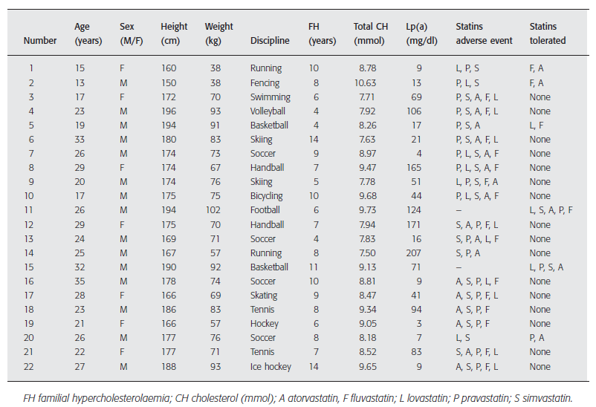
Sinzinger 2004
Notes:
The case report that incidental vitamin E administration improved statin-induced muscle pains [12] led to
the discovery that many of these patients show increased lipid peroxidation while normally statin therapy causes
a decrease [13]. It has been described that in patients with muscle problems on all the statins a withdrawal of
the drug results in cessation in muscular symptoms [14] as also seen in the athletes.
Sinzinger H, Chehne F, Lupattelli G. Oxidation injury in patients receiving HMG-CoA reductase inhibitors. Drug Safety 2002; 25:
877–83.

Slide 76
Oxidation injury in patients receiving HMG-CoA reductase inhibitors: occurrence in patients without enzyme elevation or myopathy.
Sinzinger H, Chehne F, Lupattelli G. Drug Saf.2002;25(12):877-83. Vienna
The aim of this study was to investigate whether patients with heterozygous FH who did not exhibit any symptoms or abnormalities in safety parameters during 6 months of treatment with various statins (atorvastatin, fluvastatin, lovastatin, pravastatin, simvastatin) did exhibit a change in oxidation injury as assessed by the isoprostane levels. Methods: Blood (plasma and serum) as well as urine was tested before and 1, 3 and 6 months after starting statin therapy.
Results: Out of 111 treated patients (63 males, 48 females; aged 19 to 58 years) who did not experience any adverse effects during statin treatment, 11 (seven males, four females; aged 24 to 51 years) showed a pronounced increase in 8-epi-prostaglandin (PG) F(2alpha) in all the compartments examined. In the remaining 100 patients (56 males, 44 females; aged 19 to 58 years) there was either no change in or even an apparent decrease in 8-epi-PGF(2alpha). This increase was monitored with all the statins administered. If elevated, the increase in 8-epi-PGF(2alpha) remained without change throughout the entire follow-up period. No sex difference or differential response between smokers and nonsmokers was observed.
Discussion: These findings indicate that in the absence of other clinically observable adverse effects, in some of the patients, for an as yet unknown reason, statin therapy may be associated with increased oxidation injury. The fact that changing to another statin is apparently not necessarily associated with an identical response raises the question of a specific predisposition for certain compounds in a given patient. These data add a further piece of evidence that mild adverse effects of statins that are difficult to assess might be much more prevalent than widely considered. The clinical relevance and consequence of these findings still remains to be assessed.
Notes:
Wilhelm Auerswald Atherosclerosis Research Group (ASF), Vienna, Austria. helmut.sinzinger@akh-wien.ac.at
Abstract
BACKGROUND:
Myopathy in its severe forms including rhabdomyolysis is a very rare adverse effect occurring during monotherapy with the HMG-CoA reductase inhibitors ('statins') and is associated with pronounced signs of oxidation injury. This has been found at a local (muscle) as well as at a systemic level (blood). Several lines of evidence indicate that even mild forms of myopathy during statin treatment may be associated with in vivo oxidation injury. In contrast, statin therapy has been shown to be associated with a decrease in oxidation injury.

Slide 77
Mild to Moderate Muscular Symptoms with High-Dosage Statin Therapy in Hyperlipidemic Patients —The PRIMO Study
Eric Bruckert, et.al. CV Drugs and Therapy. 2005, Volume 19, Issue 6, pp 403-414
Methods: The Prédiction du Risque Musculaire en Observationnel (Prediction of Muscular Risk in Observational conditions, PRIMO) survey was an observational study of muscular symptoms in an unselected population of 7924 hyperlipidemic patients receiving high-dosage statin therapy in a usual care, outpatient setting in France. Information on patient demographics, treatment history and muscular symptoms was obtained by question-naires.
Results: Multivariate analysis revealed the strongest predictors for muscular symptoms to be a personal history of muscle pain during lipid-lowering therapy (odds ratio, OR, 10.12, P < 0.0001), unexplained cramps (OR 4.14; P < 0.0001) and a history of creatine kinase (CK) elevation (OR 2.04; P < 0.0001). Overall, muscular symptoms were reported by 832 patients (10.5%), with a median time of onset of 1 month following initiation of statin therapy. Muscular pain prevented even moderate exertion during everyday activities in 315 patients (38%), while 31 (4%) were confined to bed or unable to work. Fluvastatin XL was associated with the lowest rate of muscular symptoms (5.1%) among individual statins.
Conclusion: PRIMO demonstrated that mild to moderate muscular symptoms with high-dosage statin therapy may be more common and exert a greater impact on everyday lives than previously thought. Knowledge of the risk factors for muscular symptoms will allow identification and improved management of high-risk patients. The risk of muscular symptoms with fluvastatin XL treatment may be lower than with high dosages of other statins.
Notes:
Objectives: To characterize the risk factors, rate of occurrence, onset, nature and impact of mild to moderate muscular symptoms with high-dosage HMG-CoA reductase inhibitor (statin) therapy in general practice.
Methods
Study design
PRIMO was a countrywide observational survey of the
risk factors and management of muscular side effects
in patients receiving high-dosage statin treatment in
general practice in France. In total, 7924 hyperlipidemic
patients aged 18–75 years who were seen in regular
outpatient visits with their general practitioners
(GPs) were entered in the study. The number of GPs
selected (2752) was based on an estimated 15% of patients
receiving high-dosage statin therapy and an a
priori hypothesis of four consultations per year. GPs
were asked to include the first three consecutive patients
who satisfied the survey inclusion criteria during
a period of up to 2 months following initiation of
the study. Patients were included if they had been
prescribed high-dosage statin treatment (fluvastatin
80 mg; atorvastatin 40 or 80 mg; pravastatin 40 mg; or
simvastatin 40 or 80 mg) for at least 3 months prior to
the study. Patients were also included if their regimen
had been adjusted (statin withdrawal or dose reduction)
within the last 3 months due to muscular pain.
This was done to avoid sample bias that would otherwise
be introduced by excluding patients who had
reported muscular pain with statin therapy but were
no longer receiving high-dosage treatment at the time
of survey. The majority of patients in PRIMO receiving
fluvastatin treatment were taking the extendedrelease
formulation (fluvastatin XL), hence we refer to
fluvastatin XL throughout the manuscript.
Patients were excluded if theywere receiving statin
treatment as part of a clinical trial, or if they were included
in any study during the observation period of
the PRIMO survey. This study complies with the Declaration
of Helsinki of the World Medical Association.
All patients gave informed consent and the study was
conducted in accordance with the French Data Protection
Authority (Commission Nationale Informatique et
Libert´e [CNIL]).
The PRIMO survey was designed by an independent
scientific committee consisting of three members.
Data collection
Information on demographic data, lifestyle, personal
and family medical history and current cardiovascular
and concomitant treatment status was obtained by
questionnaire completed by the GP in the presence of
the patient. If muscular symptoms were reported, a
second questionnaire was also completed in the presence
of the patient providing information on the type,
location, duration, possible causes and management
of the symptoms. The choice of items included in the
questionnaires were guided by previous clinical trials
and post-marketing surveillance data, and by the results
of a smaller-scale, pilot study [22].
In addition, fat mass was measured in all patients
using a BF306 body fat monitor (OMRON Healthcare
Europe B.V., Netherlands).

Slide 78
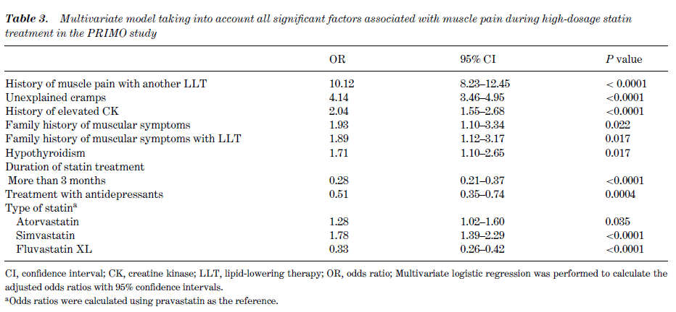
Bruckert 2005

Slide 79
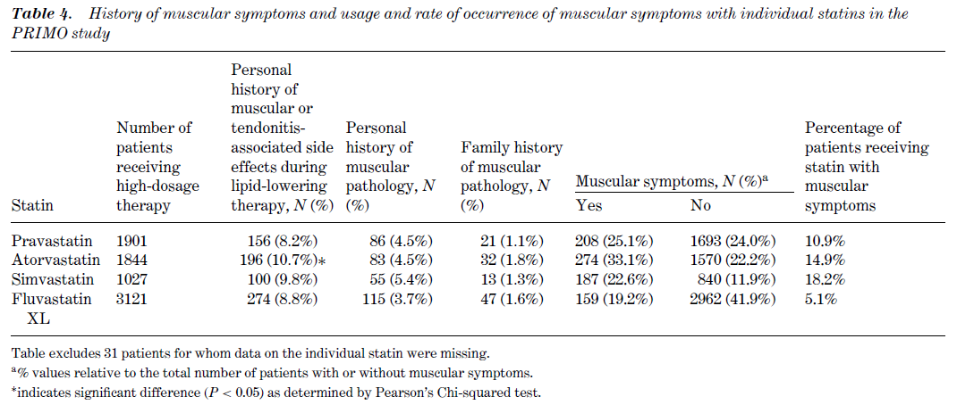
Bruckert 2005

Slide 80
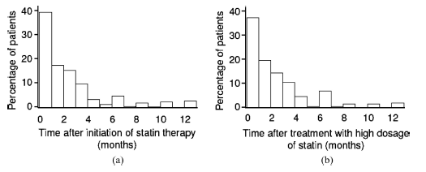
Distribution of the time of onset of muscular symptoms following (a) initiation of statin therapy; or (b) titration to high-dosage statin therapy. The median time of onset was 1 month following both initiation of statin therapy, and titration to a high dosage of statin
Bruckert 2005
Notes:
Discussion
The PRIMO study provides the first large-scale, comprehensive
investigation into the risk, causes, nature
and management of mild to moderate muscular symptoms
in patients receiving high-dosage statin therapy
in clinical practice. Several strong predictors of muscular
symptoms associated with statin therapy were
revealed, the absence or presence of which can be ascertained
in the course of a brief interview in the physician’s
office (as implicit in the methodology of this observational
study). Identification of strong predictive
factors for statin-associated muscular symptoms will
improve management of high-risk patients, enhancing
compliance and allowing optimum dosing at a time
when more aggressive management of LDL-C is advocated [23]. The rate of occurrence of muscular symptoms
in patients receiving high-dosage statin therapy
(10.5%) was considerably higher than the 1–5% reported
in clinical trials [24], and symptoms were found
to have a greater impact on everyday life than previously
thought.
The risk factor analysis in PRIMO was consistent
with the results of a preliminary study [22], confirming
that a personal or family history of muscular symptoms,
cramps, hypothyroidism and elevated CK levels
are major risk factors for muscular symptoms during
high-dosage statin therapy. Interestingly, althoughonly a small number of patients were able to report
on parents or siblings experiencing muscle pain under
LLT, the presence of such a family history almost doubled
the risk of the adverse reaction under multivariate
analysis. These results probably grossly underestimate
family history as a risk factor, since relatively
few patients have family members being treated with
LLT and even many of those who do will be unaware
of the fact. Thus, a genetic predisposition may be key
in determining whether a patient will develop muscle
pain while receiving statin therapy, a possibility that
deserves further investigation.
In the Australian Adverse Drug Reactions Bulletin,
the Adverse Drug Reactions Advisory Committee
(ADRAC) reported a list of factors associated with
an enhanced risk of suffering muscle problems in patients
receiving simvastatin and atorvastatin [25]; the
conclusions were that high doses of statins should be
used with caution in the elderly (over 70 years of age),
and in patients with renal or hepatic deficiency, hypothyroidism
or diabetes. The questionnaires in the
PRIMO study did not specifically address diabetes
or liver function, but we failed to detect any impact
of impaired kidney function (although renal function
data were not available for 13.8% of patients). We
also observed no age-dependent differences, and it
seems unlikely that the oldest patients are at higher
risk, because the incidence of muscular symptoms
in this subgroup (17.8% [1411] of patients in the
PRIMO study population were over 70 years of age)
was no different to that observed in the population as a
whole.
Age, gender and BMI were not identified as risk factors
by univariate analysis, although both lower body
fat mass and regular physical activity were associated
with a greater incidence of muscle pain. Symptomatic
patients were generally more active than the
population as a whole; this may be because active patients
are more likely to sustain the type of low-level
injury that is exacerbated by statins [26]. High alcohol
consumption is described as a cause of the potentially
fatal adverse event, rhabdomyolysis [27], but in
this population light to moderate consumption was not
associated with any increase in the incidence of muscular
symptoms. The observation that smokers were
less likely to experience muscle pain is secondary to
the fact that they were less physically active and explains
why this risk factor disappears in multivariate
analysis.
Although CK levels were not measured in the
present study, a history of elevated levels of this
marker emerged as a significant risk factor for muscular
symptoms. This finding suggests that sub-clinical
myopathy may predispose to statin-induced symptoms.
However, it remains difficult to advocate the systematic
assay of CK activity in every candidate for
LLT.
The reduced risk of muscular symptoms in patients
receiving antidepressants may be due to the recognized
decrease in physical activity in these patients,
although this should have been precluded in the multivariate
analysiswhich adjusted for physical activity, or
the non-specific analgesic effect of the antidepressants.
The lower prevalence of LLT-related muscular symptoms
in patients treated for more than 3 months is explained
by the fact that the majority of cases of LLT
myotoxicity are clinically apparent within the first 3
months.
In the PRIMO study population, 10.5% of patients
on high-dosage statin therapy complained of muscle
pain, a figure which is considerably higher than that
reported previously for clinical trials [24]. This result
is, however, consistent with a preliminary study [22],
and we believe it provides a more accurate reflection
of statin tolerability in general practice (at least for
high-dosage statin therapy) than clinical trial data. The
methodology used in PRIMO precludes various skewing
factors introduced by the rigorous patient selection
procedures of controlled studies (e.g. excluding groups
such as elderly and diabetic patients, those with renal
or hepatic impairment or patients with a history
of muscular symptoms or CK elevations). Moreover,
unless patients are specifically asked, mild symptoms
such as pain after exercise may not necessarily be reported
andmay not be recorded in clinical trial adverse
event reports.
Marked differences

Slide 81
Coenzyme Q10 reverses mitochondrial dysfunction in atorvastatin-treated mice and increases exercise endurance. Muraki A Miyashita K, et.al. J Appl Physiol. 2012 Aug;113(3):479-86 Keio University, Tokyo, Japan.
Statins inhibit 3-hydroxy-3-methylglutaryl-coenzyme A (HMG-CoA) reductase and thus decrease biosynthesis of low-density lipoprotein cholesterol and may also reduce ubiquinones, essential coenzymes of a mitochondrial electron transport chain, which contain isoprenoid residues, synthesized through an HMG-CoA reductase-dependent pathway. Therefore, we hypothesized that statin treatment might influence physical performance through muscular mitochondrial
dysfunction due to ubiquinone deficiency. The effect of two statins, atorvastatin and pravastatin, on ubiquinone content, mitochondrial function, and physical performance was examined by using statin-treated mice. Changes in energy metabolism in association with statin treatment were studied by using cultured myocytes. We found that atorvastatin-treated mice developed muscular mitochondrial dysfunction due to ubiquinone deficiency and a decrease in exercise endurance without affecting muscle mass and strength. Meanwhile, pravastatin at ten times higher dose of atorvastatin had no such effects. In cultured myocytes, atorvastatin-related decrease in mitochondrial activity led to a decrease in oxygen utilization and an increase in lactate production. Conversely, coenzyme Q(10) treatment in atorvastatin-treated mice reversed atorvastatin-related mitochondrial dysfunction and a decrease in oxygen utilization, and thus improved exercise endurance. Atorvastatin decreased exercise endurance in mice through mitochondrial dysfunction due to ubiquinone deficiency.
Ubiquinone supplementation with coenzyme Q(10) could reverse atorvastatin-related mitochondrial dysfunction and decrease in exercise tolerance.

Slide 82
Atorvastatin treatment reduces exercise capacities in rats: involvement of mitochondrial impairments and oxidative stress
Jamal Bouitbir et.al. JAP 2011; 111 no. 5 1477-1483 Université de Strasbourg, france
Our objective was to characterize mitochondrial function and reactive oxygen species (ROS) production in skeletal muscle after exhaustive exercise in atorvastatin-treated rats. The animals were divided into four groups: resting control (CONT; n = 8) and exercise rats (CONT+EXE; n = 8) as well as resting (ATO; n = 10) and exercise (ATO+EXE; n = 8) rats that were treated with atorvastatin (10 mg·kg⁻¹·day⁻¹ for 2 wk:). RESULTS Exhaustive exercise showed that the distance that was covered by treated animals was reduced (P < 0.05). Using dihydroethidium staining, we showed that the ROS level was increased by 60% in the plantaris muscle of ATO compared with CONT rats and was highly increased in ATO+EXE (226%) compared with that in CONT+EXE rats. The maximal mitochondrial respiration (V_{max}) was decreased in ATO rats compared with that in CONT rats (P < 0.01). In CONT+EXE rats, V_{max} significantly increased compared with those in CONT rats (P < 0.05). V_{max} was significantly lower in ATO+EXE rats (−39%) compared with that in CONT+EXE rats (P < 0.001). The distance that was covered by rats significantly correlated with V_{max} (r = 0.62, P < 0.01). The glycogen content was decreased in ATO, CONT+EXE, and ATO+EXE rats compared with that in CONT rats (P < 0.05). GLUT-4 mRNA expression was higher after exhaustive exercise in CONT+EXE rats compared with the other groups (P < 0.05).
Our results show that exhaustive exercise exacerbated metabolic perturbations and ROS production in skeletal muscle, which may reduce the exercise capacity and promote the muscular symptoms in sedentary atorvastatin-treated animals.
Notes:
Physical exercise exacerbates the cytotoxic effects of statins in skeletal muscle. Mitochondrial impairments may play an important role in the development of muscular symptoms following statin treatment.

Slide 83
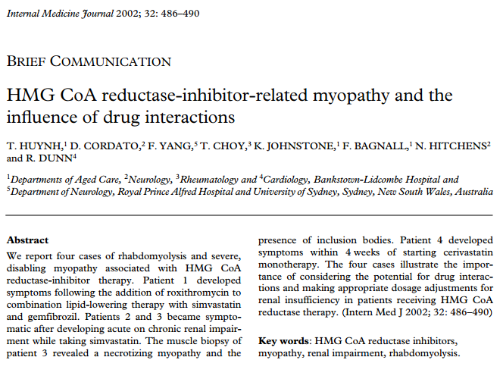
Notes:
In conclusion, we report two unique findings:
(i) HMG CoA reductase-inhibitor-related myopathy associated with roxithromycin therapy and
(ii) the presence of ‘inclusion bodies’ in the muscle biopsy of a patient presenting with inclusion-body
myositis manifesting as acute rhabdomyolysis and severe muscle weakness in the context of a patient
taking a HMG CoA reductase-inhibitor therapy. Our four cases highlight the potential of hepatic
drug interactions and the need to make appropriate dosage adjustments for renal insufficiency in
patients receiving HMG CoA reductase-inhibitor therapy

Slide 84
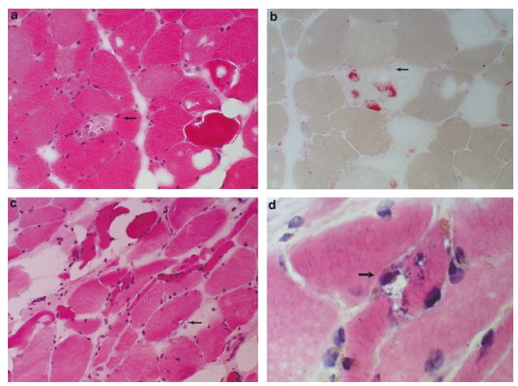
Huynh 2002
Figure 1 Parts (a) and (b) from the muscle biopsy of patient 2 show scattered necrotic muscle fibres (see arrows) and a positive acid-phosphatase reaction in macrophages consistent with a necrotizing myopathy. Parts (c) and (d) from the muscle biopsy of patient 3 show a group of fibres containing inclusion bodies and a typical rimmed vacuole. The pathological features of necrotic fibres and inclusion bodies characteristic of a necrotizing myopathy and inclusion body myositis were seen in the muscle biopsies of patient 3
Notes:
Case 2
A 70-year-old woman presented with a 4-day history of severe generalized weakness on a background of
type II diabetes mellitus, complicated by chronic renal failure, ischaemic heart disease and gout. Her
medications on admission were aspirin, frusemide, captopril, diltiazem, allopurinol and insulin. Simvastatin 20 mg/day had also been commenced 3 months
previously. She had a urinary-tract infection and was clinically dehydrated. Neurological findings revealed
grade 3/5 proximal upper- and lower-limb weakness, generalized areflexia and a distal sensory loss. Her
urine was dark in colour, consistent with myoglobinuria. Serum creatinine and CK levels on admission
were 453 mmol/L and 3100 U/L, respectively. Simvastatin was withdrawn. Nerve conduction study
findings were consistent with a generalized sensorimotor peripheral neuropathy. Needle electromyography showed spontaneous muscle activity, including
increased insertional activity, fibrillation potentials and positive sharp waves. A muscle biopsy of the left
quadriceps revealed a necrotizing myopathy (Fig. 1) and the presence of an isolated rimmed vacuole.
Serum CK peaked at 5050 U/L and returned to normal within 4 weeks. The patient slowly improved
but still required a walking frame for mobilization at discharge 6 weeks post-admission. Motor function
was normal at f…
Case 3
An 83-year-old woman presented with a 2-day history of difficulty walking. She had a background of
ischaemic heart disease, chronic renal failure, hypertension, peptic-ulcer disease and gout. Nicorandil
and candesartan had been withdrawn 2 weeks previously due to acute chronic renal impairment (serum
creatinine rise from 230 to 332 mmol/L). A serum
CK performed 2 weeks previously was 70 U/L. Medications on admission were pantoprazole, allopurinol,
clopidogrel, metoprolol and frusemide. She had also been taking simvastatin 40 mg/day for 5 years. She
demonstrated grade 4/5 upper limb and 3/5 lowerlimb proximal-muscle weakness. Urine was positive
for myoglobin. Simvastatin was ceased. Initial CK was 3200 U/L and peaked at 11 300 U/L 6 days later.
Electromyography showed small, brief duration and polyphasic motor units consistent with a myopathy. A
muscle biopsy revealed muscle necrosis and four of 20 muscle fibres seen in the biopsy specimen contained
rimmed vacuoles under light microscopy (Fig. 1).
Electron microscopy confirmed the presence of tubulo-filamentous inclusion bodies (Fig. 2). Oral
prednisolone 30 mg/day was commenced. She was
able to mobilize short distances with a frame 14 days
after admission, at which time her CK had normalized
and her serum creatinine improved to 235 mmol/L.
Corticosteriod therapy was withdrawn on discharge. However, proximal muscle weakness
persisted and she was still unable to weight-bear
without assistance on last review, 6 months postdischarge.

Slide 85
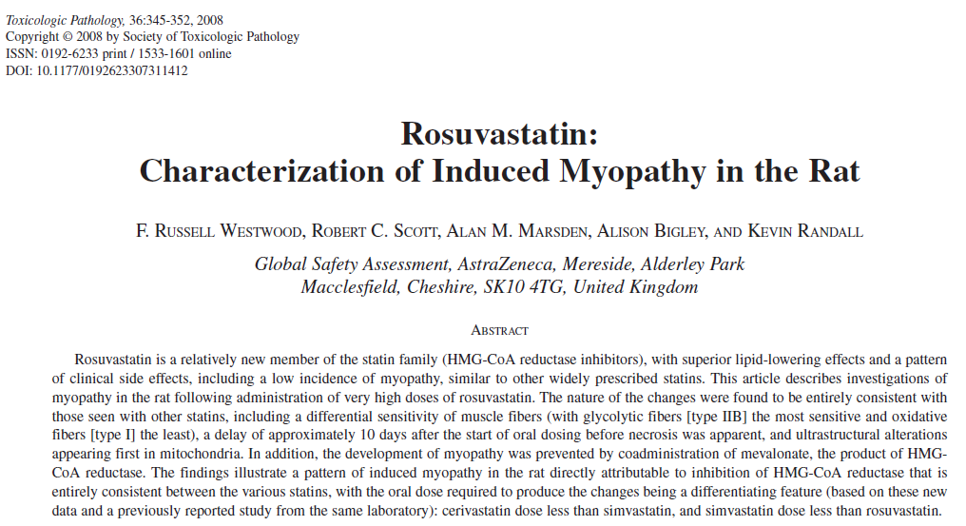

Slide 86
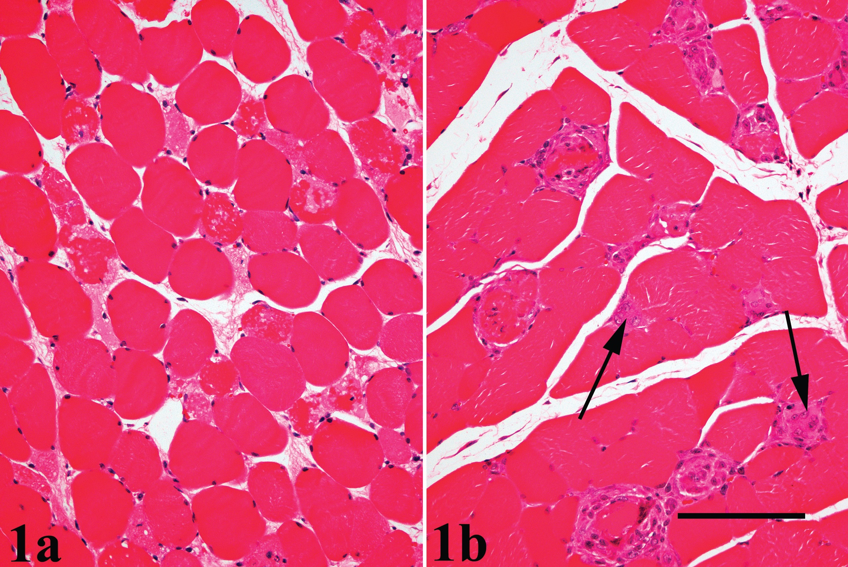
Notes:
Early necrosis in longissimus lumborum muscle at day 12 (animal 43, time-course study). Individual necrotic fibers
are eosinophilic with the sarcoplasm showing loss of structure and vacuolation. There is no notable inflammatory cell infiltration.
(B) Later necrosis in longissimus lumborum muscle at day 16 (animal 40, time-course study). There is mononuclear cell infiltration
associated with necrotic fibers and some regeneration characterized by sarcoplasmic basophilia and presence of multiple nuclei
(arrows). Bar = 50μm.

Slide 87

Enlarged degenerate mitochondria
Notes:
Early ultrastructural changes in type II muscle fiber from rosuvastatin-dosed rat (animal 42—biceps femoris).
Accumulations of enlarged degenerate mitochondria are present in subsarcolemmal areas. These are characterized by the presence
of aberrant myelinoid whorls and spheroids. Other components of the sarcoplasm show no abnormalities. Bar = 1μm.

Slide 88

Notes:
3.—Dual histochemical labeling for fast and slow myosin on formalin-fixed tissue: type II fibers—red/pink; type
I fibers—black (animal 43, biceps femoris, time-course study). There is widespread necrosis of type II fibers (thin arrows) with
sparing of type I fibers (thick arrows). Bar = 100μm.

Slide 89

Westwood 2008
Notes:
4.—Myosin ATPase histochemistry following preincubation at pH 9.4 and 4.15 on biceps femoris muscle from rosuvastatin-
dosed rat (animal 33, time-course study). The staining characteristics of early degenerative/necrotic fibers (arrows) are most
consistent with type IID or IIB. Other fiber types are spared. Bar = 50μm

Slide 90
Statin induced Myopathy Hypotheses
(1) preferential uptake of statins in skeletal muscle
cells by monocarboxylate transporters (Sirvent, Bordenave,
et al., 2005),
(2) decreased membrane cholesterol resulting in
alterations in fluidity with destabilization and degeneration
(Pierce et al., 1990; Waclawik et al., 1993),
(3) reduced chloride channel conductance (Baker, 2004), and
(4) alterations in mitochondrial function leading to cytoplasmic Ca2+ overload (Sirvent, Mercier, et al., 2005).

Slide 91
A number of hypotheses have focused on nonsterol products of mevalonate (Johnson et al., 2005), particularly the isoprenoids, with a resulting effect on products, including
(1) reduced coenzyme Q/ubiquinone, a powerful antioxidant and membrane stabilizer that is used in mitochondria for electron transport (Krum and McMurray, 2002; De Pinieux et al., 1996; Carvalho et al., 2004; Bliznakov, 2002; Rosenson, 2004);
(2) reduced enzymatic isopentylation of selenocysteine-tRNA, with prevention of its maturation to a functional tRNA molecule resulting in a fall in available selenoproteins
(3) inhibition of the prenylation/geranylgeranylation of proteins by reductions in farnesyl and geranylgeraniol pyrophosphates (Thompson et al., 2003; Johnson et al., 2004; Carvalho et al., 2004; Baker, 2004; Flint et al., 1997a, 1997b); and (4) perturbation of N-linked glycosylation of proteins (Baker, 2004).

Slide 92
These observations confirm previous findings that
fast-twitch muscles are primarily affected in statin myopathy and that even in muscles showing a substantial necrosis of Type II fibers, type I fibers are spared
(Smith et al., 1991; Reijneveld et al., 1996; Waclawik et al., 1993; Westwood et al., 2005)
Westwood 2008
Notes:
Taken together with the previously noted observations that muscles showing the most severe necrosis following administration of rosuvastatin contained a
substantial proportion of type IIB fibers, that muscles devoid of type IIB fibers were relatively or totally spared, and that the
soleus muscle, which has no type IIB or IID fibers, was totally spared, we again find (as with simvastatin and cerivastatin) a continuum
of fiber sensitivity to statins that mirrors their oxidative/glycolytic metabolic properties: least sensitive ↔ I ↔ IIA ↔
IID ↔ IIB ↔ most sensitive.

Slide 93
In conclusion,
our findings illustrate a pattern of induced myopathy in the rat directly attributable to inhibition of HMG-CoA reductase that is entirely consistent between the various statins, with a differentiating feature’s being the oral dose required to produce the changes: cerivastatin dose less than simvastatin, and simvastatin dose less than rosuvastatin.
Westwood 2008

Slide 94
Characteristics of Muscle Fiber Types
Fiber Type Type I Type II a Type II x Type II b
Contraction time Slow Moderately Fast Fast Very fast
Size of mot.neu Small Medium Large Very large
Fatigue resist. High Fairly high Intermediate Low
Activity Used for Aerobic Long-tm anaerobic Short-tm anaerobic Short-term anaerobic
Max dur of use Hours <30 minutes <5 minutes <1 minute
Force production Low Medium High Very high
Mitochl density High High Medium Low
Capillary density High Intermediate Low Low
Oxidative cap. High High Intermediate Low
Glycolytic cap. Low High High High
Major storage fuel TG CP/Glycogen CP/Glycogen CP/Glycogen
Notes:
Skeletal muscles contain two main types of fibers, which differ in the mechanism they use to produce ATP; the amount of each type of fiber varies from muscle to muscle and from person to person.
Red ("slow-twitch") fibers have more mitochondria, store oxygen in myoglobin, rely on aerobic metabolism, have a greater capillary to volume ratio and are associated with endurance; these produce ATP more slowly. Marathon runners tend to have more red fibers, generally through a combination of genetics and training.
White ("fast-twitch") fibers have fewer mitochondria, are capable of more powerful (but shorter) contractions, metabolize ATP more quickly, have a lower capillary to volume ratio, and are more likely to accumulate lactic acid. Weightlifters and sprinters tend to have more white fibers.
Fast fibers come in three varieties, called type IIa, IIx and IIb. Type IIx fibers in people used to be called, confusingly, type IIB. Type IIb fibers predominate in the fast muscle of small mammals that have to accelerate their limbs very fast against little load. Human type IIx (aka IIB) are our fastest fibers. Type IIa fibers are the slowest of all of them, and have only 36 units of myosin.
SOURCE: http://images.google.com/imgres?imgurl=http://upload.wikimedia.org/wikipedia/commons/thumb/3/33/Muscle_pathways.svg/400px-Muscle_pathways.svg.png&imgrefurl=http://www.territorioscuola.com/wiki/en.wikipedia.php%3Ftitle%3DSkeletal_muscle&h=198&w=400&sz=29&hl=en&start=15&tbnid=hLESpXzpbRuG5M:&tbnh=61&tbnw=124&prev=

Slide 95
Characteristics of Muscle Fiber Types
Fiber Type Type I Type II a Type II x Type II b
Contraction time Slow Moderately Fast Fast Very fast
Size of mot.neu Small Medium Large Very large
Fatigue resist. High Fairly high Intermediate Low
Activity Used for Aerobic Long-tm anaerobic Short-tm anaerobic Short-term anaer.
Max dur of use Hours <30 minutes <5 minutes <1 minute
Force production Low Medium High Very high
Mitochl density High High Medium Low
Capillary density High Intermediate Low Low
Oxidative cap. High High Intermediate Low
Glycolytic cap. Low High High High
Major storage fuel TG CP/Glycogen CP/Glycogen CP/Glycogen
Notes:
Skeletal muscles contain two main types of fibers, which differ in the mechanism they use to produce ATP; the amount of each type of fiber varies from muscle to muscle and from person to person.
Red ("slow-twitch") fibers have more mitochondria, store oxygen in myoglobin, rely on aerobic metabolism, have a greater capillary to volume ratio and are associated with endurance; these produce ATP more slowly. Marathon runners tend to have more red fibers, generally through a combination of genetics and training.
White ("fast-twitch") fibers have fewer mitochondria, are capable of more powerful (but shorter) contractions, metabolize ATP more quickly, have a lower capillary to volume ratio, and are more likely to accumulate lactic acid. Weightlifters and sprinters tend to have more white fibers.
Fast fibers come in three varieties, called type IIa, IIx and IIb. Type IIx fibers in people used to be called, confusingly, type IIB. Type IIb fibers predominate in the fast muscle of small mammals that have to accelerate their limbs very fast against little load. Human type IIx (aka IIB) are our fastest fibers. Type IIa fibers are the slowest of all of them, and have only 36 units of myosin.
SOURCE: http://images.google.com/imgres?imgurl=http://upload.wikimedia.org/wikipedia/commons/thumb/3/33/Muscle_pathways.svg/400px-Muscle_pathways.svg.png&imgrefurl=http://www.territorioscuola.com/wiki/en.wikipedia.php%3Ftitle%3DSkeletal_muscle&h=198&w=400&sz=29&hl=en&start=15&tbnid=hLESpXzpbRuG5M:&tbnh=61&tbnw=124&prev=

Slide 96


Slide 97

Type I muscle fibers apparently store more triacylglycerol (2–3-fold) than type II fibers (Essen 1977; Howald et al. 1985; Gaster et al. 2003).
In a recent study, endurance-trained subjects exercised for 120 min at 60% VO2max, and muscle triacylglycerol was primarily recruited from type I muscle fibers and to a minor degree from type II muscle fibers (Van Loon et al. 2003).
Notes:
Depletion of TG was not diVerent between fiber types in untrained, but tended to be higher (p = 0.07) in
type I compared with type II Wbres in trained muscles. In conclusion, HSL activity is similar in untrained and
trained skeletal muscles both before and after prolonged exercise (Helge et.al.)

Slide 98

Notes:
FIBER:Figure (A) H and E, (B) NADH, and (C) ATPase (pH 9.4) histochemical stains of a biopsy taken from the vastus lateralis of a six-month-old female with CFTD caused by a heterozygous TPM3 mutation. The type 1 fibers [dark staining on (B) NADH; light staining on (C) ATPase] are smaller than the type 2 fibers [inversely stained]. Type 1 and type 2 fibers are similar in size in healthy individuals. Bar equals 100 μm.
Type 1 fibers that are at least 12% smaller than the mean diameter of type 2A and/or type 2B fibers in the absence of other significant pathologic findings (e.g., many nemaline bodies, cores, or central nuclei; see Figure 1). In cases with type 2 fiber hypertrophy, type 1 fibers may have a normal diameter for age.
Additional findings that may also be present:
Type 1 fiber numerical predominance (Figure 1), not to be confused with fiber-type grouping
Decreased presence of 2B/2X fibers
One type of type 2 fibers (2A or 2B/2X) possibly larger than the other(s)

Slide 99


Slide 100

Notes:
The sarcolemma is the cell membrane of a muscle cell (skeletal, cardiac, and smooth muscle).^{[1]} It consists of a true cell membrane, called the plasma membrane, and an outer coat made up of a thin layer of polysaccharide material that contains numerous thin collagen fibrils. At each end of the muscle fiber, this surface layer of the sarcolemma fuses with a tendon fiber, and the tendon fibers in turn collect into bundles to form the muscle tendons that then insert into bones. The membrane is configured to receive and conduct stimuli.
Alterations in the sarcolemma membrane stability and repair system can lead to muscular dystrophy. The mechanism of one type of muscular dystrophy, for example, is lack of functional dystrophin. This means that the sarcolemma is not attached to the cytoskeleton. Therefore during muscle contraction, the sarcolemma is not synchronized with the interior of the cell. The looseness of the sarcolemma permits membrane calcium channels to open. The rise in internal calcium ions causes activation of the proteolytic enzyme calpain, which digests proteins including contractile proteins, rendering the muscle much weaker.

Slide 101
Factors That Increase the Risk of
Statin-Induced Myopathy
Patient Characteristics
Statin Properties
Increasing age
High systemic exposure
Female sex
High bioavailability
Renal insufficiency
Limited protein binding
Hepatic dysfunction
Potential for drug-drug interactions metabolized by CYP pathways (particularly CYP450 3A4)
Hypothyroidism
Diet (ie, grapefruit juice)
Polypharmacy
What’s missing ?
Reprinted with permission from Rosenson. Am J Med. 2004;116:408-416.
Notes:
The ACC/AHA/NHLBI consensus statement—as well as numerous other sources—have identified certain patient and pharmaceutical factors that have been shown to increase the propensity of patients on statin therapy to develop myopathy.
Several modifiable and nonmodifiable factors may increase the risk of myopathy with statin therapy. Patients on statins who are older (especially those who are ≥65 years), who have hypothyroidism or renal insufficiency, or who are taking drugs that can potentially interact with the statin, such as those metabolized by CYP pathways (particularly the CYP450 3A4 pathway), have an elevated risk of myopathy¹⁻³
Because concomitant treatment with fibrates may increase the risk of statin-related myopathy, the benefit of further improvements in lipid levels using these agents in combination should be carefully weighed against the potential risks associated with these combinations. However, the use of moderate statin doses with fibrates appears to have a relatively low incidence of myopathy
If a patient experiences diffuse myalgia, muscle tenderness, or weakness, CK concentrations should be measured. Statins should be discontinued in patients with symptoms and CK levels more than 10 × ULN. Patients who have symptoms without CK elevations or with moderate CK elevations should be monitored

Slide 102
Excessive eccentric muscular exercise
 Challenges integrity of sarcolemmal membrane increasing the exposure of myofilaments to statin

Slide 103
 Physical activity histories should be taken when patients complain of statin-related myalgia and other myopathies. Muscle and functional VAS index (modified Borg scale) at baseline and f/u.
Pre statin CK’s can range from 40 - 5,000U/L +

Slide 104
Low serum 25 (OH) vitamin D levels (<32 ng/mL) are
associated with reversible myositis-myalgia in
statin-treated patients
W Ahmed, N Khan, CJ Glueck, S Pandey, P Wang, N Goldenberg, M Uppal, S Khanal
Transl Res 2009 1;153(1):11-6

Slide 105
Low serum 25 (OH) vitamin D levels
(<32 ng/mL) are associated with reversible myositis-myalgia in statin-treated patients
Objective
To determine whether low serum 25 (OH) vitamin D (D2 + D3) (<32 ng/mL) was associated with myalgia in statin-treated patients and whether the myalgia could be reversed by vitamin D supplementation while continuing statins
Ahmed 2009
Ahmed, W. et al., Transl Res 2009;153:11-6.

Slide 106
Low serum 25 (OH) vitamin D levels
(<32 ng/mL) are associated with reversible myositis-myalgia in statin-treated patients
Methods
After excluding subjects who took corticosteroids or supplemental vitamin D, serum 25 (OH) D was measured in 621 statin-treated patients, which consisted of 128 patients with myalgia at entry and 493 asymptomatic patients
Ahmed 2009
Ahmed, W. et al., Transl Res 2009;153:11-6.

Slide 107
38 statin-taking patients with entry myositis-myalgia and low serum vitamin D (<32 ng/mL) who were given vitamin D supplementation therapy (50,000 units/week) for 3 months
At follow-up | n | Entry serum vitamin D (ng/mL) | Follow-up serum vitamin D (ng/mL) | P (paired Wilcox on)
Asymptomatic | 35 | 20.4 ± 7.3 | 48.1 ± 17.1 | <0.0001
Myalgia | 3 | 20.0 ± 8.2 | 49.0 ± 30.4
All | 38 | 20.4 ± 7.3 | 48.2 ± 17.9 | <0.0001
Ahmed 2009
Ahmed, W. et al., Transl Res 2009;153:11-6.

Slide 108
Low serum 25 (OH) vitamin D levels
(<32 ng/mL) are associated with reversible myositis-myalgia in statin-treated patients
Results
The 128 myalgic patients had lower mean ± standard deviation (SD) serum vitamin D than the 493 asymptomatic patients
(28.6 ± 13.2 vs 34.2 ± 13.8 ng/mL,
P < 0.0001), but they did not differ (p > 0.05) by age, BMI, type 2 diabetes, or creatine kinase levels
Ahmed 2009
Ahmed, W. et al., Transl Res 2009;153:11-6.

Slide 109
Low serum 25 (OH) vitamin D levels
(<32 ng/mL) are associated with reversible myositis-myalgia in statin-treated patients
Results
By analysis of variance, which was adjusted for race, sex, and age, the least square mean (± standard error [SE]) serum
vitamin D was lower in the 128 patients with myalgia than in the 493 asymptomatic patients (28.7 ± 1.2 vs 34.3 ± 0.6 ng/mL,
P < 0.0001)
Ahmed 2009
Ahmed, W. et al., Transl Res 2009;153:11-6.

Slide 110
Low serum 25 (OH) vitamin D levels
(<32 ng/mL) are associated with reversible myositis-myalgia in statin-treated patients
Results
Serum 25 (OH) D was low in 82 of 128 (64%) patients with myalgia versus 214 of 493 (43%) asymptomatic patients (χ² = 17.4,
P < 0.0001)
Ahmed 2009
Ahmed, W. et al., Transl Res 2009;153:11-6.

Slide 111
Low serum 25 (OH) vitamin D levels
(<32 ng/mL) are associated with reversible myositis-myalgia in statin-treated patients
Results
Of the 82 vitamin-D–deficient, myalgic patients, while continuing statins, 38 were given vitamin D (50,000 units/week for 12 weeks), with a resultant increase in serum vitamin D from 20.4 ± 7.3 to 48.2 ± 17.9 ng/mL (P < 0.0001) and resolution of myalgia in 35 (92%)
Ahmed 2009
Ahmed, W. et al., Transl Res 2009;153:11-6.

Slide 112
Low serum 25 (OH) vitamin D levels
(<32 ng/mL) are associated with reversible myositis-myalgia in statin-treated patients
Conclusions
Speculate that symptomatic myalgia in statin-treated patients with concurrent vitamin D deficiency may reflect a reversible interaction between vitamin D deficiency and statins on skeletal muscle
Ahmed, W. et al., Transl Res 2009;153:11-6.

Slide 113
Clinical and Pharmacogenetic Predictors of Circulating Atorvastatin and Rosuvastatin Concentration in Routine Clinical DeGorter M et.al. Circ Cardiovasc Genet. published online July 22, 2013; Ontario CAN
Methods and Results - In total, 299 patients taking atorvastatin or rosuvastatin were
prospectively recruited at an outpatient referral center. The contribution of clinical variables and transporter gene polymorphisms to statin concentration was assessed using multiple linear regression. We observed 45-fold variation in statin concentration among patients taking the same dose . After adjustment for gender, age, body mass index, ethnicity, dose, and time from last dose, SLCO1B1 c.521T>C (p < 0.001) and ABCG2 c.421C>A (p < 0.01) rosuvastatin concentration (adjusted R2 = 0.56 for the final model). Atorvastatin concentration was associated with SLCO1B1-hydroxycholesterol, R2 = 0.47). A second cohort of 579 patients from primary and specialty care databases were retrospectively genotyped. In this cohort, genotypes among dosing groups, Nearly 50% of patients concentrations greater than the 90th percentile.
Conclusions - Interindividual variability in statin exposure in patients is associated with uptake and efflux transporter polymorphisms. An algorithm incorporating genomic and clinical variables to avoid high atorvastatin and rosuvastatin levels is described; further study will determine if this approach reduces incidence of statin-myopathy.
Taken together, genetic testing may be most useful when a patient is starting the highest dose of atorvastatin or rosuvastatin, bearing in mind that SLCO1B1 c.521 T>C variant carriers in particular are more likely to require higher doses as a result of reduced hepatic uptake.
Notes:
ON FILE
Strikingly wide variation among patients in plasma levels of atorvastatin and rosuvastatin (Crestor, AstraZeneca), even with consistent dosing, is likely related to gene variants that affect the drugs' uptake by the liver in some patients, suggests a prospective study^{[1]}. The researchers propose that selective screening of some statin candidates for the presence of the specific polymorphisms could help individualize atorvastatin and rosuvastatin dosing with the goal of lowering the risk of statin side effects, especially myopathy.
In the study of 399 patients taking either statin, senior author Dr Richard B Kim (University of Western Ontario, London) told heartwire ,"We were surprised at the extent of interpatient [plasma-level] variability at the same dose. Tremendous variation--45-fold. That is to say, there were some people with very low blood levels and an excellent response to statins, and people with unexpectedly high levels and a reasonable response to statins." It's the latter group that appears to be at increased risk, given that statins affect lipoproteins in the liver, but the side-effect risk goes up with plasma levels.
"We also were surprised by the role of age. It really did look like, in our patients older than aged 75 with the wrong genetic makeup, the higher doses were particularly bad in terms of risk."
The study was published online July 22, 2013 in Circulation: Cardiovascular Genetics with first author Dr Marianne K DeGorter (University of Western Ontario).
The group devised a potential management algorithm that includes genotyping and is aimed at avoiding adversely high statin plasma levels, acknowledging that whether it would prevent side effects has yet to be demonstrated. But Kim said it could add to efforts to avoid significant muscle enzyme elevations or actual rhabdomyolysis.
It really did look like, in our patients older than aged 75 with the wrong genetic makeup, the higher doses were particularly bad in terms of risk.
"It's really an additional decision support tool that incorporates clinical and pharmacogenetic variables that I think gives the prescribing physician a point of reference regarding when to switch [treatments], how to switch, and dose considerations, with a mechanistic point of view in terms of drug level," Kim said. The current study "does say that if you're thinking high-dose in an older person, the [algorithm] might be particularly useful.“
In the 165 patients taking rosuvastatin, nearly all the explainable variability in blood concentrations could be attributed to two reduced-function polymorphisms, one in the uptake transporter gene SLCO1B1(p<0.001) and the other in the efflux transporter gene ABCG2 (p<0.01), the group writes. In the 134 patients on atorvastatin, explainable blood-level variability was split between two polymorphisms in SLCO1B1 (p<0.01 and p<0.05, respectively) and the activity of cytochrome P3A (CYP3A). The analyses were adjusted for gender, age, body-mass index, ethnicity, statin dose, and time from last dose, and echo a 2008 study which concluded that two SLCO1B1 variants were associated with simvastatin-related myopathy, as reported by heartwire . The screening concept is currently being applied to simvastatin therapy at least at one major center.
The group retrospectively tested their ideas, looking at the relationships between genotypic and clinical variables and statin dose, in a validation cohort of 579 patients taking either drug in a primary care setting in the US and at a referral clinic in Canada.
The group found that the transporter genotypes that raise statin concentrations were homogeneously distributed among patients taking a range of atorvastatin and rosuvastatin dosages. That is, the prescribing physicians, armed primarily with their clinical judgment to decide dosage levels, failed to achieve optimal dosing with respect to serum drug levels. But it seemed to be only patients receiving the highest dosages who showed higher-than-safe serum levels according to genotype- and age-based criteria.
Advanced nonfunctional pancreatic NET case study: A 53-year-old woman with primary pancreatic mass and liver metastases
What is your treatment strategy following failure of cytotoxic therapy?
View case
Information from Industry
"Although we didn't quite get to the sample size we needed, it did seem like people with the wrong genetic makeup are more likely to stop a statin or switch to [another dyslipidemia drug]," Kim said, at least among patients on the highest statin dosages.
The group's proposed management algorithm recommends a maximum statin dosage that will result in plasma concentrations below the 90th percentile (reflecting an assumption that 10% of patients will have statin-related muscle issues) based on patient age and transporter-related genotype.
The algorithm is based on data predominantly from whites; the group cautions that some other ethnicities, "particularly Asians," have increased sensitivity to statins.

Slide 114
There is wide variation among patients in plasma levels of atorvastatin and rosuvastatin (Crestor, AstraZeneca), even with consistent dosing, is likely related to gene variants that affect the drugs' uptake by the liver in some patients.
✓ Interpatient [plasma-level] variability at the same dose can vary as much as 45-fold Tremendous variation-- 45-fold.
Nearly all the explainable variability in blood concentrations of rosuvastatin could be attributed to two reduced-function polymorphisms, one in the uptake transporter gene SLCO1B1(p<0.001) and the other in the efflux transporter gene ABCG2 (p<0.01),
DeGorter 2013

Slide 115

DeGorter 2013
Notes:
Discussion
This study investigated the relationship between common drug transporter polymorphisms
and
plasma concentrations of atorvastatin and rosuvastatin in a real world population. We found
a
marked, 45-fold interpatient variability in observed plasma level, especially at the higher doses.
In our clinical situation, where statin dose has been titrated to effect, statin transporter
polymorphisms are associated with a detectable change in statin level. Indeed, nearly 90% of the
explainable variability in rosuvastatin concentration can be accounted for by two reduced
function transporter polymorphisms, in the uptake transporter SLCO1B1 and the efflux
transporter ABCG2. In contrast, explainable variability in atorvastatin level is almost equally
divided between two polymorphisms in SLCO1B1, and the activity of CYP3A as measured by
􀀗􀈕-hydroxycholesterol concentration. Taking our findings together, we propose a dosing
algorithm for atorvastatin and rosuvastatin that, based on our data regarding the association
between transporter genotype, age, and statin concentration, would minimize risk for high
plasma statin exposure.

Slide 116

DeGorter 2013

